Slide 1
Webinar Wednesdays Series
Title: Effective Coalition Leadership
December 6, 2023
Presented by: Colber Prosper, M.S., National Coalition Institute Trainer

Slide 2

Introductions
Colber Prosper, M.S.
Presenter and
Webinar Facilitator
& NCA Trainer
National Coalition
Institute
Samantha Andrews
Training Manager
National Coalition Institute

Slide 3
Effective Coalition Leadership
Webinar
House Keeping
Don’t forget about the Q&A box – we’ll be holding the bulk of the questions until the end, so make sure to stay the whole way through!
When typing into the chat box, be sure to select “everyone” so all can see.
We are recording this webinar and the recording will be up on the Webinar Wednesday page in the next few days. Here is the link to where the recording will be posted. CADCA's Webinar Wednesdays Series | CADCA
I will be putting an evaluation link into the chat box as we’re wrapping up; you’ll be able to receive a letter of participation once you complete that evaluation. The letter is only available though for those who attend the webinar live.

Slide 4


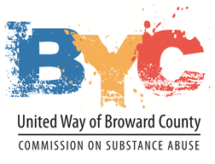
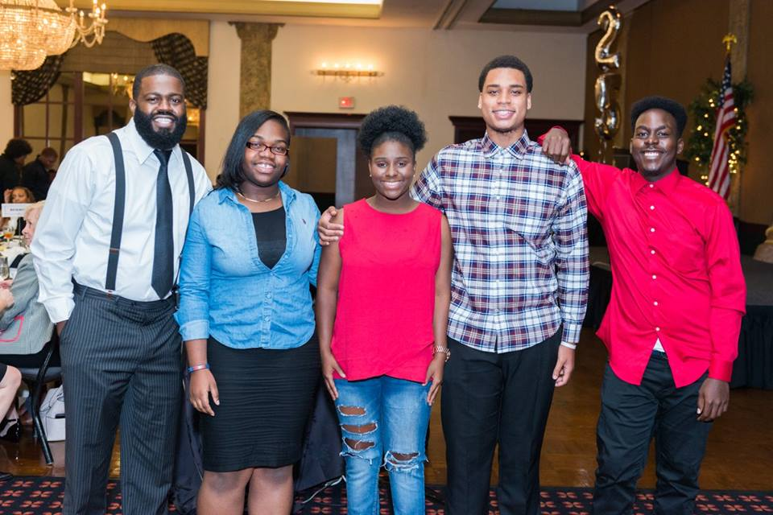


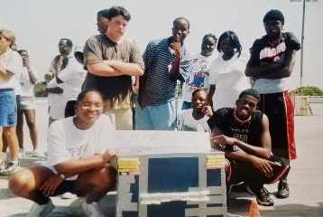
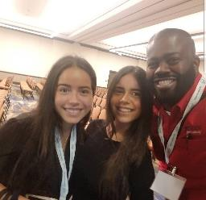
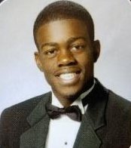


Slide 5
Today’s Objectives
Define leadership
Describe the transformational leadership model
Formulate action steps based on the 4 components of transformational leadership

Slide 6
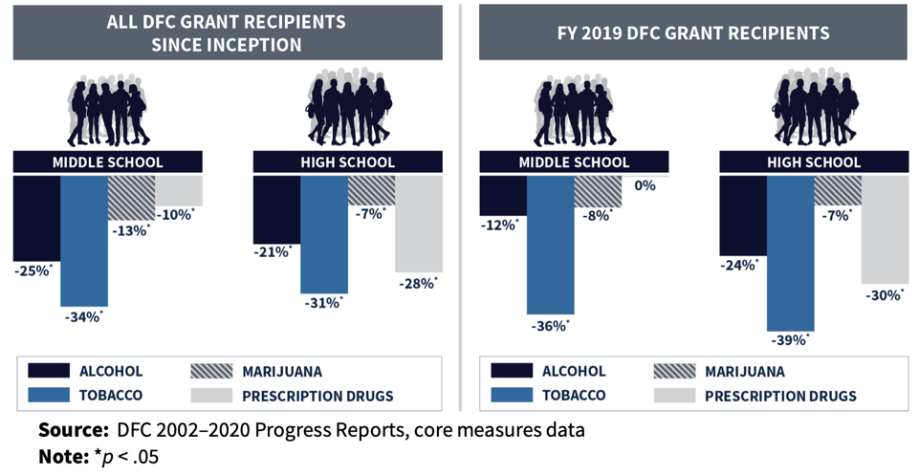
Prevention Works!
National Evaluation of the DFC Program

Slide 7




Slide 8

What is good leadership?

Slide 9
Transformational Leadership
According to [James MacGregor] Burns, leadership must be aligned with a collective purpose and effective leaders must be judged by their ability to make social change.
The concept of moral leadership is proposed as a means for leaders to take responsibility for their leadership and to aspire to satisfy the needs of the followers.
Burns position is that leaders are neither born nor made; instead, leaders evolve from a structure of motivation, values, and goals (Steward, 2006)

Slide 10
Transformational Leadership
Transformational leaderships refers to the leader moving the follower beyond immediate self-interest through idealized influence (charisma), inspiration, intellectual stimulation, or individual consideration. It elevates the follower’s level of maturity and ideals as well as concerns for achievement, self actualization, and the well-being of others, the organization, and society (Bass, 1999)

Slide 11
4 Components of Transformational Leadership
Idealized Influence – refers a leaders who act as solid role models for their followers due to their extraordinary capabilities and high doctrines of ethical conduct…The leaders deliver their followers with a clear vision and mission for their company and, in turn earn a high level of respect and trust from their followers
Inspirational Motivation – motivate followers so that they are able to perform beyond the expectation…thus making the achievement of organizational goals an attractive means of achieving personal goals

Slide 12
4 Components of Transformational Leadership
Intellectual Stimulation – leaders simulate their supporters’, efforts to be innovative and creative by questioning expectations, reframing difficulties, and imminent new idea…Followers are encourage to try new approaches, and their ideas are not criticized because they differ from the leader's ideas…
Individualized Consideration – gives special attention to each individual follower’s needs for achievement and growth by acting as a coach or mentor…show consideration for their followers’ needs and are prepared to encourage the development of appropriate workplace behavior (Reza, 2019)

Slide 13

Prevention Workforce

Slide 14
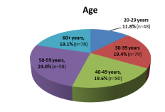
California Prevention Workforce Survey 2019
  Average age in the prevention field is 47
  63% are above 40 years of age
  20% are nearing or at retirement
  39.1% reported being in the prevention field for more than 10 years
  31.1% reported being in the field 3 years or less (nearly 1 in 3 are new)

Slide 15
Missouri Prevention Workforce Survey 2019
  Average age in the prevention field is mid-40s (median 42-47)
  Median age of STRC/PRC Staff: 36-41
  35% are 53 or older (nearing retirement age)
  31% reported being in the prevention field for more than 10 years
  43% of STRC/PRC staff have been in the field 3 years or less

Slide 16
Voluntarily Leaving
California Prevention Workforce Survey 2019
  37.6% will definitely/most likely voluntarily leave the prevention field in the next 3 years
  Of those 54.2% will be looking for a job in the prevention field
Missouri Prevention Workforce Survey 2019
  28.4% will likely voluntarily leave the prevention field in the next 3 years
  24 – 29 age group: 50% will likely voluntarily leave the prevention field in the next 3 years
  32% of 24 – 29 age group will be looking for a job in the prevention field

Slide 17
Missouri Prevention Workforce Survey 2019
  37.5% of Black prevention professionals are somewhat likely voluntarily leave the prevention field in the next 3 years while 6.3% are definitely going to leave. Of those, 37.5% will look for another job in prevention
  26.7% of White prevention professionals are very likely or somewhat likely to leave the prevention field in the next 3 years while 2.1% are definitely going to leave. Of those, 18.5% will look for another job in prevention

Slide 18

The Coalition

Slide 19
Why it is so Difficult to Form Effective Community Coalitions (Kadushin et al, 2005)
Robert Wood Johnson Foundation- Fighting Back Grant
15 communities were selected out of 330
  Later funded 7 more communities
Lack of regard to the complexities of the social structure of communities

Slide 20
Why it is so Difficult to Form Effective Community Coalitions cont.
Six structural obstacles
  Coalitions and their structures being poorly defined
  Actual definition of the “community” is poor and not specific
  Ethnic, race and class divisions
  Effects of past narratives
  Bringing everyone together
  Decision making process
Do you
agree with
these obstacles?

Slide 21


Slide 22
What Explains Community Coalition Effectiveness? A Review of the Literature (Zakocs and Edwards, 2006)
Literature review between 1980-2004
  Criteria
    Coalition sought to improve population-health outcomes
    Measured quantitatively or qualitatively
    Published in a peer-reviewed journal or gov document
Coalition effectiveness
  Coalition building (internal)
  Community changes (external)
Search in databases and 1,168 abstracts found

Slide 23
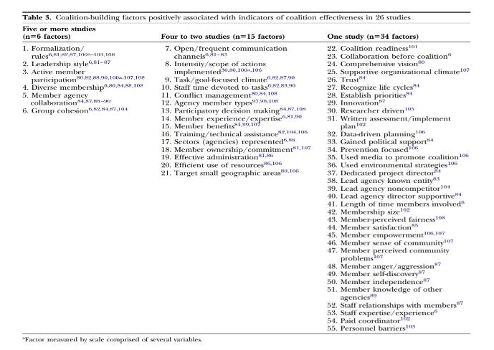
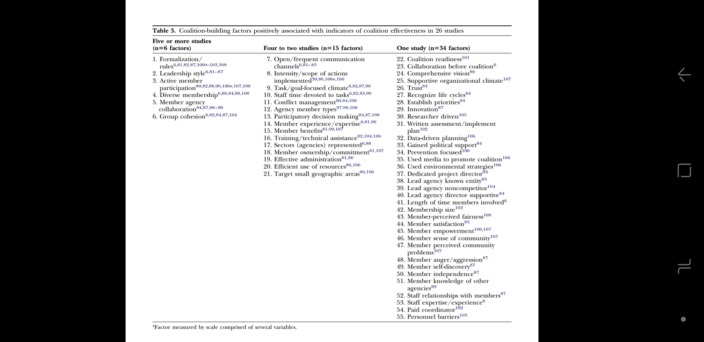
What Explains Community Coalition Effectiveness? A Review of the Literature (Zakocs and Edwards, 2006)

Slide 24
Transformational Leadership
Idealized Influence – refers a leaders who act as solid role models for their followers Can the transformational leadership model address some of your coalition’s challenges?
Inspirational Motivation – motivate followers so that they are able to perform beyond the expectation
Intellectual Stimulation – leaders simulate their supporters’, efforts to be innovative and creative
Individualized Consideration – gives special attention to each individual follower’s needs for achievement
Discussion Prompts:
Is leadership a factor to your coalition’s effectiveness?
Can the transformational leadership model address some of your coalition’s challenges?
How can the 4 components of transformational leadership be applied to your coalition or agency?

Slide 25


Closing Remarks

Slide 26


Questions / Comments?

Slide 27
Training and Webinar
Announcements

Slide 28

National Coalition Institute www.nationalcoalitioninstitute.org
Date | Type of Training/Webinar | Type of Training/Webinar | Duration
2023
December 11-14, 2023 |  | NCA Training - Cohort 2 | Week 1 of 3
December 11-14, 2023 |  | NCA Bootcamp Training – Cohort 3 | 1 Week/4 Full Days
December 12, 2023 |  | Research into Action Webinar – Title/Focus: Long-term behavioral effects of a school-based prevention program on illicit drug use among young adults | 90 Minutes
December 13, 2023 |  | Webinar Wednesday – SPANISH SESSION on Fentanyl CADCA En Espanol: Estrategias de prevention del uso del fentanilo desde un enfoque de Coalicion Comunitaria. The webinar will cover Fentanyl and communities’ strategies to address the crisis. | 90 Minutes
December 18-19, 2023 |  | Coalition Launch Training (Organization Development) Cohort 1 | 2 Full Days
2024
January 8-11, 2024 |  | NCA Training - Cohort 3 | Week 1 of 3
January 8-11, 2024 |  | Bootcamp - Cohort 4 | 1 Week/4 Full Days
January 16, 2024 |  | New Prevention Employee Webinar Title: YOU GOT THE JOB…. NOW WHAT!!! (Prevention Guide 101) | 90 Minutes
UPCOMING
Training and Webinar Opportunities
28

Slide 29
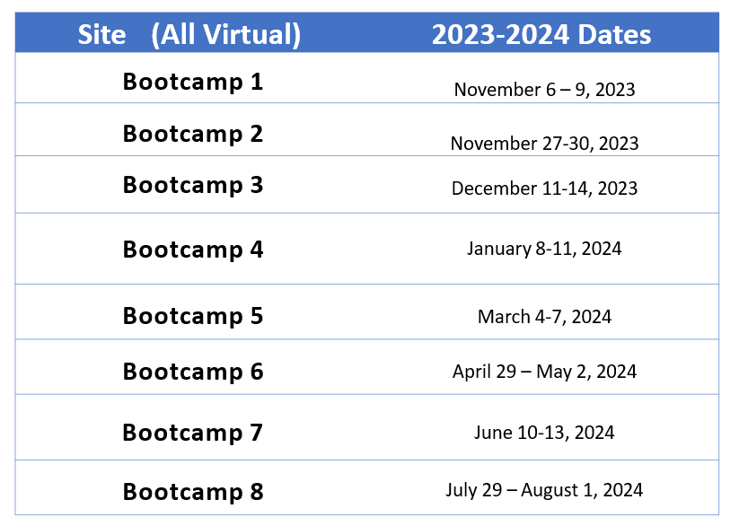
2023-2024
NCA
Bootcamp Training Schedule

Slide 30
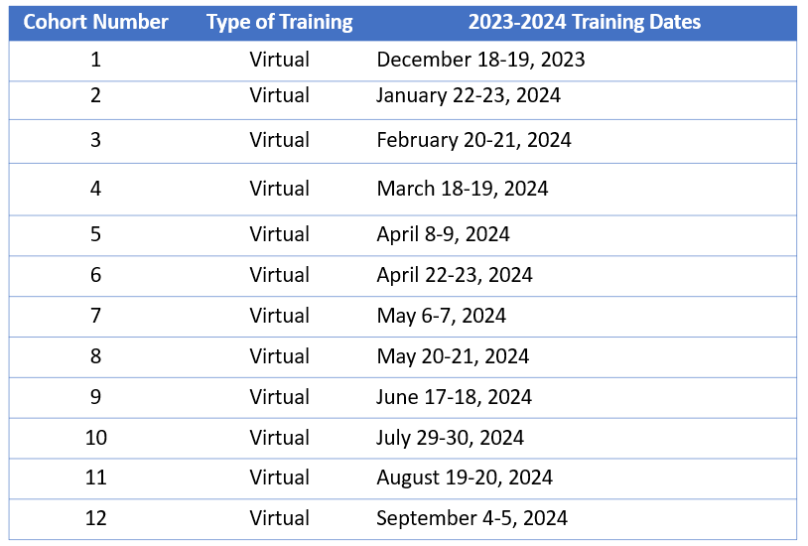
2023-2024
Coalition Launch Training
(Organization Development)
Schedule

Slide 31

Contact Us!
Email: training@cadca.org
Phone: 1-800-54-CADCA ext. 240
Online: nationalcoalitioninstitute.org/contact-us/
*New* National Coalition Institute (NCI) Website - www.NationalCoalitionInstitute.org
National Coalition Academy (NCA) Training Questions - NCA@cadca.org
Coalition Development Support or Services Questions – CDS@cadca.org

Slide 32

Stay Connected!
Community.cadca.org
CADCA
CADCACoalitions
CADCA
CADCA
CADCACoalitions
CADCAorg
®

Slide 33

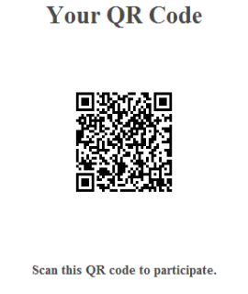
Please review this webinar
https://research.zarca.com/r/SiDZle

Slide 34
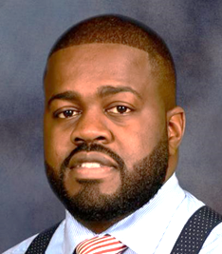
Thank You For Your Participation
Colber Prosper
Submit Questions or
Comments to:
training@cadca.org
Visit our website to register for
NCI Trainings and Webinars:
www.nationalcoalitioninstitute.org

