Slide 1


Exploring arts‑based interventions for youth substance use prevention: a scoping review of literature
October 31, 2023
Research into Action Webinar Series
cadca.org
Notes:
This is the latest installment of CADCA’s Research Into Action webinar series. Nicole Sanz, the host, is an Analyst on CADCA’s Evaluation and Research team. The purpose of this webinar series is to introduce coalition members and substance misuse preventionists to current and relevant research being conducted in the substance use and community coalition fields.

Slide 2


Today’s Presenter
Dr. Geoffrey Maina, R.N., Ph.D
Associate Professor
Prince Albert Campus of the College of Nursing
University of Saskatchewan, Saskatchewan Canada
Notes:
Dr. Geoffrey Maina, R.N., Ph.D, join us for a presentation on findings from his recent article, “Exploring arts‑based interventions for youth substance use prevention: a scoping review of literature” published in BMC Public Health
Dr. Maina is an Associate Professor at the Prince Albert Campus of the College of Nursing at the University of Saskatchewan, Saskatchewan Canada. His program of research focuses on interventions with an emphasis on HIV prevention and care, (i.e., on harm reduction, stigma reduction, and peer interventions, both locally and globally); improving outcomes for clients and families affected by addiction and promoting immigrant health. He uses diverse community-based research methodologies that employ qualitative research methods such as art-based methods, and methodologies that honor lived experiences such as patient-oriented research. He teaches perspectives of nursing in a global context, mental health and addiction nursing courses, and therapeutic interventions for individuals and groups in an undergraduate program and nursing research in the graduate program. He is also actively involved in supervising master’s and doctoral students in mental health and addiction thesis projects.

Slide 3



Exploring art-based interventions for youth substance use prevention: A scoping review of literature
Presenter: Dr. Geoffrey Maina, University of Saskatchewan, College of Nursing

Slide 4
Objectives of presentation
To describe the genesis and context of the work of the project
Describe the impact of COVID-19 and the opportunities to imagine new possibilities
Describe the process of the scoping review
Discuss the implications of the findings on policy and practice.

Slide 5
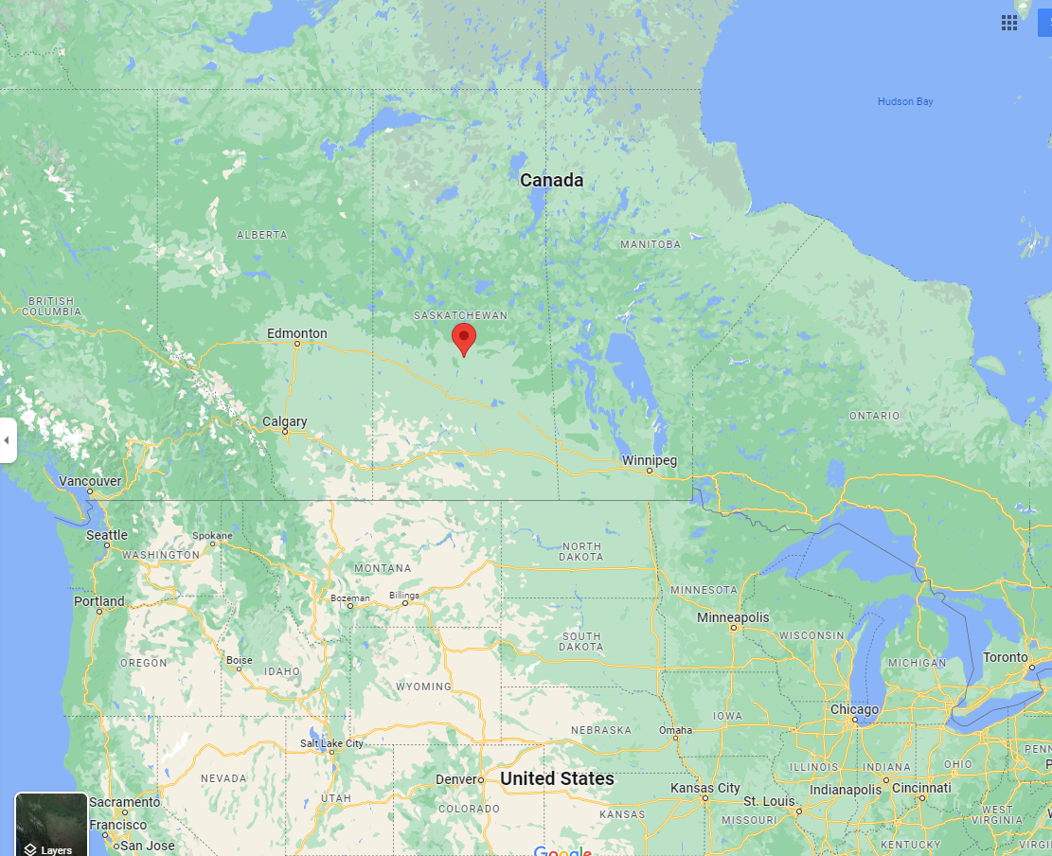
Where is prince Albert?

Slide 6
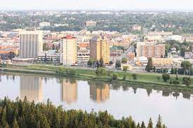
Significance of Prince Albert, Sk
Prince Albert is the 3rd largest city in the province of Saskatchewan
Has a population of approx. 35,000 people
40% self-identify as indigenous
Is called the Gateway to the North as there is no other city beyond it (surrounded by indigenous reserves, farmlands, and boreal forests)
Serve a catchment of about 100k or so
Notes:
The city is significant to the Northern Communities ( indigenous communities). It used to be the meeting place of many indigenous communities in the North before it was settled by Europeans.

Slide 7
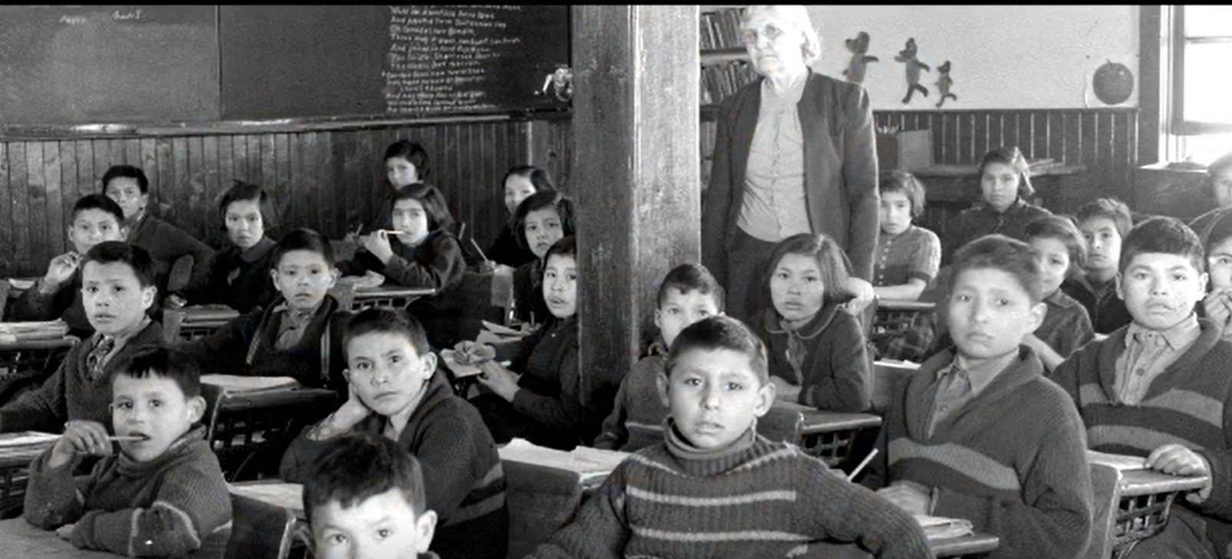
Indigenous people and legacies of colonization
Notes:
In 1876, the government of Canada passed the Indian Act which was meant to assimilate the indigenous people into the dominant culture
This legislation created the framework for the establishment of residential schools which led to a decrease in practices of Indigenous language and culture (Wilson, 2018).
Attendees to these residential schools were forcefully separated from their families and experienced diverse forms of violence, and the cultural disruption caused by attending residential schools hindered their reintegration into their communities (PJenn, 2021).
Led to acts that are now called cultural genocide
Dislocation of children from their families to be assimilated in residential school
Prohibition of practicing their culture and languages
The robbing of cultural identify
Graduates of residential schools struggled to assimilate in their home reserves

Slide 8
The legacies of colonization ( stats)
The main impacts of the legacies of colonization are addiction and MH issues (Maxwell, 2014).
25% suffer from addiction, compared to 17% of the general population.
Indigenous grade 9-12 (14-17 years old) youth have a higher prevalence of substance use compared to non-indigenous youth (Sikorski, Leatherdale, & Cooke, 2019).
Indigenous people are 13 times more likely to experience opiate overdose fatalities compared to nonindigenous people addicted to opiates in BC (First Nations Health Authority, 2017).
HIV infection among the indigenous people is more than x2 the national average and the main risk is IDU (Ministry of Health, 2018).

Slide 9

The local statistics
The alcohol use per capita is about 1.5 times the national average and almost double the provincial average
73.8% of youth consume alcohol compared to the 62.2% national average
Binge drinking is 20% higher than the national average (PA Alcohol Strategy Steering Committee, 2016)
9.2% of emergency room visits and 18.2% of hospital admissions are due to addiction-related ailments ( Maina, et al, 2018)
Between Jan. 2015 and 2016, 23 patients spent a combined 668 days in acute care and only a small percentage completed the treatment

Slide 10
The sad stats with the youth in the region
73.8% of grade 10-12 students consume alcohol, which is 11% more than the national average [1]. Binge drinking among school-aged children is estimated to be 67.9%, a full 20% higher than the national average [Prince Albert and Area Community Alcohol Strategy. (2016, Fenno, 2016.
Children are exposed to alcohol and drug use at an early age, ranging from six to 11 years for alcohol, marijuana, opiates, and cocaine [Maina, Crizzle, Maposa, & Fournier, 2019).
Missing school (76%), mental health (47%), alcohol (59%), and drugs (52%) are leading factors in cases brought to Community Mobilisation of Prince Albert (Nilson; 2014)
About 10% of individuals held in police cells due to intoxication were school-going children, and 37% of students missing 90-100% of their classes have a history of alcohol-related police involvement [1].
Notes:
The philosophy behind the project- if there is any hope to break the vicious cycle of addiction, it is working with the youth

Slide 11
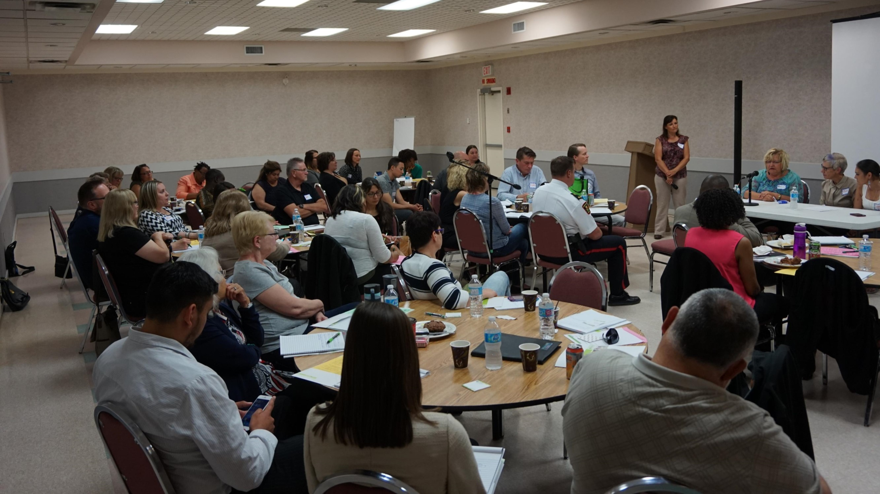
Knowledge translation event

Slide 12
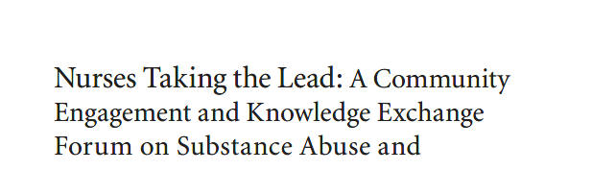
Findings

Slide 13
Giving youth a voice
Research project: Engaging and empowering the youth at risk of alcohol and drug use in Prince Albert: An art-based intervention
Methods:
  Photovoice is a qualitative participatory action research method based on health promotion principles that uses photography and critical group dialogue to help people identify priorities and inform practice [20].
  Students will be asked to take photos that convey risks and vulnerabilities to alcohol and drug use and those that communicate alternative lifestyles they hope for themselves
  Students were to be supplied with journals to record their thoughts as they took the photos
  Then, an exhibit was to be organized and community members were to be invited to witness

Slide 14
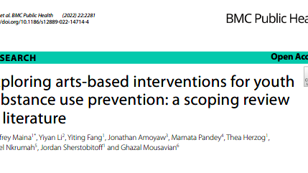
Then covid happened
Notes:
Sought permission to carry out a project with similar objectives as the risk of community-based research was too much for the participants during COVID season

Slide 15

Our plan B
Replace the original research with a scoping review
Broadened the scope to art-based method, to understand how art-based interventions were used in the youth-based substance use interventions
What do we consider as art- photography, poetical language, sculpture, painting, craft, music, dance, etc?
The end goal would be the same as the original research i.e. present to community stakeholders
Notes:
Art as a medium can be therapeutic to prevent and promote recovery and to empower affected individuals to voice their concerns

Slide 16
So what is a scoping review? ( Munn et al., 2018)
A type of review that is meant to determine the scope or coverage of the body of literature on a topic
They give indications of the volume of available literature and an overview of it.
Purpose
  to identify the types of available evidence in a given field
  to clarify key concepts/ definitions in the literature
  to examine how research is conducted on a certain topic or field
  to identify key characteristics or factors related to a concept
  as a precursor to a systematic review
  to identify and analyze knowledge gaps

Slide 17
steps in scoping review ( Arksey and O’Malley, 2005)
Step 1: identify a research question-
  What is known about art-based interventions aimed at preventing youth substance use
  What are the characteristics and study outcomes of these interventions
  What is the perceived effectiveness of these interventions
Step 2- identifying relevant studies-
  Key words used- art-based; youth, substance use, intervention, and prevention
  Databases searched- ERIC, MEDLINE, CINAHL, EMBASE, Web of Science, PschInfo
  Inclusion criteria- articles that used art methods to prevent substance use among youth, studies with a clearly defined intervention, studies that target youth 12-17 years old and written in English

Slide 18

steps in scoping review(2)
Step 3- article selection
Step 4- charting the data
Step 5- collating, summarizing and reporting the results

Slide 19
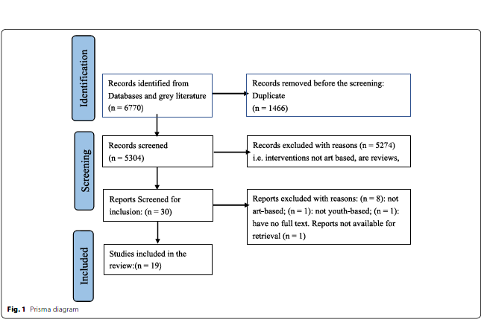
Prisma diagram

Slide 20
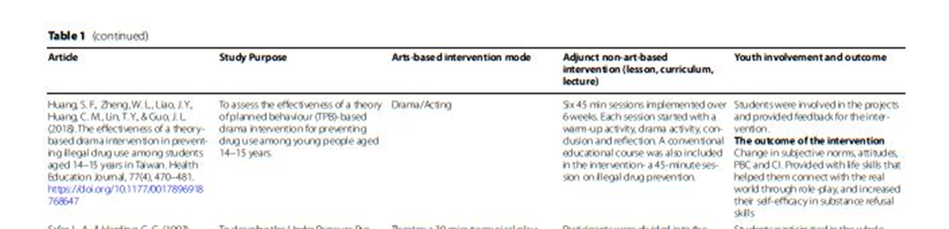
Pinch table

Slide 21
Theme 1- Intention of the intervention
Increase knowledge, and change attitudes and practices through
  life skills training, intra, and interpersonal skills
  Assertiveness- REAL- refuse, explain, avoid, and leave
Knowledge impartation-
  information on the immediate, and long-term impact of substance use
  Regulations surrounding substance use – drinking and driving
Increase efficacy to withstand the pressure to use substances
Foster cultural identity and awareness
Empower youth to be critical thinkers about the choices they make

Slide 22

Theme 2- Intervention types
Videos and live performances
Narrative accounts of resistance, lived experiences
Musical docudrama
Art group video ( performance)
Enacted scenarios by professional actors
Role plays promoting responsible drinking

Slide 23

Theme 3- perceived effectiveness
Aesthetic appeal
Ability to engage the youth
Relevance and relatability
Structure
Impacting skills, changing attitudes, youth empowerment
Active youth engagement – voice to be heard
Incorporating cultural elements

Slide 24

Discussion
Aim was to change perception, gain refusal skills, reduce potential harms of substance use
How:
  Behavioral change requiring knowledge, shifting attitudes, and formation of new behavioral patterns
  Knowledge of the substance and the skills to manage context and incorporate other risks for substance use- mental health, developmental stage
  Meaning-making and space to share their perspectives
Majority of the intervention included was media/Action oriented- visual- appealing to both cognition and affect.
Notes:
appealing to cognition, affect, and behavior- CBT and KAP

Slide 25

Discussion (2)
The delivery is to be done in a relaxing, fun, and helpful manner while paying attention to context, relevance, relatability, culture, experiences
Video- visual effectiveness as an instructional tool
Active engagement of youth- different modalities to capture youth attention ( relatability and relevance)
Manageable because the community is their main resource
Replicable because of attending to the content, context, and then strategy.

Slide 26

Lessons that can be learned
Any intervention focusing on youth substance use must:
Attend to the content and context
Be developmentally appropriate for the youth
Seen to be relevant and relatable
Have a tangible takeaway in real-life
Lead to youth empowerment
Create critical thinkers and problem solvers who can identify and manage risks

Slide 27

Conclusion
Art based intervention appeal to the thought, emotions and behavior to propel action
Must attend to setting and character of the community ( culture and prevalent substance)
They must be culturally sensitive
Relatability is important – featuring characters and settings like the target community
Active involvement fosters ownership of the process and the outcome
Interventions needs to be aesthetically and intellectually stimulating

Slide 28

Limitations
Did not assess the quality of the studies
Only articles published in English
The search strategy can never be fault proof

Slide 29

How can this work be used
Program implementation- select from the list of featured programs
Presenting the findings can spur conversations that can lead to an adaptation
  Like the original plan, the findings can be used to engage the community
Conducting systematic review to appraise the quality of the findings

Slide 30
References
Arksey, H., & O'Malley, L. (2005). Scoping studies: towards a methodological framework. International journal of social research methodology, 8(1), 19-32.
Fenno, J.G. (2016). “Prince Albert Youth Drug and Alcohol Use: A Comparison Study of Prince Albert, Saskatchewan, and Canada Youth.” Journal of Community Safety and Well-Being 1(3): 61–65. 3.
Maina, G., Crizzle, A., Maposa, S., & Fournier, B. (2019). Sociodemographic profiles and clinical outcomes for clients on methadone maintenance treatment in a Western Canadian clinic: implications for practice. Journal of Forensic Nursing, 15(4), 231-241.
Munn, Z., Peters, M. D., Stern, C., Tufanaru, C., McArthur, A., & Aromataris, E. (2018). Systematic review or scoping review? Guidance for authors when choosing between a systematic or scoping review approach. BMC Medical Research Methodology, 18, 1-7.
Nilson, C. (2014). Risk-driven collaborative intervention: A preliminary impact assessment of community mobilization Prince Albert Hub Model. https://cfbsjs.usask.ca/documents/research/research_papers/RiskDrivenCollaborativeIntervention.pdf
Prince Albert and Area Community Alcohol Strategy. (2016). Accessed at http://mobilizepa.ca/images/documents/pdfs/CommunityAlcoholStrategy20160412.pdf
First Nations Health Authority. (2017). Overdose Data and First Nations in BC. Preliminary Findings. Accessed at https://www.fnha.ca/AboutSite/NewsAndEventsSite/NewsSite/Documents/FNHA_OverdoseDataAndFirstNationsInBC_PreliminaryFindings_FinalWeb_July2017.pdf
Maxwell, K. (2014). Historicizing historical trauma theory: Troubling the trans-generational transmission paradigm. Transcultural Psychiatry, 51(3), 407-435.
Ministry of Health. (2018). HIV Prevention and Control Report, 2018. Population Health Branch. Accessed at https://skhiv.ca/wp-content/uploads/2020/01/GovSK-HIV-Prevention-Control-Report-2018.pdf
Sikorski, C., Leatherdale, S., & Cooke, M. (2019). Tobacco, alcohol and marijuana use among Indigenous youth attending off-reserve schools in Canada: cross-sectional results from the Canadian Student Tobacco, Alcohol and Drugs Survey. Maladies Chroniques et Blessures au Canada, 39.

Slide 31
Questions from CADCA
Who have you presented your findings to and who would you want to reach?
Are you and your colleagues working on a systematic review or do you have plans to continue the research you initially intended to do? If so, has your approach changed since this review?
How can coalitions and substance use preventionists in the field best use the findings from your research?
Notes:
Questions from CADCA:
Stage 6 of Arksey and O'Malley’s methodological framework for conducting a scoping study is “Consulting”. You mentioned you would present your findings to community partners and stakeholders. Who have you presented your findings to so far and who would you want to reach?
Now, post-covid, Are you and your colleagues working on a systematic review or do you have plans to continue the research you initially intended to do? If so, has your approach changed since this review?
You mentioned how your work can be used. Specifically, How can coalitions and substance use preventionists in the field best use the findings from your research? These are not only professionals in the public health field but also teachers, parents, students, and community leaders.

Slide 32
Mark Your Calendars for the next RIA!
Tuesday, December 12th at 12pm
“Long-term behavioral effects of a school-based prevention program on illicit drug use among young adults”
^{Dr. Kenneth Griffin}
Notes:
The next Research Into Action Webinar is scheduled for December 12th. Mark your calendars and watch your emails for the registration link mid-November.

Slide 33
Thank You!
CADCA wishes to thank Dr. Geoffrey Maina for his timely and insightful presentation.
For help with any evaluation or research related issue, or questions about this webinar, please send an email to evaluation@cadca.org

