Slide 1
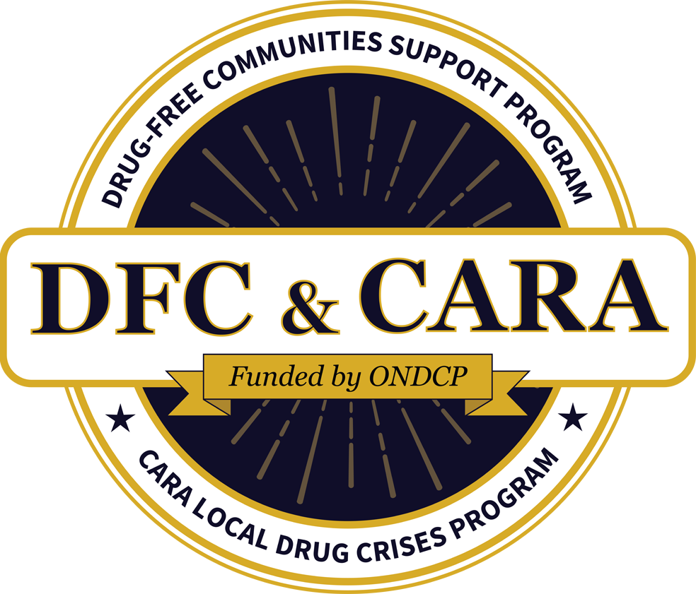
What Coalitions Need to Know about the Opioid Response Network
Sarah Canavese, MPH, MCHES
Catherine Brunson
This material is based upon work supported by the Office of National Drug Control Policy under Grant No. [G2399ONDCP08A]. Opinions and points of view expressed in this document are those of the authors and do not necessarily reflect the official position of, or a position endorsed is endorsed by, the Office of National Drug Control Policy
GLOBAL | COLLABORATIVE | INNOVATIVE | PASSIONATE | LEADER

Slide 2
Don’t forget about the Q&A box – we’ll be holding the bulk of the questions until the end, so make sure to stay the whole way through! When typing into the chat box, be sure to select “everyone” so all can see. We are recording this webinar and the recording will be up on the Webinar Wednesday page in the next few days. Here is the link to where the recording will be posted. CADCA's Webinar Wednesdays Series | CADCA I will be putting an evaluation link into the chat box as we’re wrapping up; you’ll be able to receive a letter of participation once you complete that evaluation. The letter is only available though for those who attend the webinar live.
Webinar House Keeping

Slide 3
Today’s Objective
We will show you how to facilitate a discussion with your coalition on priorities and challenges in combating opioid misuse, engaging sector partners in treatment and recovery, and identifying key beneficiaries of ORN training and TA. Participants will see how to pinpoint top priorities that foster focused action.
3

Slide 4
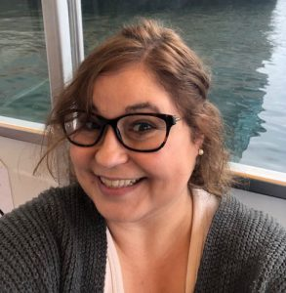
About our speaker
Sarah Canavese, MPH, MCHES, is a part of the Opioid Response Network team, which provides training and education in prevention, treatment, and recovery to organizations and communities addressing opioid and stimulant use. Sarah has her Bachelor’s in Journalism and a minor in Event Planning and her Master’s in Public Health, she has combined these skills over the last 10 years to engage and educate audiences around tobacco use, mental health, and opioid use

Slide 5
Opioid Response Network Overview
Sarah Canavese, MPH, MCHES
Technology Transfer Specialist

Slide 6
Notes:
Will you play the video?

Slide 7
Working with communities.
The SAMHSA-funded Opioid Response Network (ORN) assists states, organizations and individuals by providing the resources and technical assistance they need locally to address the opioid crisis and stimulant use.
Technical assistance is available to support the evidence-based prevention, treatment and recovery of opioid use disorders and stimulant use disorders.
Funding for this initiative was made possible (in part) by grant nos. 6H79TI080816 and 1H79TI083343 from SAMHSA. The views expressed in written conference materials or publications and by speakers and moderators do not necessarily reflect the official policies of the Department of Health and Human Services; nor does mention of trade names, commercial practices, or organizations imply endorsement by the U.S. Government.
Notes:
SAMHSA funds the opioid response network to help provide resources and technical assistance to address the opioid crisis and stimulant use.
Across the nation, each state or territory has a designated team to provide education and training in response to the opioid crisis on request.
The Technical Transfer Specialists’, or the TTS, manage these requests.
The Technology Transfer Specialists (TTS) roles and responsibilities include project management to coordinate and track TA requests. We manage the TA teams, schedule meetings, and maintain communication channels. We assist the TA teams in matching evidence based practices and implementation strategies to fulfill TA requests.
I will tell you a bit more about these teams and their roles and responsibilities of the project partners, consultants, and specialists as we go on.

Slide 8
Working with communities.
The Opioid Response Network (ORN) provides local, experienced consultants in prevention, treatment and recovery to communities and organizations to help address this opioid crisis and stimulant use.
Each state/territory has a designated team, led by a regional Technology Transfer Specialist (TTS), who is an expert in implementing evidence-based practices.
Notes:
We accept requests for education and training.
Each TTS, manages requests in their region.
We currently are split into 10 different Regions that are aligned with the Health Human Services (HHS) Regions.
So, each Region has at least one of me!

Slide 9
Working with communities.
The Opioid Response Network (ORN) has a goal of being culturally responsive to our requests.
To embody those practices we have steps in place to make sure we are engaging with the right people to provide technical assistance (TA) for the right audience.
We currently have 3 workgroups that focus on minority populations.
Black Communities Work Group
Alaska Native/ Indigenous Tribe Work Group
Sexuality and Gender Diversity Work Group
Notes:
Along with our 10 Regions we also have a team of TTS’ dedicated to tribal requests.
They make up the Indigenous Communities Response Team and they are split into 5 different regions.
Their priority is Tribal requests.
Those workgroups vet consultants to meet their stated standards to provide TA consulting services to those putting in the TA Request.
We want to make sure that the training and education is targeted and tailored to the audience we are engaging with.

Slide 10
Consultant Teams
Prevention
Recovery
Treatment
Implementation Science
Special Populations
Core Partners
Notes:
Each Region has a panel of consultants in Prevention, Treatment, and Recovery.
We use local consultants when possible who can provide tailored trainings based on their knowledge of the area.
We also have utilize Core Team partners and national specialists in as needed.

Slide 11
Partners
Notes:
The ORN is very lucky to have partners that we work with to help provide TA assistance.
We work with national partner’s across the USA.
Some of those partners are CADCA, C4 Innovations, Boston Medical Center, National Sheriffs Association, and the list goes on.
The TTS’s goal, MY goal, is to find the right fit for what the requesters needs are. And with these partners we are able to help in an in-depth way that will bring about change.

Slide 12
Overall Mission
To provide training and technical assistance via local experts to enhance prevention, treatment (especially medications like buprenorphine, naltrexone and methadone) and recovery efforts across the country addressing state and local - specific needs.
Notes:
So, to nut shell it, Our mission is to provide training and TA via local experts to enhance prevention, treatment (especially medications like buprenorphine, naltrexone and methadone) and recovery efforts across the country by addressing state and local specific needs.

Slide 13
Contact the Opioid Response Network
To ask questions or submit a request for technical assistance:
Visit www.OpioidResponseNetwork.org
Email orn@aaap.org
Call 401-270-5900

Slide 14
Technical Assistance
TA is education and training, and can include building collaborations across various systems to ultimately bridge the gap between research, policy, and evidence based practice.
Notes:
Now that you have all of this information what does it all mean?
Our focus at ORN is Technical Assistance.
Fancy language for training and education.

Slide 15
TA Requests can address a variety of things: Training, Education, Program Implementation, Coalition Building If you need targeted opioid or stimulant use disorder assistance, we have someone on our team who can help!
Notes:
We can help educate your local coalition on how to have conversations around stigma and provide language to help better explain treatment.
We can help provide training with a CADCA bootcamp to help build strong coalitions.
We can provide strategic planning sessions to help review current policies and procedures.
The list goes on!
There are a couple of things that we don’t do:
give you money. write a grant for you. create anything for you.

Slide 16
Requests
The Opioid Response Network (ORN) works on a request basis.
You can go to our website to submit a request: www.opioidresponsenetwork.org
At the top right corner there is a big orange button that says: SUBMIT A REQUEST
Notes:
We are a request based program, and to make a request it is pretty easy.

Slide 17
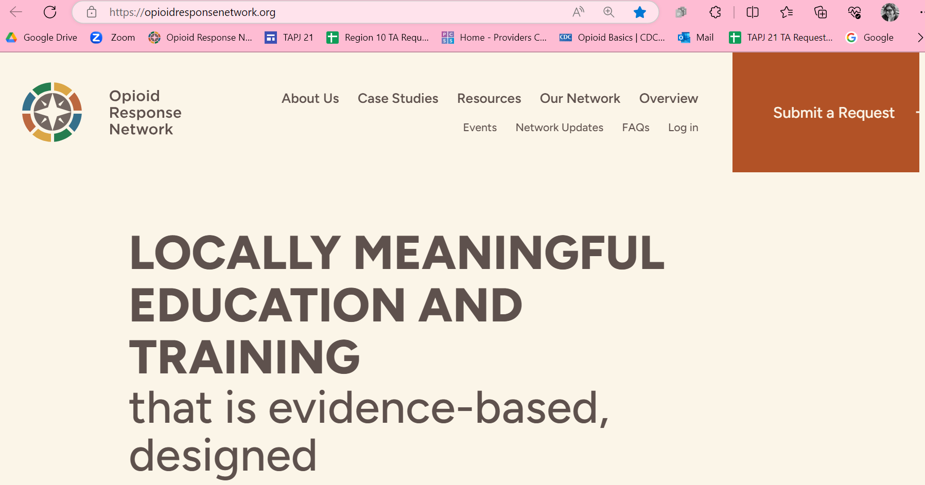
Requests
Notes:
Seriously, you can’t miss it! ☺

Slide 18
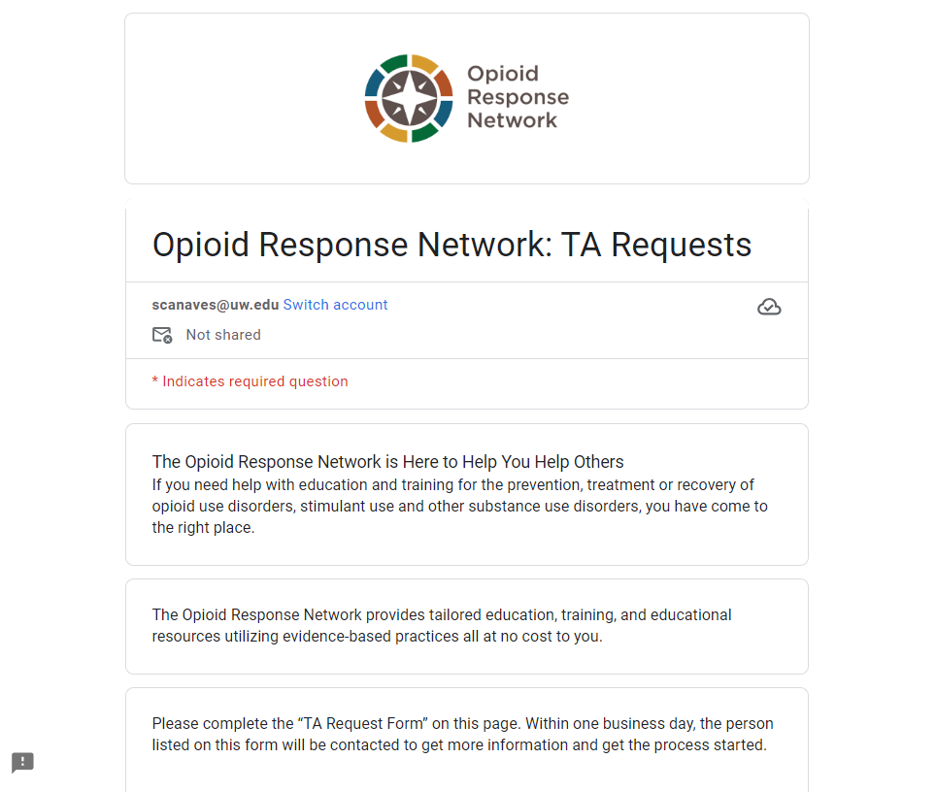
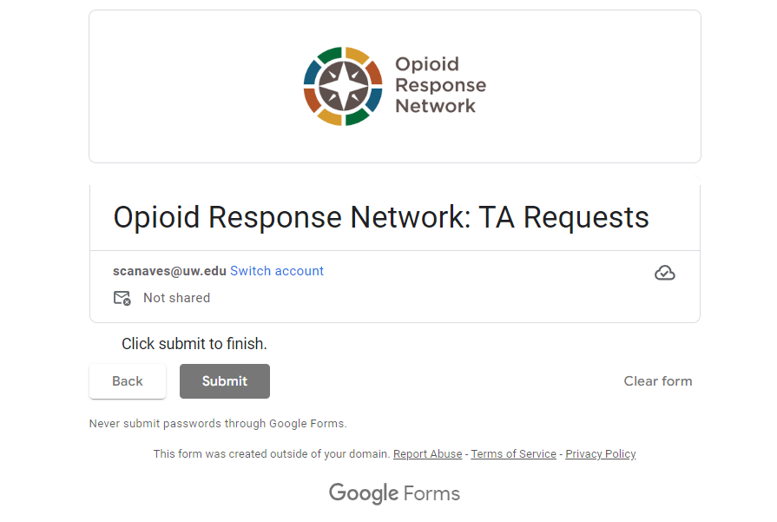
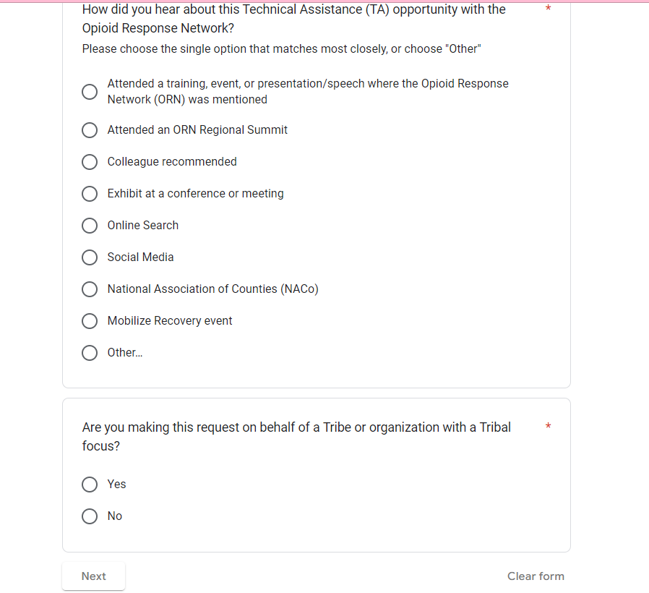
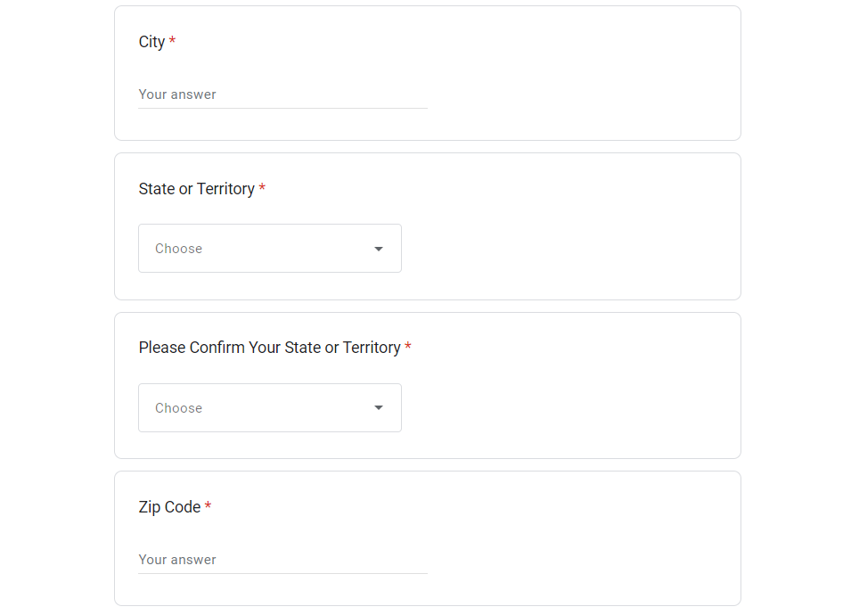
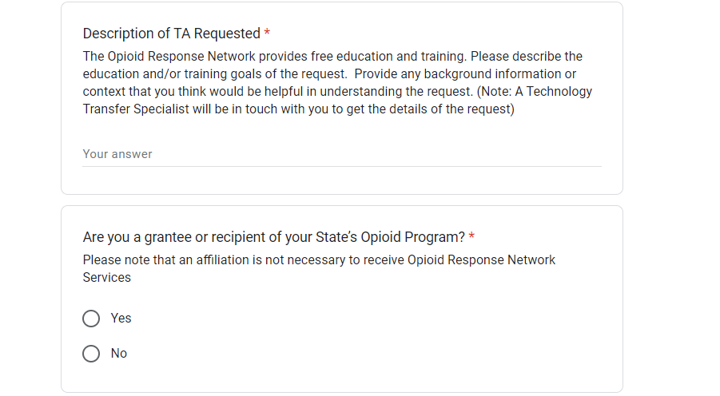
Notes:
When you hit Submit Request it takes you to this google form. You provide basic information, including your state. We ask you verify the state because that is how your request is routed.
We ask that you write a description of the help you are looking for. We don’t need a book, but we do need details so we know what we will be looking at.
Once you click submit on your request it is automatically routed to the Region you belong in.

Slide 19
ORN Workflow
Notes:
You will get an email of welcome and ask to set up a time to meet with a TTS.
During that meeting your TTS is looking into what you are needing help with, digging deeper to make sure we can address your concerns.
When we have a better idea on what you are looking for we are able to submit a summary.
This summary is reviewed and approved.
Once approved we start looking for consultants who we believe would be a good match to the request.
This is where those work groups can come into play and help us find someone suited to be a consultant.
When we are outreaching to consultants we are taking the time to provide information to them, but not overwhelm them.
We do this in code, kidding. We let them know more about the TA with short terms, instead of a long email.

Slide 20
Requests
Prevention
Treatment
Recovery
Other
Harm Reduction
Stigma
DEI Training
Universal
Targeted
Intensive
Notes:
We identify requests under one of the three topics we cover, those are prevention, treatment and recovery. We are also starting now to expand our trainings and education to focus on specialized topics, such as harm reduction.
We also have three types of requests.
Universal requests build awareness, which could look like a request asking for resources.
Then we have a targeted requests that are building skills, which is where there is a specific goal and/or outcome the requester is looking for.
And finally we have an intensive request that is building awareness and skills on an organizational level, this is a request that we believe will take an extended period of time and require more than one consultant to accomplish, such an MOUD implementation.
Once a consultant agrees to work with us we set up a meeting and work together to build out the request.
And as I mentioned, we do all sorts of requests.
Here are some examples:

Slide 21
Prevention Request Example
Coalition Building
Help creating an Emergency Public Health Response Plan through requestors coalitions.
3 Coalitions
1 running
1 just starting
1 defunct
With CADCA consulting, we discovered that before we could work on the plan, we needed to help build out their coalitions.
We tailored our training to meet their needs.
Notes:
Through our needs assessment I was able to dig a little deeper to figure out what it is they needed help with.
Once we realized we should be looking at the coalitions instead of this plan, we decided to do a bootcamp. But this request was from a group working in public health, and we weren’t able to find a series of four days were they could go to a standard bootcamp.
So we tailored to them. We broke it up into months and scheduled one training every month for four months, and inbetween those trainings we would meet with each coalition to help them build out their own coalitions based on the information they had been taught in the last training.
We have closed this request, but we have in fact gained two new requests where we are focusing on two of the counties who need extra focused help. For one we will be helping on their strategies and building them out, on the other we are working to create a timeline for the coalition to move forward with building out a sustainable coalition.
And all because we had a request to help them build out a plan. (Don’t worry, they got those plans done, we just spent more time on coalitions building!)

Slide 22
Treatment Request
Implementation
Help implement 5 MOUD programs across Oregon.
Review and provide best practice policies to help build out their programs.
Provide training for each clinic around opioids, what the landscape is, how we got here, what medications are used for MOUD, what medications do, what they don’t do, and stigma.
Harm Reduction
Notes:
Though treatment can cover a lot of things, we do a lot of implementation for MOUD programs and safe syringe programs.
We also have consultants who are providers who can walk through case studies of patients on medication and teach best practice through this type of education.
This particular Treatment request was to help build out 5 MOUD programs in Oregon. We helped them review policies and procedures to make sure they were in line with current best practice, when we are providing TA, we always go back to the data. What we are providing is always best practice, though consultants are welcome to provide insights based on their own experiences.
We helped them provide stigma education to their employee’s to get them on board with the new changes.

Slide 23
Recovery Request
Building Coalition Leaders
Requested ORN to provide education and training on a variety of topics
9 coalitions
5 active but not engaged
4 defunct
They had a set of standards that hadn’t been touched in several years.
Tailored training based on their needs.
Notes:
This request came in to provide prevention training for a group of coalitions.
During my Needs Assessment when I was probing about who the training would be provided to, the requester admitted that several of their coalitions were defunct since covid.
Digging deeper I was able to discover that they have been working on getting coalitions revitalized and working on creating a set of standards that they could present to these coalitions to help guide them in the making of any new coalition. I assured them that we could help.
I sent an email to both Sean and Joy the minute I got out of that meeting and asked, do you do coalition building for groups that AREN’T prevention? I had only ever worked with groups that were coalition building for prevention.
Turns out they do!
We set up several meetings to have strategic planning sessions where we would review their standards and provide advice based on best practice and their experiences working within coalitions.
Once that was in order we made a training program over five months that was specifically tailored to WRA to help grow engagement and sustainability in those coalitions that are active.
While we are still doing this TA request we have already seen a renewed passion within the group.

Slide 24
Other Requests
We also provide some specialized TA help around the following topics:
Harm Reduction
Stimulants
Stigma
DEI Training
Notes:
I am working with a circuit judge in Oregon to provide harm reduction education in regards to their court rooms and what that looks like for judges.
I am working with another group to help them understand more about contingency management, which is the only proven treatment for stimulant use.
I find that every training we are doing, we are weaving stigma and how to combat it throughout the trainings. It is still there, and we are working to chip away at it, one training at a time!
Finally, I have a DEI request with a Peer Recovery organization, we focus on what it is like for patients to come into the clinic, and to do that we look through the lens of those who have an opioid use disorder.
I generally tell people if it has to do with opioids or stimulants we have someone who can help you with that.

Slide 25
Our Approach: To build on existing efforts, enhance, refine and fill in gaps when needed while avoiding duplication and not “re-creating the wheel.”
Notes:
The best thing about the work that we do is how we can help our requesters, from asking for resources on how to use appropriate language while talking with patients, to implementing an entire new system of care, our goal is always to provide best practice that is based in data. And, we don’t want people re-creating the wheel. We know what works, let us help you, help others.

Slide 26
About our speaker

Slide 27
Identifying Coalition Priorities and Challenges that Could Benefit from Technical Assistance

Slide 28
Poll
What have been the priorities of your coalition related to preventing opioid misuse? (check all that apply)
Public awareness campaigns
Addressing youth risk & protective factors
Engaging parents
Changing community level environments (availability, school, workplaces, etc.)
Advocating for policy or systems level change
Targeted capacity building (practitioners, law enforcement, faith, etc.)
Other
Notes:
ASK: for those that said other, can you please share in the chat box the strategies you’ve been working on?

Slide 29
Discussion
What have been the challenges in achieving your goals and objectives?

Slide 30
ZinbergNE, Drug, Set, And Setting: The Basis for Controlled Intoxicant Use (1984)
Notes:
As we plan to address opioids/stimulant use in our communities, like any other substance, we need to consider what drug is being used (fentanyl/nitrazene/xylazine) Used in conjunction with heroin and pills? How it’s being used/route of administration? The setting – where it’s being used? Consider the physical environment , the social environment, the economics of the drug use – are they selling to support their families? The cultural characteristics that come in to play especially in rural communities. We also need to consider the mindset of the individuals using the drug – their demographic and social characteristics their physical and mental health, their interpersonal skills. We know that isolation and a lack of connectedness fuels drug use. IF their needs are not bring met through human interactions, they will find something to fill that void – often bonding with drug use. Like any substance that we’re addressing, we have to look at the who, what, when, where, how it is being used? Where is it being used? Who is using? When are they using it? How are they getting it? In order to develop strategies and a comprehensive plan to address heroin, prescription opioids, methamphetamine, fentanyl and other novel substances.

Slide 31
Coalition Discussion
How did you discover that you had a opioid/stimulant problem in your community?
What consequences are you seeing in your community because of opioid/stimulant use?
Who is affected? How are they affected?
Settings (where and when is the use occurring?)
What data or indicators are you using to measure and monitor opioid/stimulant use?
How is the use of fentanyl and its consequences similar or different to opioid prescriptions and heroin use in your community?
Notes:
Possibly divide in 4’s and rotate around flipchart papers. At your tables, have a conversation and share what it is you are seeing in your community. Who is using? How are they using them – swallowing pills, snorting or injecting? What consequences are you experiencing because of use beyond overdoses?
How many of you are actively aware of meth use in your community? Have you been seeing a steady increase? Have you spoken with law enforcement regarding what they’re seeing? Coroner’s reports?

Slide 32
Membership Engagement
Coalition Capacity Challenge:
They come to the meeting, they eat turkey sandwiches, we offer them opportunities to be engaged, but we can’t get folks to “do the work”…
Does this sound familiar?
Notes:
No matter what topic we are discussing, membership engagement always arises as a challenge. Give me a thumbs up if this sounds familiar to you??? Know you are not alone. If we are going to achieve community level change in our communities around opioid/stimulant use, we have to have all sectors of the community at the coalition table. Easier said than done.

Slide 33
Tell Me What You Do for Them?
Notes:
I’ve conducted a lot of technical assistance with coalitions around capacity building. So when I hear this challenge, I ask them
I suggest to you that I think you will be immensely more successful in building partnerships and getting folks engaged if you FIRST do for them. Become a member of their organization, volunteer at their events, recruit volunteers to their efforts, make a donation. Requesting technical assistance can be one of those very valuable things you can provide them so they clearly see how it’s beneficial to be engaged in your coalition.

Slide 34
Discussion
What have been the priorities of coalition partners to address opioid/stimulant use in your community?
ASK them what challenges they face and where they need assistance.
Notes:
IS this a TA request for ORN? I agree with Sarah – submit it. Never hurts to ask and ORN works across the Continuum of Care on anything opioid/stimulant related so it’s very likely they can assist your community.

Slide 35
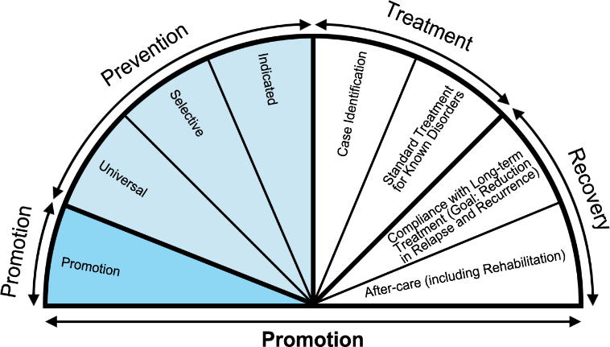
IOM Continuum of Care
Diagnosis
Source: National Research Council and Institute of Medicine. (2009).
Notes:
The Continuum of Care – good news! ORN can provide TA at all stages across the continuum. And I really urge you to think beyond your own coalition to how you can support your partners in the community by requesting assistance for them. ASK and show them this is a two-way relationship.

Slide 36
What Can Coalition’s Do to Support Efforts Across the Continuum of Care?
Assess and promote community readiness.
Engage in efforts to reduce the stigma associated with substance use disorders.
Provide education awareness on addiction, risk factors and overdose prevention across all sectors of the community and how to access treatment resources.
Collaborate with agencies working across the Continuum of Care to ensure a comprehensive, complementary and mutually reinforcing set of strategies are employed across your community.
Ensure individuals with lived experience have a seat at the table!!!
Notes:
We can identify specific sectors and roles across the CoC – all of these are areas that ORN can assist your community. And if you haven’t engaged individuals with lived experience, particularly individuals who are using substances, ORN can also assist you with doing so in a culturally sensitive way and provide concrete examples of how they can provide valuable contributions.

Slide 37
Summary- Opioid Continuum of Care
Strategies Across the Continuum
Prevention
Intervention
Treatment
Recovery Support
Notes:
Additionally, ORN can help with strategies across the continuum. All of these are areas where ORN TA can assist you.

Slide 38
TA – How Can We Help?
Stigma/Discrimination/Language Matters
NIMBY as it relates to Opioid Treatment Program’s (OTP’s)
Conduct consensus meetings/focus groups
Organize educational awareness trainings with county case managers/social workers to improve information and understanding about medications for opioid use disorder (MOUD) and maternal child health/family wellbeing.
Share information/resources/research related to pregnancy and maternal child health and the effectiveness of MOUD.
Notes:
Additional areas ORN TA can assist…

Slide 39
TA – How Can We Help?
Naloxone Expansion
Naloxone training
Research and share models for development of a sustainable Naloxone distribution program in inpatient settings.
Ongoing facilitation of implementation and consultation to help sustain Naloxone integration efforts in the community.
Public Awareness Campaigns around naloxone availability and effectiveness.
Assistance with collaborating with first responders.

Slide 40
TA – How Can We Help?
Practitioner/Healthcare:
Developed and implemented a practitioner needs/interest survey.
Provided practitioner training on addiction and SBIRT.
Identified practitioner(s) who can provide academic detailing/training on opioid prescribing and alternative pain treatments.
Developed promotional materials for medical offices and practitioners.
Collaborated with requester to develop referral resources for healthcare settings.
Notes:
These are actual examples of some TA that has been provided by ORN.

Slide 41
TA – How Can We Help?
MOUD Expansion
Asset mapping of community resources
Identify community champions
Categorize community leverage points by expertise, to build capacity.
Secure providers who can provide training on Evidence Based Practices for treating patients with Opioid Use Disorder (OUD) using FDA approved medications.
Conduct regional meetings and trainings around stigma reduction and SUD/OUD 101 with multiple stakeholders and faith community.
Advocacy training to increase prevention and recovery resources.
Notes:
Draw your community maps again through the lens of identifying and mapping community resources across prevention, treatment and recovery to identify needs and gaps in service areas.

Slide 42
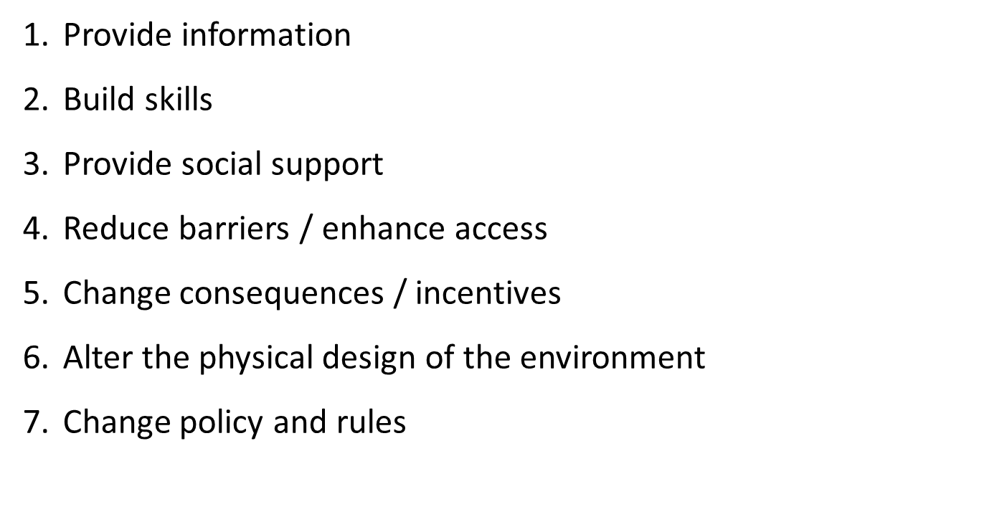
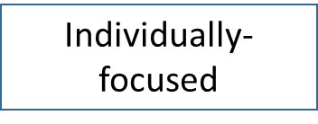
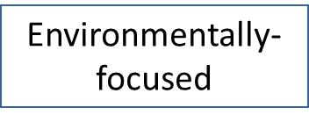
Preventing the Use of Opioids/Stimulants with the Seven Strategies for Community Change
Notes:
Or we can identify areas in need of assistance using the 7 strategies for community change. Consider strategies and tasks that need to be completed in the next 12-18 months. What do you need help with?

Slide 43
TA – How Can We Help?
Coalition and capacity building efforts
Training on Strategic Prevention Framework
Conducting community assessments
Cultural Competence
Community mobilizing
Advocating for policy or systems change
Public awareness campaigns
Any other way you think we can help you address opioid misuse and overdoses!

Slide 44
Facilitating a Conversation with Coalition Members to Identify Areas of Need

Slide 45
Sample Agenda ABC Coalition Meeting Date/Time/Location
I. Welcome & Introductions
II. Identifying Coalition Priorities and Challenges
What is ORN-TA? ORN-TA initiative, funded by SAMHSA, provides education and training at no-cost on evidence-based practices in the prevention, treatment, and recovery of opioid use disorders. This effort has been designed as a locally tailored and locally driven approach to TA delivery and requesters will be connected with TA providers in their state.
III. Provide a list of coalition priorities related to preventing opioid misuse
Public awareness campaign
Develop treatment referral resource for healthcare providers
Whatever you need to accomplish list here
IV. Identify sector partner’s priorities (prevention, treatment & recovery)
V. Identify challenges in achieving your goals and objectives
VI. Post the 3 identified priorities
VII. Closing discussion: Who might benefit from having ORN training or TA?
VIII. Adjournment
Next Meeting: DATE/TIME/LOCATION
Notes:
Facilitation Suggestion: Provide everyone post-it notes and ask them to list one item/post it note. Have them brainstorm their sector priorities. Place them on flipchart paper. Next, have them identify challenges in achieving goals and objectives and post those on a separate piece of flipchart paper. Using stickers or markers, ask each person to take a marker and identify what they think are the 3 top priorities/challenges. Next, get verbal agreement there is consensus on the priorities. Following the meeting, submit a request if there are areas where ORN can assist your coalition on your identified priorities.

Slide 46
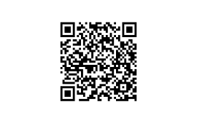
Training Evaluation
https://research.zarca.com/r/deYPAg

Slide 47
THANK YOU!

Slide 48
Closing Remarks

Slide 49
Please complete our survey
https://research.zarca.com/r/deYPAg

Slide 50
Stay Connected!
Facebook.com/CADCA
Twitter.com/CADCA
Instagram.com/CADCACoalitions
YouTube.com/CADCAorg
LinkedIn.com/company/CADCA
cadca.org
®

