Slide 1
Involucramiento de commundiades Latino Estadounidenses en Coaliciones de prevencion: Retos Soluciones y Lecciones CADCA En Espanol
Moderadora:
Yurimar Santiago
GLOBAL | COLLABORATIVE | INNOVATIVE | PASSIONATE | LEADER
Notes:
Explain Wednesday Webinar series

Slide 2
Don’t forget about the Q&A box – we’ll be holding the bulk of the questions until the end, so make sure to stay the whole way through! When typing into the chat box, be sure to select “everyone” so all can see. We are recording this webinar and the recording will be up on the Webinar Wednesday page in the next few days. Here is the link to where the recording will be posted. CADCA's Webinar Wednesdays Series | CADCA I will be putting an evaluation link into the chat box as we’re wrapping up; you’ll be able to receive a letter of participation once you complete that evaluation. The letter is only available though for those who attend the webinar live.
Webinar House Keeping
Notes:
Copy link of Wednesday Webinar site into chat

Slide 3
TODAY’S
OBJECTIVES
THIS IS AN EXAMPLE OF WHAT MY PREVIOUS WEBINAR USED FOR OBJECTIVES.
At the end of this session, participants will be empowered to:
1. Articulate the significance of using evidence-based strategies to address substance use in Urban/Inner-Cities.
2. Identify strategies that have worked successfully in other communities that may work in theirs.
3. Understand the individual and collective risk factors and analyze WIIFM's of youth in Urban/Inner-Cities.

Slide 4
About our panelist
(add head shot)

Slide 5
Panel Discussion topics
5

Slide 6
Content
(add head shot)

Slide 7
7

Slide 9
Next in the Wednesday Webinar series
August 2nd at 1pm (EST)
Preventing opioid substance misuse
Will be updated with additional details. Samantha will share information.

Slide 10
Closing Remarks
Add the contact information of the panelist that are comfortable sharing.

Slide 11
22nd Annual Mid -Year
CADCA’s 2023 Mid Year will take place on July 16-20th at the Gaylord Texan resort in Grapevine Texas.
Mid-year offers training from top experts in the field. Information, tools, and strategies to take your prevention work to the next level and the latest science, news, and trends on substance misuse issues
Registration starts June 5th
Go to ww.cadca.org/myti2023 to learn more
Notes:
Highlight the presentations from international and domestic Spanish session.

Slide 12
Stay Connected!
Facebook.com/CADCA
Twitter.com/CADCA
Instagram.com/CADCACoalitions
YouTube.com/CADCAorg
LinkedIn.com/company/CADCA
cadca.org
®

Slide 13
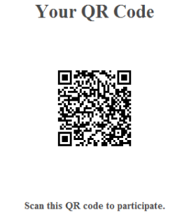
Evaluation Links
QR will be updated prior to webinar
Notes:
E&R to make Q&R code

