Slide 1
Leadership in the Midst of
Social Distancing
GLOBAL | COLLABORATIVE | INNOVATIVE | PASSIONATE | LEADER

Slide 2
OBJECTIVES
Identify opportunities for youth engagement during social distancing
GLOBAL | COLLABORATIVE | INNOVATIVE | PASSIONATE | LEADER
Help youth assess how they can exhibit their leadership style within various settings during social distancing
Give youth opportunity to develop and execute activities that are safe during social distancing

Slide 4
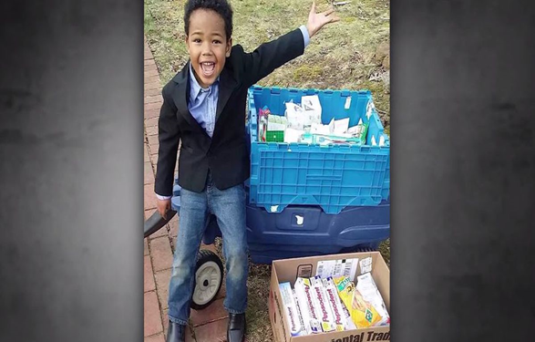
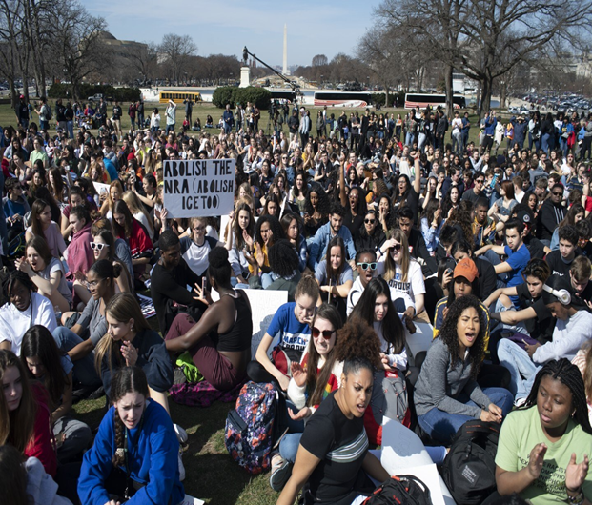
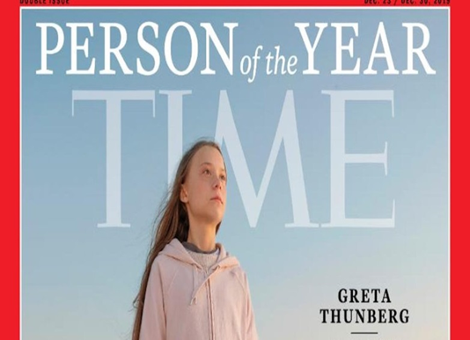
“Every Youth has the potential
to be a leader”
Tyler Stallings

Slide 5
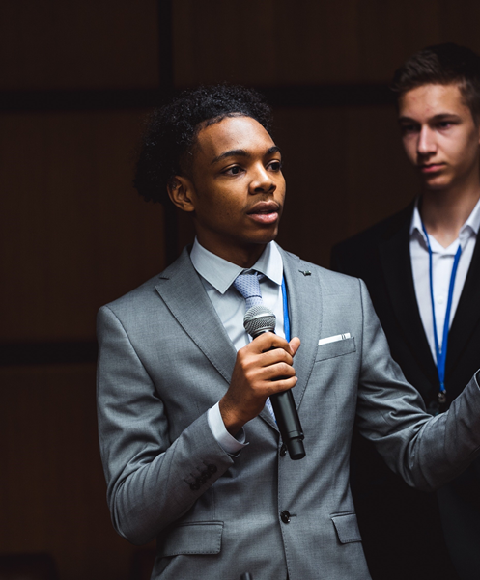
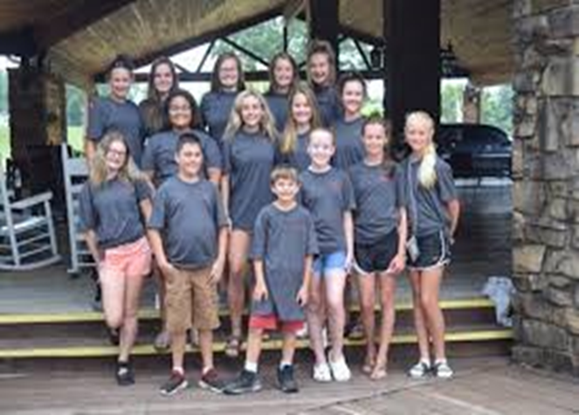
CYC and JR CYC students developed a strategic plan around addressing underage alcohol use in Casey County. They are an awesome group of students!

Slide 6
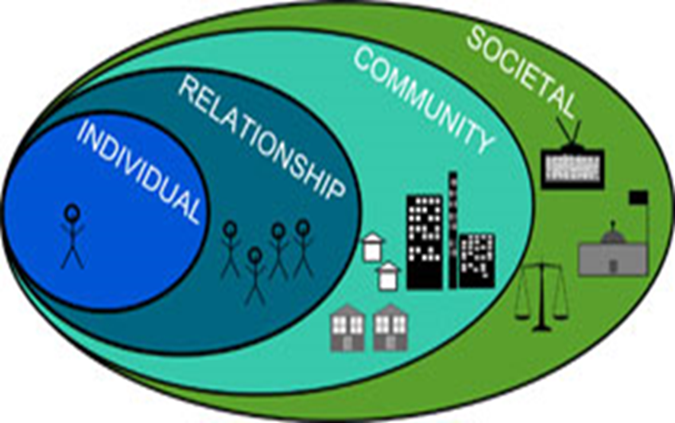
Social Ecological Model

Slide 8
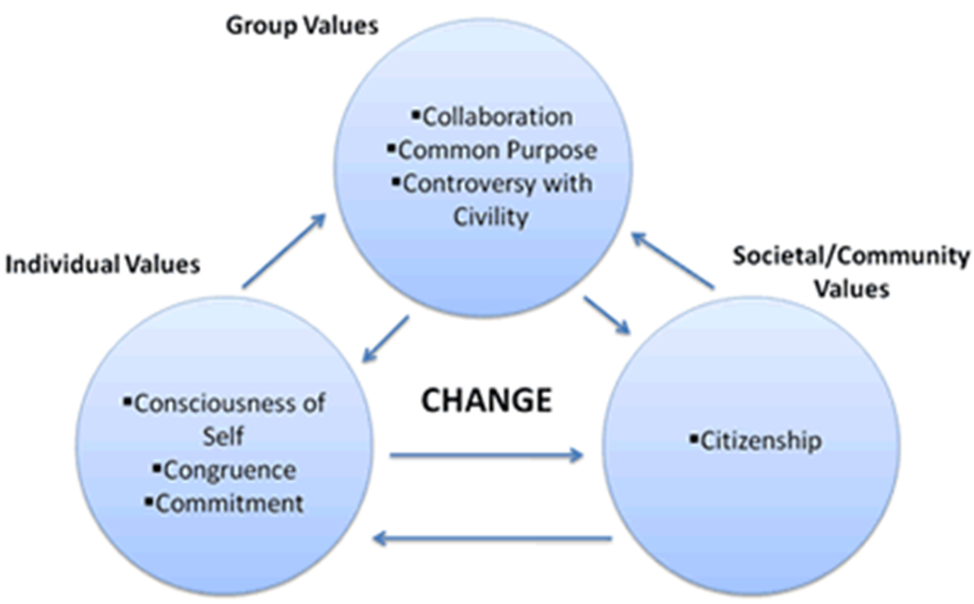

Slide 9
Consciousness of Self

Slide 10
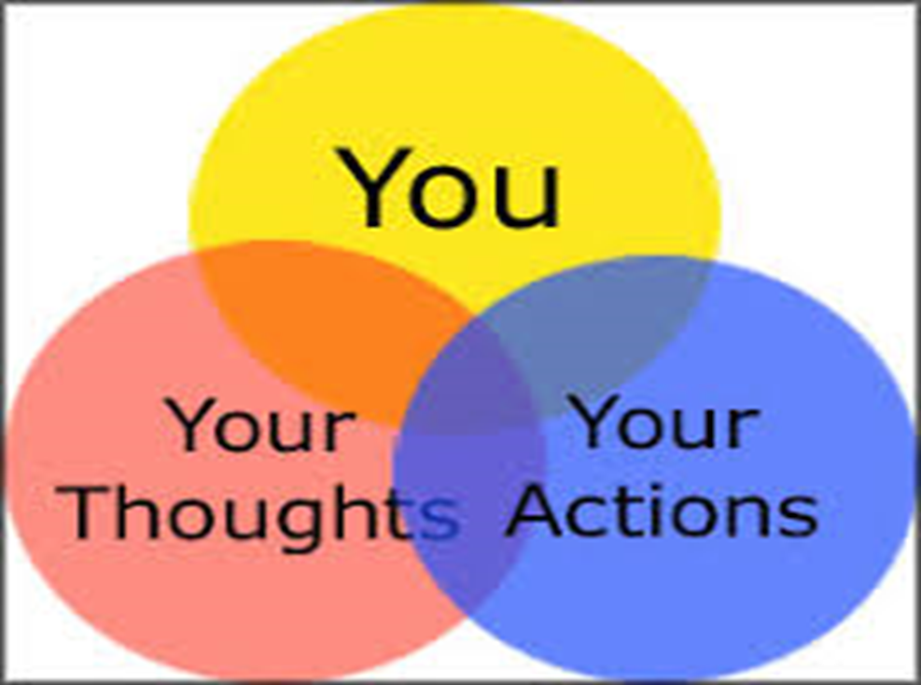
Congruence

Slide 11
Commitment
“ The path of change is filled with
Moments of great resistance. Of having
to make painstaking choices; ones outside
of our comfort zone. It is these choices
that teach us our greatest lessons. They show us
Our strength. Our power. Our worth. Ourselves.

Slide 12
Collaboration

Slide 13
Common Purpose

Slide 14
Controversy with Civility

Slide 15
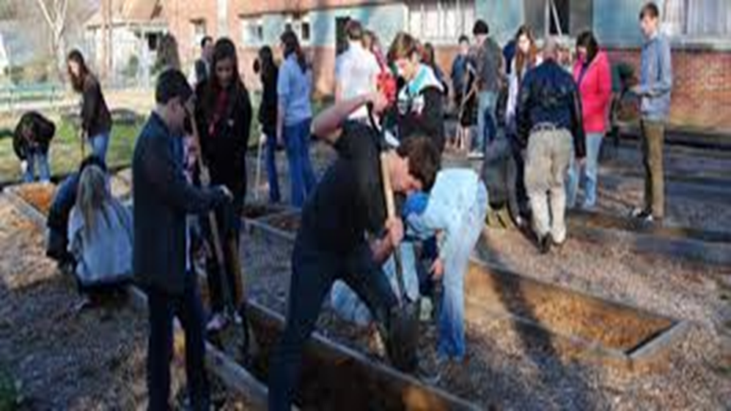
Citizenship

Slide 16
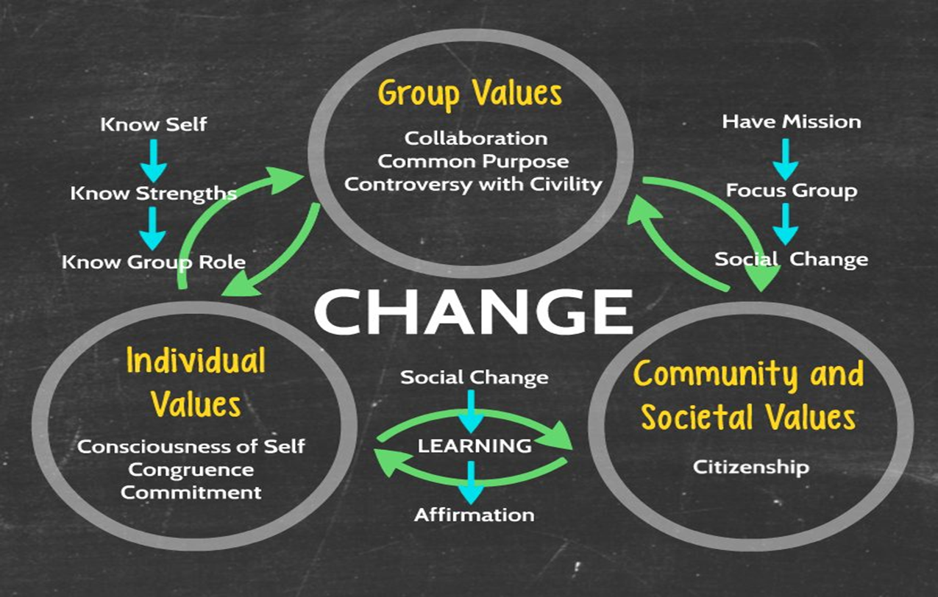

Slide 17
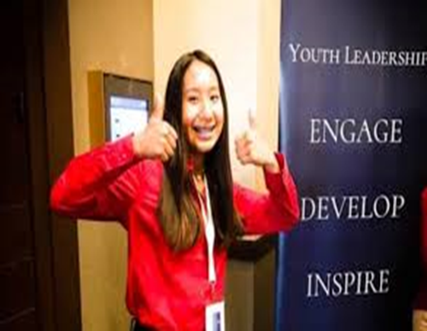
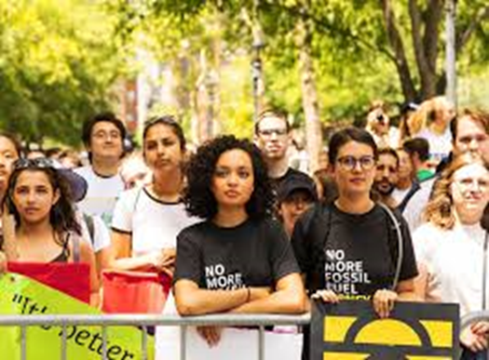
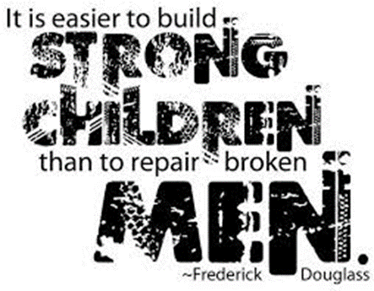
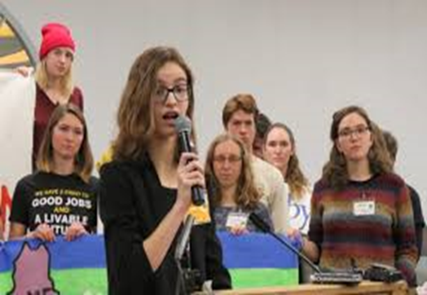
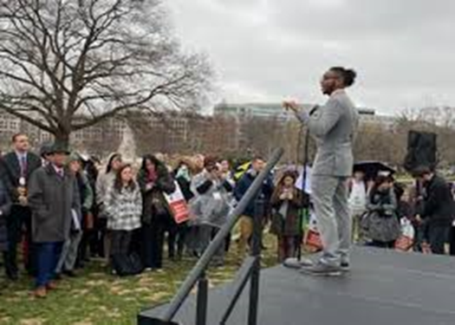

Slide 19
Title here
Title here
Title here
Title here

Slide 20
Stay Connected!
Facebook.com/CADCA
Twitter.com/CADCA
Instagram.com/CADCACoalitions
YouTube.com/CADCAorg
LinkedIn.com/company/CADCA
cadca.org
®

