Slide 1
CADCA Youth Leadership Webinar
GLOBAL | COLLABORATIVE | INNOVATIVE | PASSIONATE | LEADER

Slide 2
CADCA Youth Leadership
MOTTO
CADCA's Youth Leadership is committed to strengthen the skills and capacity of young people to influence positive change in the communities where they live, learn and grow. Knowing that young people are the best resource for creating this change, our motto is “Engage. Develop. Inspire.”
PURPOSE
Our Youth Leadership purpose is to empower youth through Engaging, Developing and Inspiring them to be change agents in their communities. This is achieved through a highly interactive and collaborative training that goes through the Strategic Prevention Framework which is a proven model for community change that increases leadership capacities, civic and political engagement and problem-solving among youth.

Slide 3
Engaging Youth Coalitions in Public Policy
Victor Shi, CADCA youth Trainer
GLOBAL | COLLABORATIVE | INNOVATIVE | PASSIONATE | LEADER

Slide 4
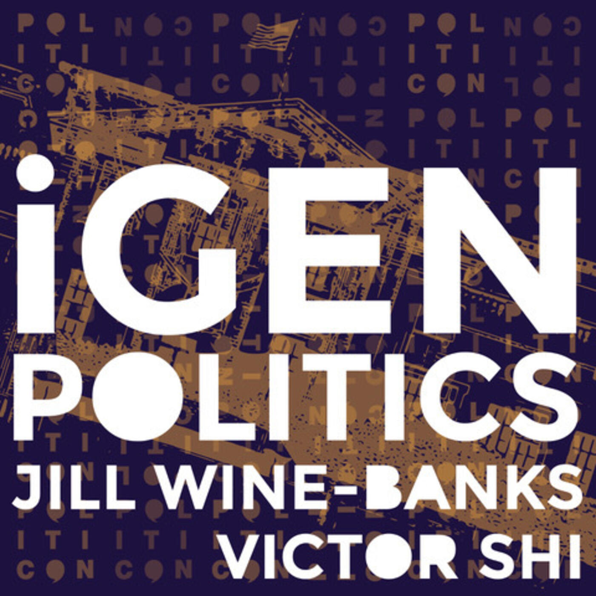
About me
CADCA trainer since 2019
Rising junior at UCLA
Youngest elected delegate for Joe Biden in 2020
Co-host of iGen Politics Podcast
From Chicago

Slide 5
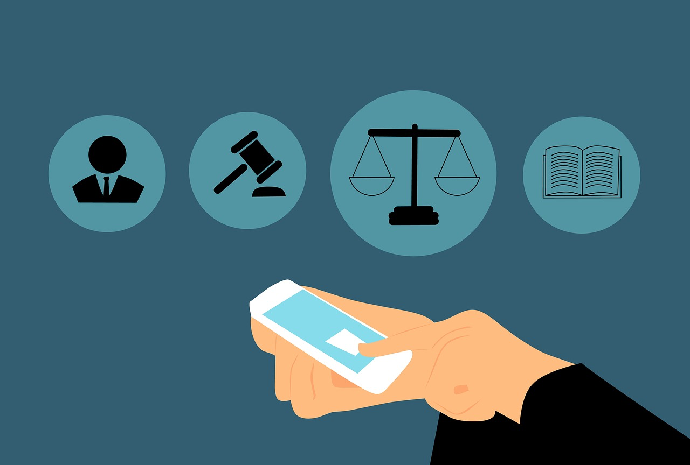
Goals for today
Part 1: Understand what is public policy
Part 2: Understand where a coalition and YOU fit into public policy
Questions

Slide 6
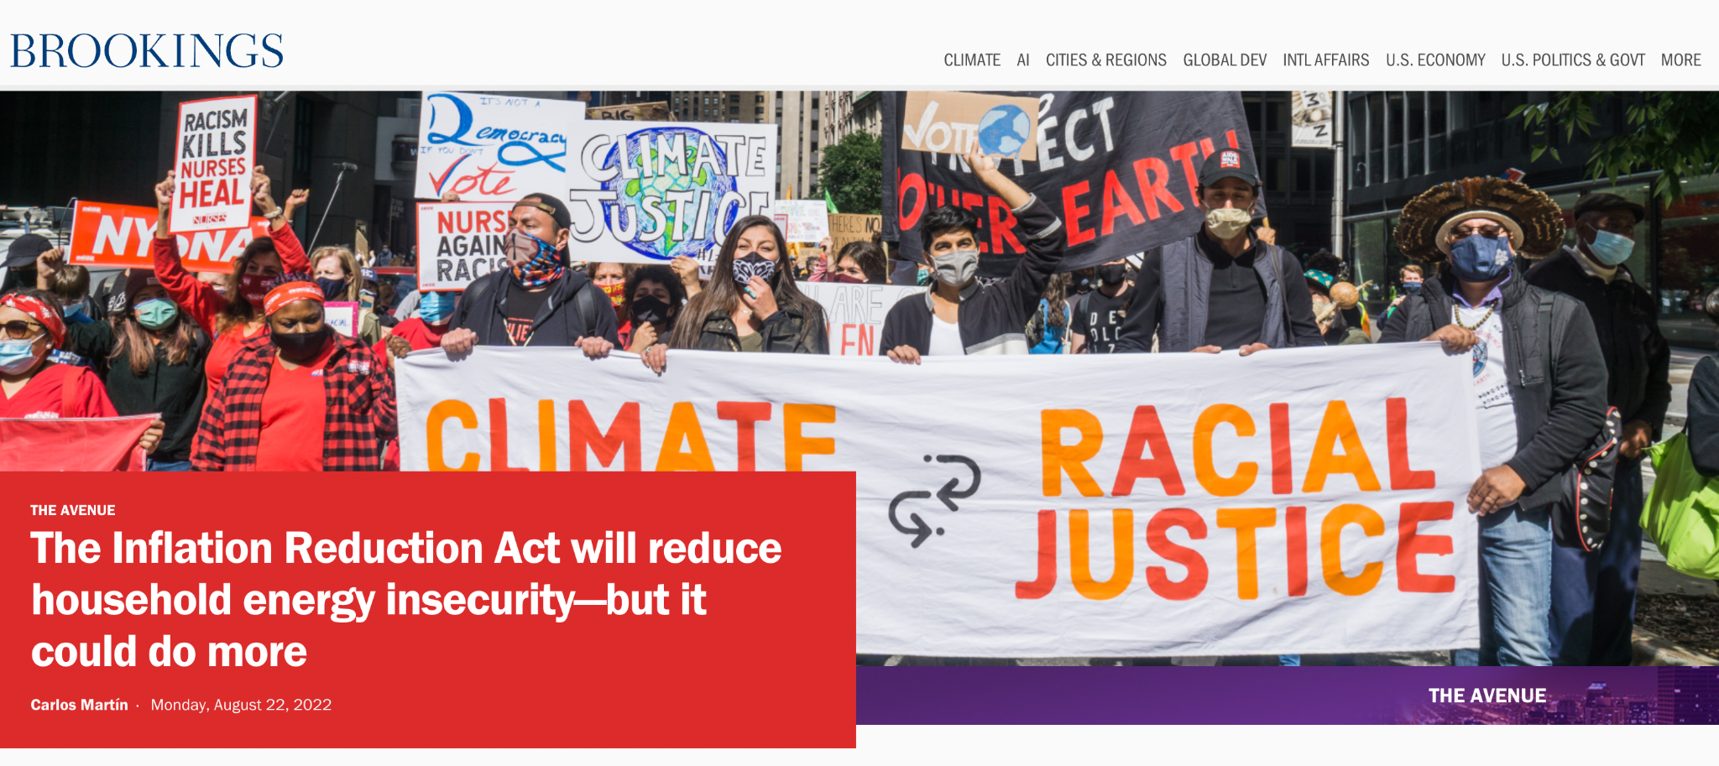
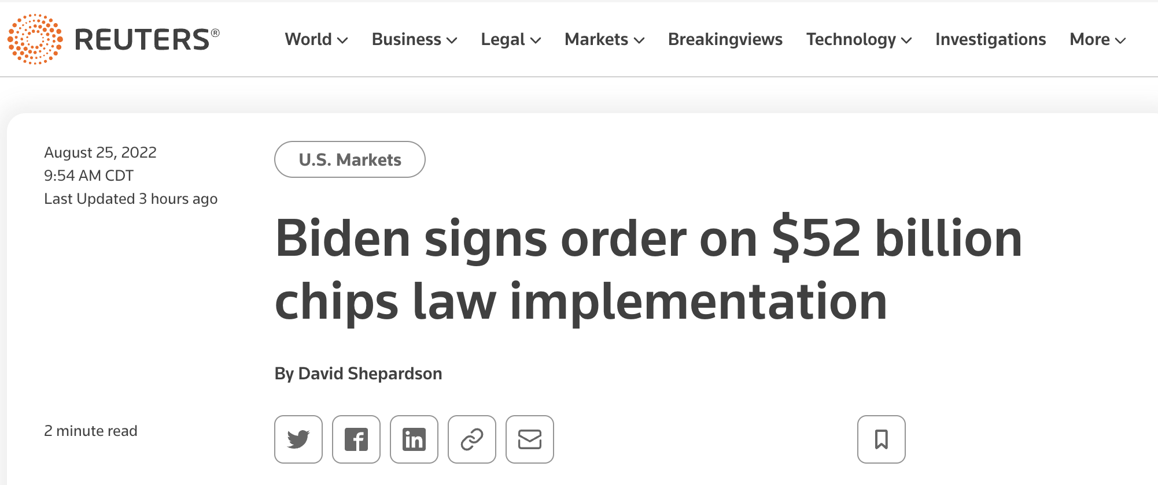

Slide 8
Public Policy
In its most simplest form, it’s about identifying a problem, locating causes of [x problem], and finding solutions to [x problem].
Problem → Cause → Solution

Slide 9
Public Policy — Examples
Education — public vs. private schools; who funds; student loans
Policing — how should police departments be run?
Environment — how should we respond to climate change?
Voting rights — what laws should be in place to expand access to the ballot box?
Healthcare — cost of healthcare, insurance companies, how to regulate the industry?
Economy — what should the minimum wage be? Regressive or progressive tax system?
Transportation/Infrastructure — how much should we invest in roads and transportation? Broadband?
Safety — gun reform? How do we create safer communities?
Of course, drug policy — what we here at CADCA do

Slide 10
How to Think Through Public Policy
Must understand how government functions.
Let’s do a Civics 101!

Slide 11
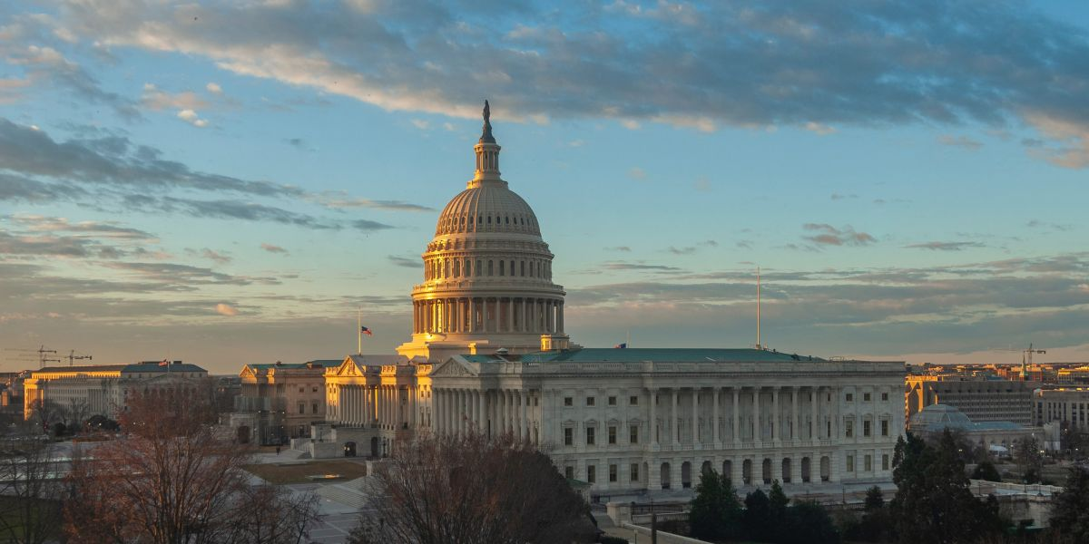
535 Members of Congress; 100 Senators (6-year term); 435 Representatives (2-year term
PURPOSE: Propose and pass laws
1 President (4-year term, maximum 8 years), 1 Vice President, and varied amount of cabinet-level officials
PURPOSE: Enforce laws
9 Supreme Court Justices (nominated by the President), serves for life
PURPOSE: Interpret Laws

Slide 12
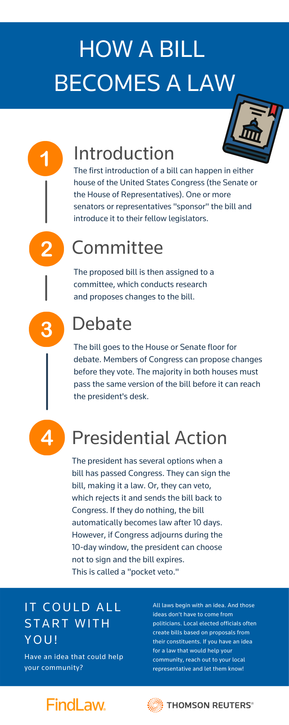
What is most important for Public Policy — Congress

Slide 13
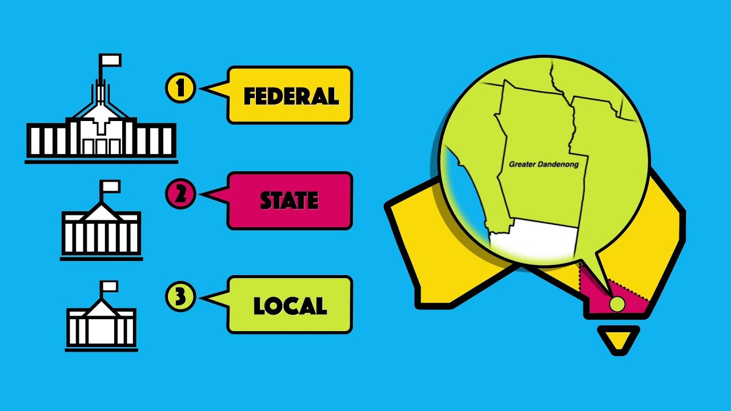

Slide 14
With a better understanding of government…
Now, it’s time to identifying the problem in your community
Ex. Drug policy — underage drinking, usage of vapes, marijuana consumption.
What is the problem in your community?
This will be the basis for the policy you end up creating.

Slide 15
How to think about the causes
Two tracks:
Qualitative data in your community/state
Quantitative data in your community/state

Slide 16
Make your data/story compelling
How long has it been a problem? Short vs. Long-term?
Sample size – how many people were surveyed? Enough?
What are the assumptions? Any leaps in logic?
Easily refutable? What does the other side think?

Slide 17
Solution
Here at CADCA, we think through seven different strategies:
Provide information
Enhance skills
Provide support
Enhance/reduce barriers
Consequences (incentives and disincentives)
Change physical design
Modify/change policies

Slide 18
Part 2
Where YOU fit in
How can you and your coalition become a better advocate and strategist in passing public policy?

Slide 19
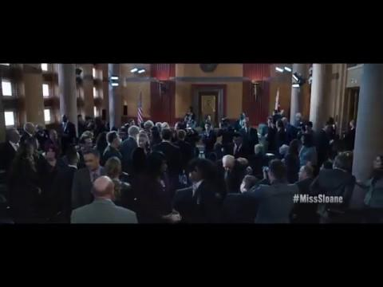
Example from “Miss Sloane”

Slide 20
Example from “Miss Sloane”

Slide 21
Key words and phrases
Foresight
Anticipating your opponent’s moves
Advising counter measures
Using resources
Winner plots one step ahead of the opposition
Making sure you surprise them and they don’t surprise you
Grassroots action
Working influential Senators
Identify who holds sway
Don’t just waltz into a Senator’s office and make your case – find who they trust, who they can’t afford to piss off
NOTE: DFC recipients may NOT lobby.

Slide 22
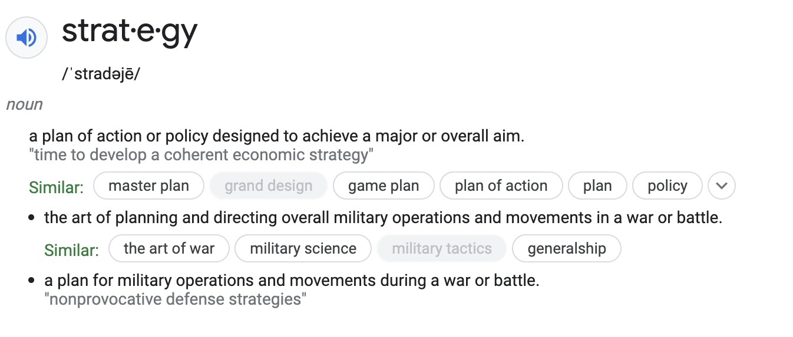
Let’s think about Strategy in Public Policy

Slide 23
Strategy
Strategy is not just about getting from “A” to “B”
A
B

Slide 24
Strategy
Strategy will always be filled with unexpected roadblocks
B
A

Slide 25
Strategy
So it’s about anticipating and working around them
B
A

Slide 26
Strategy
The outcome is the same (winning), but the process is what matters
Thinking about the steps
Thinking through the various advantages and disadvantages
And that requires not only strategy but also foresight

Slide 27
Foresight
Involves opponent usually
Consider what your power leverage is
What is in your power? In your favor?
What isn’t in your power and favor? How do you respond?
Take advantage of your strengths
End goal: Win

Slide 28
Foresight
Involves opponent usually
Consider what your power leverage is
What is in your power? In your favor?
What isn’t in your power and favor? How do you respond?
Take advantage of your strengths
End goal: Win

Slide 29
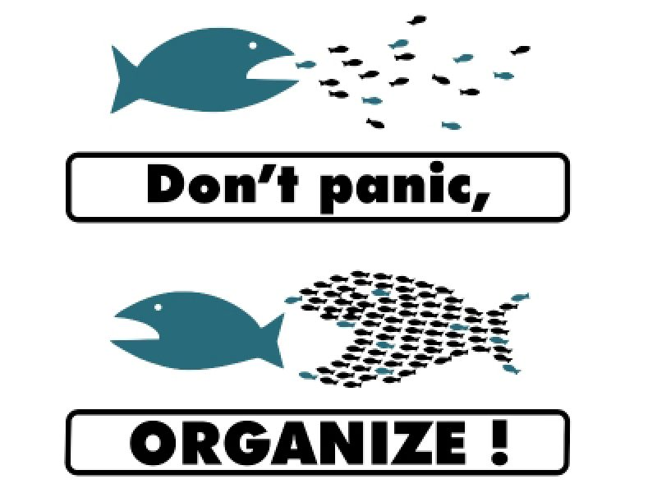
Next: Applying it to the levels of change
Community Coalition-Building
Civic Advocacy
Lobbying
Grassroots Demonstrating
Civil Disobedience

Slide 30
Coalition building
Coalition: An alliance of tactical groups formed to oppose a common foe and work toward a common goal
Solid leadership is needed
Have a clear intention
Work together to achieve a goal

Slide 31
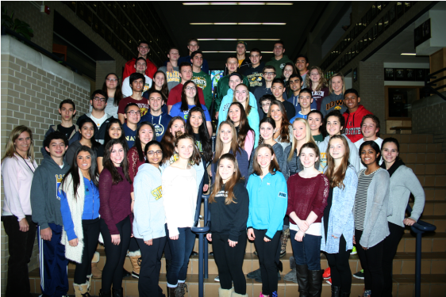
Community Youth Activism
Policy Committee
Example: “Catalyst”
Human Resources
Sender School Outreach
Marijuana Legislation Committee
Community Outreach
Parent Committee
SHS Outreach

Slide 32
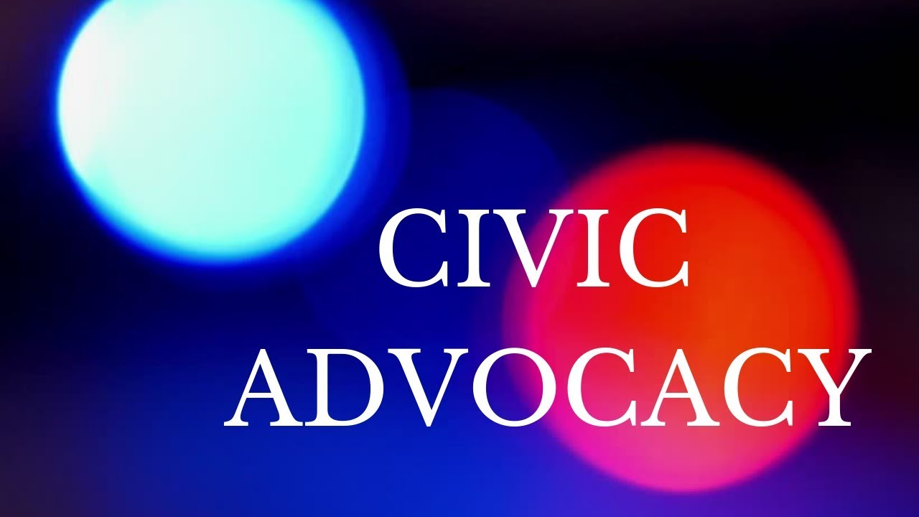
Civic Advocacy
Working with legislators and lawmakers to create change
Local, state, and federal-level politics
Requires good communication skills and research
Focus is on challenging or changing existing laws

Slide 33
Lobbying
Advancing a specific POLICY agenda through the legislative process
Requires knowledge of how laws are made
Focus is usually on creating NEW laws or
enforcement measures
Direct communication with legislators or
legislative staff

Slide 34
Grassroots Demonstrations
Using the power of large groups to force pressure on those in power
Often about the entire SYSTEM rather than specific policies
More confrontational method
Best when many demonstrations are coordinated simultaneously

Slide 35
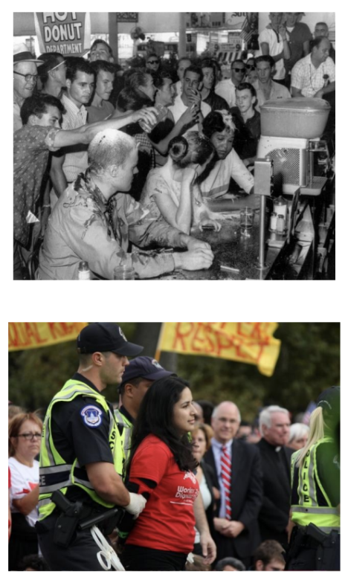
Civil Disobedience
Refusal to obey unjust and immoral laws
Appealing to one’s sense of justice
Open, non-violent, and public

Slide 36
How will you use your voice?

Slide 37
Questions?
CADCA.org

Slide 38
Resources & Evaluation:
Resources and slides are posted to the CADCA Webinar Wednesday page here:
https://www.cadca.org/resources/cadcas-2021-webinar-wednesdays
The recording of this webinar will be available on the CADCA webinar Wednesday page in the days following.
Thank you for joining us today! Please be sure to complete the evaluation: https://research.zarca.com/r/2TUEq0
Please join us for our next webinar on 9/21/22 to discuss How Social Media helps your communities

