Slide 1
Light the Flame: Creating a Wildfire of Parental Support
Angela Da Re
GLOBAL | COLLABORATIVE | INNOVATIVE | PASSIONATE | LEADER
Notes:
Recruitment and retention are critical to the success of any coalition, but solid parental engagement can be the spark that ignites a community-wide fire. This webinar will highlight strategies for increasing outreach success, participant engagement, and partnership, specifically around parental involvement and mission endorsement. Learn about proactive and reactive recruitment strategies and outreach techniques to engage parenting adults of many backgrounds and cultures. Working cooperatively, you will begin identifying what is essential to parents and caregivers, how to help them believe in your mission and take action to accomplish the coalition’s goals.

Slide 2
Don’t forget about the Q&A box – we’ll be holding the bulk of the questions until the end, so make sure to stay the whole way through! When typing into the chat box, be sure to select “everyone” so all can see. We are recording this webinar and the recording will be up on the Webinar Wednesday page in the next few days. Here is the link to where the recording will be posted. CADCA's Webinar Wednesdays Series | CADCA I will be putting an evaluation link into the chat box as we’re wrapping up; you’ll be able to receive a letter of participation once you complete that evaluation. The letter is only available though for those who attend the webinar live.
Webinar House Keeping

Slide 3
Today’s Objectives
Define and discuss the importance of parents and caregivers related to all prevention strategies
Proactively address Parental engagement throughout the SPF
Understand the role of culture in relationship building
Identify recruitment and retention strategies for ongoing coalition connection
3

Slide 4
About our speaker
Notes:
Angela Da Re has been in substance use disorder prevention and health promotion for 25 years. She is a skilled facilitator and trainer who supports communities across a diverse landscape in prevention and early intervention, emphasizing community and family-based prevention. She is the CEO of Delta Prevention, a California-based not-for-profit. She also serves as a national consultant and trainer for Community Anti-Drug Coalitions of America (CADCA). She trains in the year-long National Coalition Academy and virtual and on-site trainings customized for local communities.
She is a model trainer for the Strengthening Families Program, and a family coach, and regularly implements family communication-building classes.

Slide 5
Define Your Goal Strategy: Determine your goals by understanding YOUR Why
Why do you want increased participation of parents?
Notes:
Flash Brainstorm: In your coalition, what purpose would having more engaged parents serve?

Slide 6
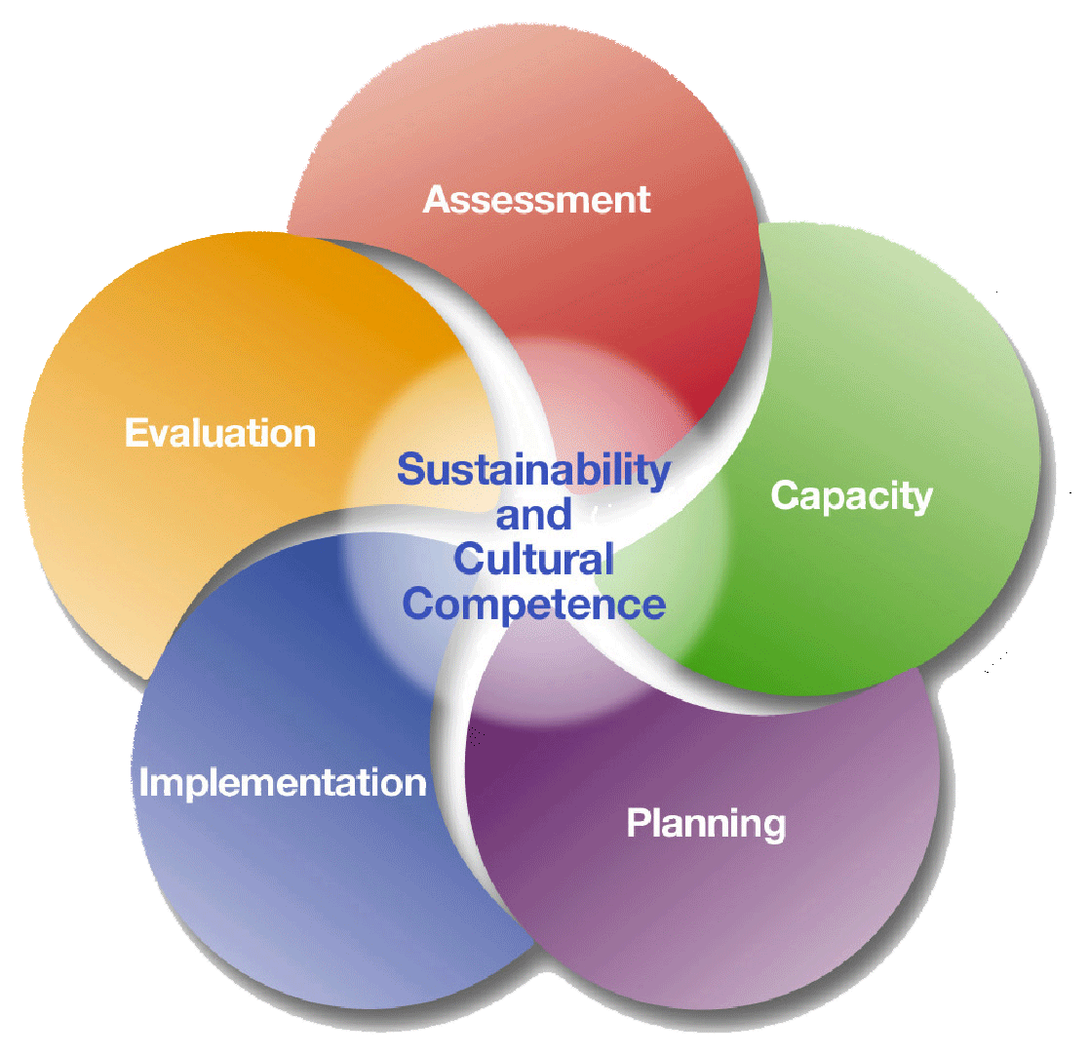
Strategic Prevention Framework
Assessment
Profile population needs, resources, and readiness to address needs and gaps
Capacity
Mobilize and/or build capacity to address needs
Planning
Develop a Comprehensive Strategic Plan
Implementation
Implement evidence-based prevention programs and activities
Evaluation
Monitor, evaluate, sustain, and improve or replace those that fail
Notes:
Identify Recruitment Strategies AT EACH STAGE of the SPF

Slide 7
Ideas for Relationship Initiation
Serve FIRST
Action Committees
ASK
TRAIN
Support
Notes:
When it comes to creating parenting adults who are ON FIRE to work on community issues, there are several things that will get you long term traction…
Serve First – With or without a global pandemic, parenting adults are struggling for new and different resources, many of which the coalition can provide. We have access to education and non profits as well as updated drug info, afterschool ideas, strengthening families, family game nights etc etc etc. We are or could be a trusted community partner in helping parenting adults get what they need to raise kids who thrive.
Create an action committee – Once you determine your goal, creating an action committee might be the easiest way of getting parents involved. Asking them to join the coalition to help meet one goal or solve one problem will likely be more effective than asking them to stay long term and it will give them an optional “out” when the goal is met. Task forces and action committees, as you might assume from their names, are action -oriented.
Most People Report Having Never Been ASKED
Train People on how to work with a coalition – Not intuitive
Support them with a Mentor to show them the ropes

Slide 8
Why Parenting Adults? Understanding the Data
Notes:
Parents have an enormous influence over their children and yes, even teens. Supporting them by understanding the data ourselves and communicating it fully to them makes the work of engaging them easier

Slide 9
What is Substance Use Disorder Prevention?
Substance use disorder prevention focuses on strategies to prevent all levels of substance use.
…And why focus on youth?
Notes:
Since substance misuse occurs so often in adolescence AND the increase pressure substance use puts on the brain during development, Adolescence is the time in the lifespan we most often focus on.
DFC requires it

Slide 10
Addiction is primarily a CHILDHOOD Disease
Notes:
“A child who gets through age 21 without smoking, abusing alcohol or using illegal drugs is almost certain never to do so.”
(CASA –National Center on Addiction and Substance Abuse at Columbia University)
One study revealed that most Americans who are addicted to tobacco, alcohol or other substances started smoking, drinking or using drugs before they were 18 years old.
That same study also found that one-quarter of Americans who began using any addictive substance before age 18 were addicted, compared with one in 25 Americans who started using an addictive substance when they were 21 or older.
So who has influence?

Slide 11
Teen Drinking puts kids at risk
“The younger adolescents are when they start to drink, the more likely they are to engage in risky behaviors, including using drugs… having sex with six or more partners, and earning grades that are mostly D’s and F’s in school."
*Early teens are at higher risk for substance abuse
Notes:
National institute on Alcohol abuse and alcoholism NIAAA Alcohol Alert
(NIAAA Alcohol Alert, Jan. 2006, p.1)
In order to convince a parenting adult to work collectively we have to convince them that their individual roles are crucial.

Slide 12
Alcohol affects a teen brain differently than an adult brain
“The brain goes through dynamic change during adolescence and alcohol can seriously damage long – and short-term growth processes.” (American Medical Assn.)
Notes:
Do parenting adults know this? Where do they get their information on this topic?
Please put some of your answers in the chatbox
Their parents
Facebook
Media
Social Media
How can we, as a coalition, ignite a fire if they don’t believe there is a problem?

Slide 13
Long-term study 11,000 teen drinkers negative SOCIAL consequences
60% more likely to be alcoholics
60% more likely to be homeless
40% more likely to have accidents
40% more likely to use illegal drugs
40% more mental health problems
Double the risk for criminal convictions
By age 30, teens who binge drank @ age 16 were:
Notes:
Understanding both possible consequences as well as the potential to impact both their own family as well as their community is key

Slide 14
Most addiction is PREVENTABLE
Well-trained parents help kids become socially responsible & emotionally resilient
Notes:
“Strong families avoid many adverse outcomes: substance abuse, teen pregnancy, school failure, aggression, and delinquency.” (Hops, et al., 2001)

Slide 15
Who has Influence?
Two ways to curb youth use is by mitigating their access or their desire (both change behavior)
Parents and Caregivers have influence over BOTH
Notes:
Communities can help mitigate both but Parents and caregivers have more direct influence.

Slide 16
Influence With Youth
Engaging Parents and Caregivers in Prevention at home AND in the Community

Slide 17
What do parents and caregivers need?
To be convinced of their own importance
Practical tools

Slide 18
Talk They Hear You Campaign – Sacramento, California Example

Slide 19
in our community
Alcohol is the #1 Substance of Abuse by Youth in Sacramento County
Sacramento teens are drinking too early:
27% of 7th grade students tried alcohol before age 15 43% of 9th grade students 35% of 11th grade students
Sacramento teens are drinking too much:
13% of 9th grade students report binge drinking in the past 30 days 18% of 11th grade students
Sacramento teens are drinking too often:
9% of 7th grade students report they drank on 3 or more days in the last 30 days 18% of 9th grade students 25% of 11th grade students (California Healthy Kids Survey, 2013)
Notes:
https://www.samhsa.gov/talk-they-hear-you
Use this slide, if helpful, to highlight relevant data or findings that will aid you in illustrating the importance of addressing underage drinking in Sacramento or with a particular audience. Additional Data Points are available through SCCY and other sources, change data to suit your audience, Additional resources are below:
• Alcohol is the #1 substance of abuse by youth in Sacramento County
• Underage drinking is a national public health issue – an estimated 10 million people under age 21 drank alcohol in the past month in the U.S. (National Survey on Drug Use & Health, SAMHSA)
• Around 80% of children feel that parents should have a say in whether they drink alcohol. (Jackson, C. (2002). Perceived legitimacy of parental authority & tobacco and alcohol use during early adolescence. Journal of Adolescent Health 31(5], 425-432. Nash, S.G., McQueen, A., and Bray, J.H. (2005}. Pathways to adolescent alcohol use: Family environment, peer influence, and parental expectations. Journal of Adolescent Health, 37{1}, 19-28.)
• Between the ages of 11 and 18, youth are especially susceptible to outside influences such as peers, family members and the media. (Moreno, M.A., Briner, L.R., Williams, A, Walker, L. & Christakis, D. A. (2009) Real use or "real cool": Adolescents speak out about displayed alcohol references on social networking websites. Journal of Adolescent Health, 45(4), 420-422.)
• Studies have shown that parents have a significant influence on young people's decisions about alcohol consumption. (Nash, S.G., McQueen, A., and Bray, J.H. (2005). Pathways ta adolescent alcohol use: Family environment, peer influence, and parental expectations. Journal of Adolescent Health, 37(1}, 19-28.)
• If children are in an environment where parents or peers drink a lot or view drinking favorably, they are more likely to drink themselves. (Bonnie, R.J. and O'Connel, M.E. (Ed.) (2004) Reducing underage drinking: A collective responsibility. National Research Council and Institute of Medicine. Washington DC: The National Academies Press)
• Children with family history of alcoholism are at an increased risk for becoming an alcoholic. (West, M.O.,Prinz, R.J.1987 Parental alcoholism and childhood psychopathology, Psychological Bulletin, 102(2),204-218.)
• Most 6-year-olds know that alcohol is only for adults. Between the ages of 9 and 13, children start to view alcohol more positively. Many children begin to think underage drinking is OK. Some even start to experiment. It is never too early to talk to your children about alcohol. (U.S. Department of Health and Human Services. The Surgeon General's Call to Action to Prevent and Reduce Underage Drinking: A Guide to Action for Educators. U.S. Department of Health and Human Services, Office of the Surgeon General, 2007)
Sacramento teens are drinking too early: 27% of 7th grade students tried alcohol before age 15 43% of 9th grade students 35% of 11th grade students Sacramento teens are drinking too much: 13% of 9th grade students report binge drinking in the past 30 days 18% of 11th grade students Sacramento teens are drinking too often: 9% of 7th grade students report they drank on 3 or more days in the last 30 days 18% of 9th grade students 25% of 11th grade students (California Healthy Kids Survey, 2013) Sacramento County Coalition for Youth is supported by Substance Abuse Prevention and Treatment funds provided by the Sacramento County Department of Health and Human Services, Division of Behavioral Health Services, Alcohol and Drug Services. The Sacramento County Office of Education manages the project, in partnership with Sacramento County Alcohol and Drug Services, local prevention providers and community-based stakeholders.
• About 10% of 12-year-olds say they have tried alcohol, but by age 15, that number jumps to about 50%. The sooner you talk to your children about alcohol, the greater chance you have of influencing their decisions about drinking. (U.S. Department of Health and Human Services. The Surgeon General's Call to Action to Prevent and Reduce Underage Drinking: A Guide to Action for Educators. U.S. Department of Health and Human Services, Office of the Surgeon General, 2007.)
• Children who drink alcohol are more likely to:
o Use drugs (Grunbaum, J.A., Kann, L., Kinchen, S., Ross, J., Hawkins, J., Lowry, R., et al. (2004, May 21). Youth risk behavior surveillance-United States, 2003. Morbidity and Mortality Weekly Report Surveillance Summaries. Atlanta, GA: Centers for Disease Control and Prevention.)
o Get bad grades (Bonnie, R.J., and O'Connell, M.E. (Ed.). (2004). Reducing underage drinking: A collective responsibility. National Research Council and Institute of Medicine. Washington, DC: The National Academies Press.)
o Suffer from injury or death (Underage Drinking Enforcement Training Center. (2011, September). Underage drinking costs.)
o Engage in risky sexual activity at earlier ages, more often and unprotected. (Fergusson, D.M., and Lynskey, M. T. (1996). Alcohol misuse and adolescent sexual behaviors and risk taking. Pediatrics, 98(1), 91-96. Tapert, S.F., Aarons, G.A., Sedlar, G.R., and Brown, S.A. (2001). Adolescent substance use and sexual risk-taking behavior. Journal of Adolescent Health, 28(3), 181-189.)
o Make bad decisions – drinking lowers inhibitions and increases the chances that children will engage in risky behavior or do something that they will regret. (Goldberg, J.H., HalpernFelsher, B.L., and Millstein, S.G. (2002). Beyond invulnerability: The importance of benefits in adolescents' decision to drink alcohol. Health Psychology, 21(5), 477-484. Halpern-Felsehr, B.L., and Cauffman, E. (2001). Costs and benefits of a decision: Decision-making competence in adolescents and adults. Journal of Applied Developmental Psychology, 22(3), 257-273.)
o Have health issues such as depression and anxiety disorders (Bonnie, R.J., and O'Connell, M.E. (Ed.). (2004). Reducing underage drinking: A collective responsibility. National Research Council and Institute of Medicine. Washington, DC: The National Academies Press)
• What you say to your children about alcohol is up to you. But remember, parents who do not discourage underage drinking may have an indirect influence on their children's alcohol use. (Sieving, R.E., Maruyama, G., Williams, C.L., and Perry, C.L. (2000). Pathways to adolescent alcohol use: Potential mechanisms of parent influence. Journal of Research on Adolescence, 10{4), 489-514.}

Slide 20
Parents have influence!
Around 80% of children feel that parents should have a say in whether they drink alcohol.
Between the ages of 11 and 18, youth are especially susceptible to outside influences such as peers, family members and the media.
Notes:
When placing the data on the slide, you might consider putting the reference in the notes section for easy reference
Around 80% of children feel that parents should have a say in whether they drink alcohol.
(Jackson, C. (2002). Perceived legitimacy of parental authority & tobacco and alcohol use during early adolescence. Journal of Adolescent Health 31(5], 425-432. Nash, S.G., McQueen, A., and Bray, J.H. (2005}. Pathways to adolescent alcohol use: Family environment, peer influence, and parental expectations. Journal of Adolescent Health, 37{1}, 19-28.)
Between the ages of 11 and 18, youth are especially susceptible to outside influences such as peers, family members and the media. (Moreno, M.A., Briner, L.R., Williams, A, Walker, L. & Christakis, D. A.
(2009) Real use or "real cool": Adolescents speak out about displayed alcohol references on social networking websites. Journal of Adolescent Health, 45(4), 420-422.)

Slide 21
Parents have influence!
About 10% of 12-year-olds say they have tried alcohol, but by age 15, that number jumps to about 50%. The sooner you talk to your children about alcohol, the greater chance you have of influencing their decisions about drinking
Studies have shown that parents have a significant influence on young people's decisions about alcohol consumption.
Notes:
About 10% of 12-year-olds say they have tried alcohol, but by age 15, that number jumps to about 50%. The sooner you talk to your children about alcohol, the greater chance you have of influencing their decisions about drinking. (U.S. Department of Health and Human Services. The Surgeon General's Call to Action to Prevent and Reduce Underage Drinking: A Guide to Action for Educators. U.S. Department of Health and Human Services, Office of the Surgeon General, 2007.)
Studies have shown that parents have a significant influence on young people's decisions about alcohol consumption. (Nash, S.G., McQueen, A., and Bray, J.H. (2005). Pathways ta adolescent alcohol use: Family environment, peer influence, and parental expectations. Journal of Adolescent Health, 37(1}, 19-28.)

Slide 22
Parents are important
Parents are the primary messengers for underage drinking prevention. To be successful, parents need prompts and conversation starters.
Parents should take advantage of opportunities to discuss the issues as they present themselves.
And Parents need to be intentional – start the conversation. Talk!
We can’t do it without you! The SCCY Needs YOU to work on making change in Sacramento!
Notes:
The purpose of the next two slides is to present key Campaign development findings to illustrate the Campaign research.
Background:
To inform the development of this Campaign, SAMHSA completed a comprehensive background study, including a literature review, media content analysis, and environmental/competitive analysis. Based on findings from this study, SAMHSA conducted a series of nationwide focus groups—both telephone and in-person—to explore attitudes, concerns, social and cultural context, influences on parenting behavior, and language used to discuss underage drinking.
SAMHSA also conducted one-on-one interviews with children in the target age range, which provided insight on the individuals to whom children turn to for advice about alcohol. Additionally, in-depth interviews with stakeholders from the advocacy and prevention arena and representatives from the alcohol industry identified promising practices and opportunities for collaboration.
Background continued:
Additionally, SAMHSA learned that parents are the primary messengers for underage drinking prevention; although, coaches and others in the community also can influence a young person’s decisions about drinking underage.
To be successful, parents said they wanted prompts and conversation starters to initiate a talk about alcohol with their children. Children said that they wanted parents to take advantage of opportunities to discuss underage drinking as they presented themselves, such as while watching a beer commercial on TV with their parents, versus having the conversation come out of the blue.

Slide 23
Define Your Goal: Strategy: Determine your goals by understanding YOUR Why
Why do you want increased participation of parents?
Notes:
Lets come back to this really important question and make this discussion even more interactive… Now we are going to switch over from a pre-recorded session to a live session so you can see if I really am wearing the same outfit! Get your paper and pens ready and let’s start creating YOUR strategy

Slide 24
Influence With Connectors
Tapping the power of RELATIONSHIPS
Notes:
Why are parenting adults so important to coalitions?

Slide 25
Parents and caregivers have RELATIONSHIPS that we don’t
Schools
Sports
Scouts
Faith Communities
Other Parents
Who Else?
Notes:
In a coalition, you need the connections of your coalition partners. Parents have those connections.

Slide 26
Recognize that we are asking for 3 things, in varying degrees:
Time
Talent
Treasure
Notes:
People will not all be at the same stage of their lives nor will they always have an abundance of all 3 at any given time. Linking to their passion and keeping the relationship alive is what will keep us connected over time.
Can I throw money at it?
Treasure could be $$, relationships

Slide 27
Strategizing For Success
Notes:
placeholder

Slide 28
Reaching Parents
Families have their own pace and culture. They congregate and connect in their own ways. Finding and engaging families means learning and understanding the culture and flow of a community.
Listening. Understanding
Notes:
The elephant principle

Slide 29
Creating a Strong Recruitment Strategy
Define the audience you are recruiting and for what activity.
Determine where they can best be contacted.
Decide which communication format(s) will be more likely to reach them.
Design the messages.
Determine the best messengers.
List possible barriers.
Identify how to overcome barriers.
ACTIVITY!
Notes:
Read slide
When you have identified the target audience, creating the plan will help you to strategize. This is TARGETED recruitment

Slide 30
Creating a Recruitment Strategy
1. Define the audience you are recruiting and for what activity.
Notes:
You have been sent a fillable recruitment strategy form. You can use that form or just jot down your answers. We’re going to ask you to share some of your examples… and as we go through the presentation we hope to be able to fill in all of the blanks.

Slide 31
Whom Do I Want to Reach?
While prevention can impact all ages and populations, it is helpful to be specific:
Parents
Grandparents
Foster Parents
Parents of teens? Tweens? Youngers?
Notes:
When creating a recruitment strategy, it is important to identify WHO you want to recruit onto your coalition

Slide 32
Strategizing for Success
To be successful, we must:
Actively compete for a participant’s time
Give participants a reason to engage
Remove barriers for engagement
Understanding the concerns of
Parents is key to successful engagement in ALL prevention work.
Notes:
In all prevention work, recruitment, and retention requires well thought out plans designed to meet the needs of our target population. To be successful, we must:
Actively compete for a participant’s time
Give them reason to engage
Remove barriers for engagement. Barriers can be unique by location, but can include: location and transportation to activities, materials not in a participants primary language, meeting times not conducive to participation etc.
Understanding the concerns of youth, parents, and community stakeholders is key to successful engagement in prevention services.
In the chatbox (or Poll) tell us WHY a parent might engage? (This could be a small group)

Slide 33
Where my passion lies
Please tell us your top one or two reasons why you do the work you do.
Type your answers in the chatbox
Notes:
Remember! They ALSO have passion; you just have to find it!

Slide 34
Reasons Parents Participate:
To learn more about an issue
Experience with the issue
Concern about what issues impact their family
To meet other parents
To address existing challenges
To make positive change
Why Else?

Slide 35
Finding and Connecting with Parents
Employers/local business centers
Healthcare providers/ pharmacies
Supermarkets
Local restaurants (pizza joints)
Local newspapers
Social media (Facebook Local, Nextdoor)
Festivals and fairs
Community events
Town hall meetings
Local groups (social, political, etc.)
Others?
Notes:
Parents often have several points of contact.
Parents can also be reached in many of the same places youth are (i.e. schools, social media, places of worship), but they can also be reached in other nontraditional locations such as the areas listed on the slide: business centers, festivals and fairs, local social or political groups.

Slide 36
Brainstorm
As quickly as possible, brainstorm as many answers as possible to the following question:
Who has access to/relationships with parents in your community?
Notes:
Use this information to help identify barriers and opportunities (who knows them, has relationships with them? etc)
Chatbox?

Slide 37
Capacity Building and Engagement with parents
Understand how prevention impacts All sectors and how working together can impact their goals too.
Engage in learning opportunities
Provide learning opportunities
Listen, listen, listen
Be prepared to work on focus “issues”
Notes:
Capacity building is the cornerstone of working with others in the community
Understand How SUD Prevention impacts other sectors and how working together can impact their goals too. WIFM – What’s In It For ME
People are busy. They don’t want another role and yes, you can sometimes create champions because they can become passionate about what you’re doing but more likely you have to identify FOR THEM how working with YOU will benefit THEM
Learn their language - A working knowledge about how they measure success will give you a deeper insight
Provide learning opportunities– Teach and train prevention principles as often as you can. Make it relevant to them. Fun and interesting.
Listen, Listen, Listen
Be prepared to work on their “issues” – Long lasting cooperative relationships have to be built. Be prepared to help them succeed in their areas as well.

Slide 38
Use the WIIFM Principle
The most important areas to understand for outreach and engagement:
Concerns
Values
Interests
Culture
When you can begin to understand, recruitment flows
Notes:
Outreach involves the use of program or department staff or volunteers to seek out and encounter members of targeted populations, generally in their service environment. In order to engage these community members from the beginning, it’s important that whoever is doing the outreach is trained or oriented to deliver the right recruitment message.
The message should be in clear, easy-to-understand language (avoid acronyms and jargon), in the primary language of the potential participant and clearly describe the expectation of participants, why their participation is important, how it may impact them, their family members and neighbors, and what kinds of accommodations will be made to enable them to participate (childcare, transportation, incentives, etc).
Targeted messages to clients may also be delivered using social marketing, such as posters hung at the service site and flyers or other materials made easily available for clients who express interest. Agencies may also be able to offer services as an incentive if services are currently fee-based (ex: sessions of free family counseling, etc.).
It’s also helpful to focus outreach to agency clients on those clients that have been referred as potential participants, as the provider will have knowledge regarding what kind of contribution the client will be able to make (whether the client might be likely to meaningfully participate in prevention planning)
Recruiting members of the focus population, those affected by the issue, to participate in a way that is meaningful to the process, but that also meets their needs. They often offer the most important insights and creative solutions and should be considered as equal partners in the prevention planning process.

Slide 39
Creating a Recruitment Strategy
2. Determine where can they best be contacted
Notes:
In considering where you’ll find participants and partners for your programs and strategies you’ll want to determine Where can they best be contacted.
For example: If you are looking for youth for your leadership program, finding someone to connect you with the right youth may be key. Is there someone at the school who you can talk to? A church? A community center? Depending on the programmatic outcomes and the identified risk and protective factors, a relationship with Juvenile hall may be beneficial.
If you are looking for families, perhaps partnering with the schools or the department of mental health will help you find them.
Take a shot at the next question on your recruitment strategy worksheet “Where can they best be contacted?”
share
Regardless of how you connect with them your materials and the message on them should be compelling to them. Let’s look now at Which communication format(s) will be more likely to reach them

Slide 40
Creating a Recruitment Strategy fire
3 & 4 - Decide Which Communication Format(s) will be More Likely to Reach Them and Which Messages Would They Be Most Likely to Respond To?
Notes:
Once you have determined where they can best be contacted, you’ll want to think through
Which communication format(s) will be more likely to reach them. A phone call? An in-person meeting? A warm hand off from a mutual friend? Even a facebook message or flyer! Choose the method you think will have the greatest success. Jot down a few ideas on your worksheet
Share
Determining the format is only half of the battle…. The message that gets them involved has to speak to them. Are you asking them to be on your coalition? In your afterschool program? In a series of family classes? Then make the messages, the “ask” compelling… Remember the WIFM principle while you fill in the next blank and answer the question:
Which messages would they be most likely to respond to?
Share

Slide 41
Creating a Recruitment Strategy
5. Determine the best messengers.
Notes:
Oftentimes we are not the best messengers. Perhaps there is a stigma attached to what we do or maybe we don’t have the relationships that are needed to compel someone to become involved. In that case, thinking through and planning Who are the best messengers? Can raise the likelihood of success. Perhaps it’s a sports coach or a local religious leader, maybe the local judge or a beloved teacher. Tapping into those connections can dramatically increase your success. What are some examples you have from your community?
Fill in the next blank in the worksheet.
Share

Slide 42
Creating a Recruitment Strategy
6 & 7 - List Barriers and Identify Ways to Overcome Them
Notes:
Finally, All communities regardless of size have barriers but rural and frontier communities have several unique barriers such as distance, transportation, lack of services. List some possible barriers to recruitment of your programs and strategies and we’ll brainstorm together ways to overcome them.
Fill out both forms on your worksheet.
Share.

Slide 43
A Reminder: Culturally Relevant Strategies:
Address problems THE WAY THEY SEE THEM
Complement rather than compete
Understand…
Concerns
Values
Interests
Are inclusive
Create real change
Cultural relevance is key to sustainability AND impact.

Slide 44
Retention
Notes:
Placeholder

Slide 45
Retention: It’s a Matter of
Time…..

Slide 46
… and Focus

Slide 47
Retention Strategies for Parenting Adults
Projects with successful retention strategies have these things in common they:
Listen
Build on empathy
Address concerns
Address barriers
Instill Hope
Encouragement
Strengthen provider/family alliances

Slide 48
Recruitment and Retention are built on one thing: Relationships!

Slide 49
Final Thought
“If at first, you DO succeed - try to hide your astonishment.”
~Author Unknown

Slide 50
Questions, Comments, Thoughts, Ideas?

Slide 51
Contact Information
Angela Da Re
CADCA Trainer
dare.email@gmail.com

Slide 52
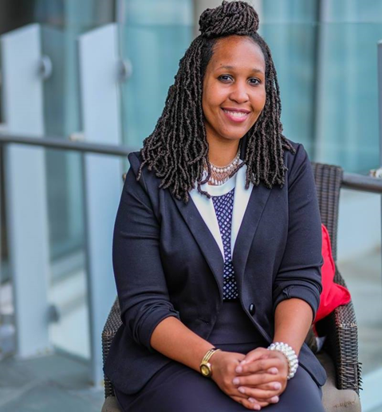
Next in the Wednesday Webinar series
April 19th at 1pm (EST) “How to bring Urban Leaders together to enhance capacity, support and resources” with CADCA Trainer Jerria Martin.

Slide 53
22nd Annal Mid -Year
CADCA’s 2023 Mid Year will take place on July 16-20th at the Gaylord Texan resort in Grapevine Texas.
Submit a Call for Presentation now on CADCA.org
Deadline for submission is 4/3/21
Registration starts June 5th

Slide 54
Stay Connected!
Facebook.com/CADCA
Twitter.com/CADCA
Instagram.com/CADCACoalitions
YouTube.com/CADCAorg
LinkedIn.com/company/CADCA
cadca.org
®

Slide 55
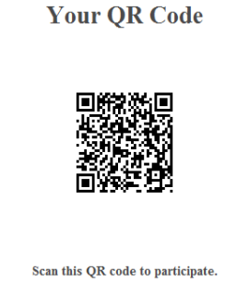
Closing Remarks
https://research.zarca.com/r/uboVGY

