Slide 1
Trauma 101: The Impact of Ace’s The Basics of a Trauma-Informed Approach in a Youth Setting
Amanda Hampton, OCPS
GLOBAL | COLLABORATIVE | INNOVATIVE | PASSIONATE | LEADER

Slide 2
Don’t forget about the Q&A box – we’ll be holding the bulk of the questions until the end, so make sure to stay the whole way through! When typing into the chat box, be sure to select “everyone” so all can see. We are recording this webinar and the recording will be up on the Webinar Wednesday page in the next few days. Here is the link to where the recording will be posted. CADCA's Webinar Wednesdays Series | CADCA I will be putting an evaluation link into the chat box as we’re wrapping up; you’ll be able to receive a letter of participation once you complete that evaluation. The letter is only available though for those who attend the webinar live.
Webinar House Keeping

Slide 3
Amanda Hampton currently lives with her husband and two children in Ohio. She originally started her career in HR and Sales Marketing in the Tourism industry. After the economic down turn she left that field and begun volunteering in WrapAround and Prevention services. She eventually became an Ohio Certified Prevention Specialist and expanded prevention services from 1 program to 15. Today she manages all prevention services for the county she serves, as Prevention Services Manager. She is also a CADCA Youth trainer and has offers trainings with a focus in Alcohol Literacy Challenge, Trauma 101, Mental Health First Aid, Youth Mental Health First Aid, Teen Mental Health First Aid, SBIRT, BDT Steps A, Botvin LifeSkills, GenRX,
Amanda Hampton
Meet your Presenter

Slide 4
Today’s Objectives
Define Trauma
Define Trauma-Informed Approaches
Understand how trauma affects the brain
List Adverse Childhood Experiences (ACEs)
Shift in thinking
Identify practical ways to create a Trauma-Informed environment for youth
4

Slide 5
Things to remember…
Establish and provide safety
Underlying Question is…
What helps you feel safe?
What happened to you?
Symptoms are…
Healing happens…
Adaptations to traumatic events
In relationships

Slide 6
What is Trauma?
Individual trauma results from an event, series of events, or set of circumstances that is experienced by an individual as physically or emotionally harmful or life threatening and that has lasting adverse effects on the individual’s functioning and mental, physical, social, emotional, or spiritual well-being.

Slide 7
The Three E’s in Trauma
Events
Experience
Effects
Circumstances cause trauma
Circumstances & Dosage Matter
Include adverse physical, social, emotional, or spiritual consequences

Slide 8
Traumatic Events
render victims helpless by overwhelming force
involve threats to life or bodily integrity, or close personal encounter with violence and death
disrupt a sense of control, connection and meaning

Slide 9
Potential Traumatic Events
Abuse | Loss | Chronic Stressors
Emotional | Abandonment | Poverty
Sexual | Neglect | Racism
Physical | Separation | Involved medical procedures
Domestic Violence | Natural Disaster | Community trauma
Witnessing Violence | Accidents | Historical trauma
Bullying | Terrorism | Family members with substance use disorder
Cyberbullying | War
Institutional

Slide 10
ACE Study
The Adverse Childhood Experiences Study (ACE Study) is a research study conducted by Kaiser Permanente health maintenance organization and the Centers for Disease Control and Prevention (CDC).
Participants were recruited to the study between 1995 and 1997 and have been in long-term follow up for health outcomes.

Slide 11
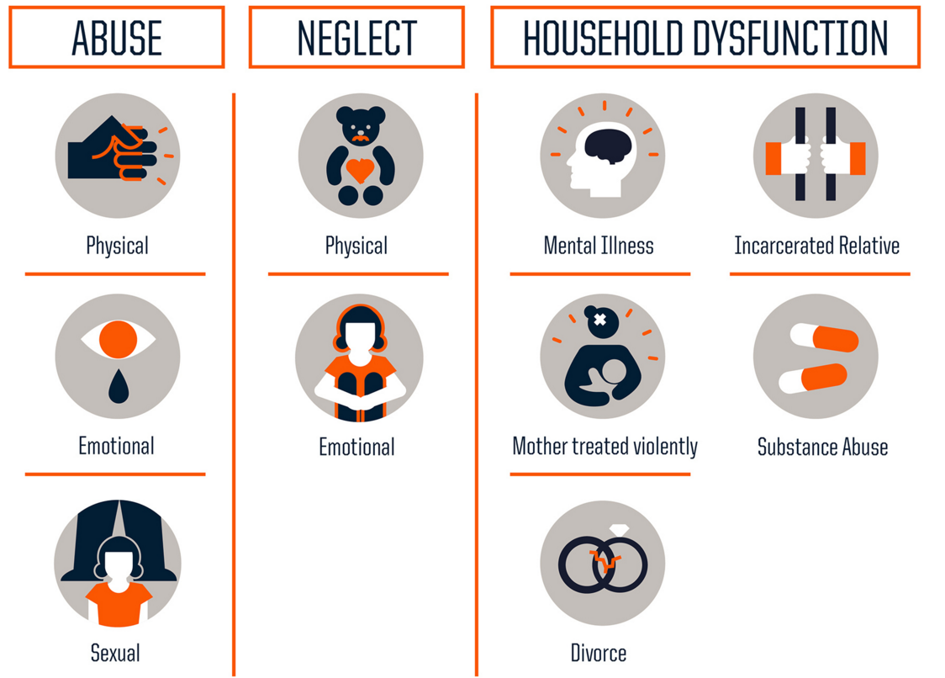
ACE’S
WWW.CDC.GOV

Slide 12
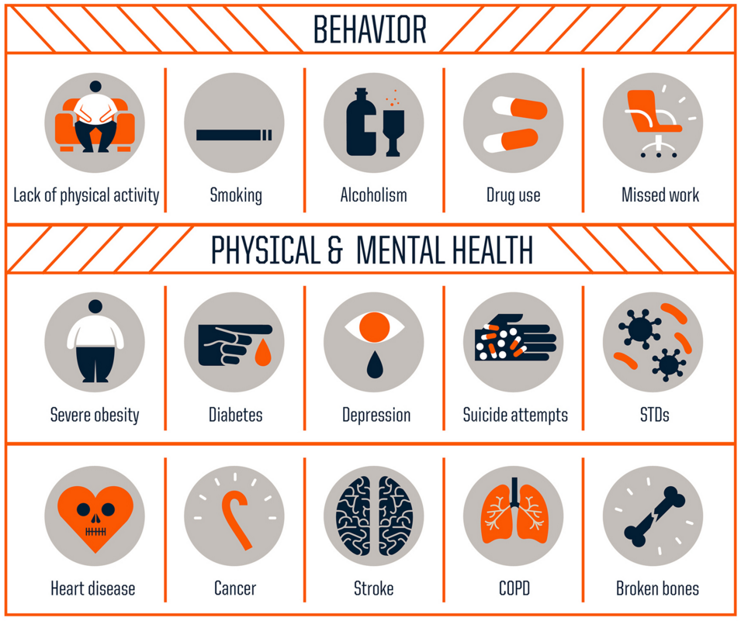

Slide 13
Brain Development
Brain stem
basic functioning (breathing & heart beat)
Mid brain
survival & response to safety
Limbic
regulates feelings & emotions
Cortex
“executive” functions like reasoning & planning

Slide 14
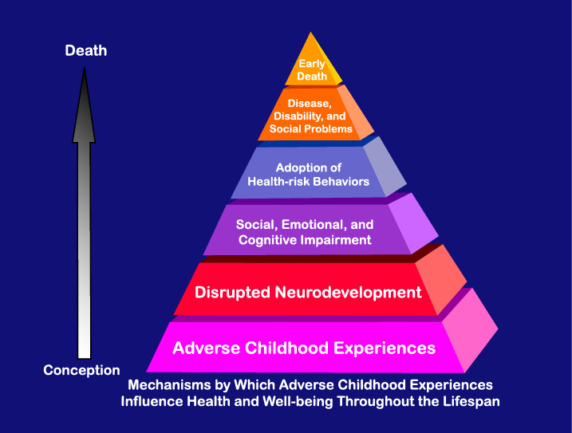
Effects on Social, Emotional and Cognitive Impairment
Causes and individual’s alarm system to no longer function as it should.
Create emotional and physical responses to stress.
Results in emotional numbing and psychological avoidance
Diminishes the capacity to trust.

Slide 15
When we try to teach children to think before they act, we are asking them to use one part of their brain to help them access and control what another part of the brain wants to do out of instinct.

Slide 16
Effect
The effect of trauma on an individual can be conceptualized as a normal response
to an abnormal experience.

Slide 17
Trauma in Children
48% of children have experienced at least one of ten types of adverse experience
Children with histories of traumatic experiences are 2 times as likely to have chronic health conditions
Children with traumatic experiences are 2½ times more likely to have repeated a grade in school
Exposure to violence in the first years of childhood deprives children of as much as 10% of their potential IQ

Slide 18
What is a Trauma-Informed Approach?
Framework for:
Understanding
Recognizing
Responding
to the effects of all types of trauma
Emphasizes Safety
Physical
Psychological
Emotional
for all people, and helps survivors rebuild a sense of control and empowerment
http://www.traumainformedcareproject.org/

Slide 19
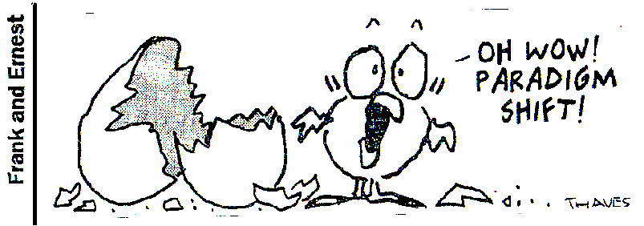
Becoming “trauma-informed”
Instead of……
“What’s wrong with you?”
how about……
“What happened to you?”

Slide 20
Shift in Thinking
All behavior has meaning
Symptoms are ADAPTATIONS or SURVIVAL SKILLS
We build on success not deficits
Prevention is far more impactful
Notes:
.

Slide 21
Creating a Trauma-Informed Program
Recognize behavior
Causes
Skills that increase/decrease
Environment
Culture
Distress Tolerance Skills

Slide 22
“Behavior” is not bad
Behavior is action that can be observed and measured
…seen…heard…counted…
MALADAPTIVE
ADAPTIVE
Positive
Adapt/adjust to circumstances
Negative
Used to handle anxiety in a non-productive manner

Slide 23
Causes of behavior
Physiological
Environmental
Intrapersonal
Trauma

Slide 24
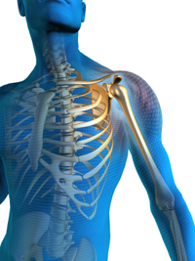
Causes of Behavior
Physiological
Pain
Hunger
Thirst
Discomfort
Mental Health
Allergic reactions
Autism
Medical needs
Fatigue
Nausea

Slide 25
Causes of Behavior
Environmental
Noise
Temperature
Lights
Crowding
Space limitations

Slide 26
Causes of Behavior
Inter/Intra-personal
Personality
Emotions
Skill Limitations
Communication Challenges

Slide 27
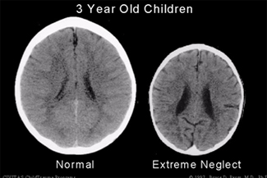
Causes of Behavior
Trauma

Slide 28
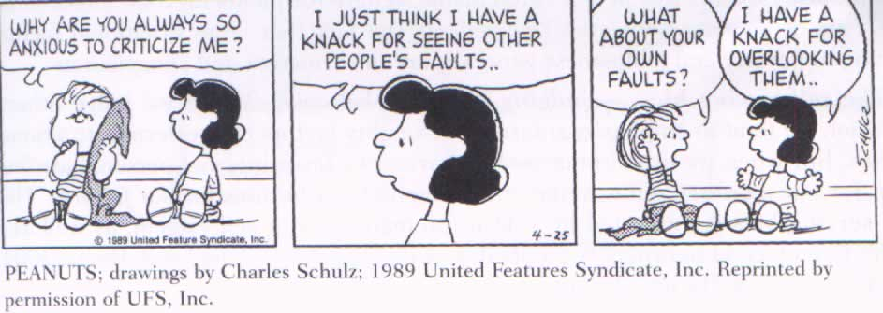
Fundamental Attribution Error
Assuming someone behaves the way they do because it’s “just who they are” rather than thinking of alternative reasons.

Slide 29
Things that INCREASE in a crisis
Fear
Anger
Frustration
Energy
Anxiety
Heart rate
Blood Pressure
Sweating

Slide 30
Things that DECREASE in a crisis
Concentration
Reasoning
Attention Span
Coping skills
Problem Solving
Communication
Listening
Comprehension

Slide 31
Remember…..
When we try to teach children to think before they act, we are asking them to use one part of their brain to help them access and control what another part of the brain wants to do out of instinct.

Slide 32
Five Fundamental Must Haves

Slide 33
See their world
Don’t make judgements
4 Elements of Empathy
Understand feelings
Communicate understanding

Slide 34
How to Use Your Environment
reduce
adjust
accommodate
regulate
change
organize

Slide 35
Culture
Prevention
Help someone have a good day
Intervention
Help someone through a bad day

Slide 36
Spotlight
Floodlight
Solutions
Success is decided by having a good day
Relationships & opportunities
Problems Consequences
Elimination of behaviors

Slide 37
Distress Tolerance Skills

Slide 38
Coping Skills
Meditation
Time
Exercise
Friendship
Hobbies
How to manage emotions (disappointment, mistakes, etc.)
You must sign out by typing your name in the chat box in order to receive credit for attending.

Slide 39
Find More
https://mha.ohio.gov
MHA
Learn and Find Help
Treatment Services
Ohio's Trauma-competent Care Initiative
Resources
TCC Resource Library
https://mha.ohio.gov/get-help/treatment-services/ohios-trauma-competent-care-initiative/resources/tcc-resource-library

Slide 40
Thank you!
Amanda Hampton, OCPS
ahampton@co.Madison.oh.us@mcadamhs.org

Slide 41
Register today! CADCA.org/Forum2023
CADCA members save $200

Slide 42
Become a member today!
Access to the CADCA Community, a go-to for members to network, share resources and learn from one another including 9,000+ discussions and 500+ resources.
First access to Legislative Alerts and Updates so you stay in the know with CADCA’s public polidy efforts and time-sensitive legislative issues
Training discount of up to $200 per coalition member to the National Leadership Forum and Mid-Year Training
And much more…
Learn more and join at cadca.org/membership

Slide 43
Stay Connected!
Facebook.com/CADCA
Twitter.com/CADCA
Instagram.com/CADCACoalitions
YouTube.com/CADCAorg
LinkedIn.com/company/CADCA
cadca.org
®

