Slide 1
Text-Delivered Counseling for Adolescent Substance Misuse
December 6th, 2022
Research into Action Webinar Series
cadca.org

Slide 2
Today’s Presenter
Nikola Zaharakis, PhD
Research Assistant Professor
University of Tennessee, Knoxville

Slide 3
Text-delivered counseling for adolescent substance misuse
Nikola Zaharakis, PhD – research assistant professor, university of Tennessee, knoxville

Slide 4
Adolescent substance misuse
Reducing substance use among adolescents → prevent current and future problems
Influenced by demographic, individual, and social factors
Interventions should target malleable risk and protective factors
Two key malleable factors:
1. Adolescent depression and anxiety symptoms
2. Parenting skills
Mobile health interventions
Allow broader reach
Shown success in reducing adolescent alcohol and tobacco use

Slide 5
GOALS
Evaluate text-based intervention for substance use, with a focus on prescription opioid misuse, in partnership with a Federally Qualified Health Center
Feasibility: integration of procedures to screen, evaluate, and recruit eligible participants
Acceptability: participants perceptions of the intervention and its activities
Efficacy: examining the change in risk and protective factors following the intervention
Notes:
Feasibility was tested by the partnerships ability to integrate procedures to screen, evaluate, and recruit eligible participants
Acceptability was assessed through participants perceptions of the intervention and its activities
Efficacy was assessed by looking examining the change in risk and protective factors following the intervention

Slide 6
Methods
69 adolescents, randomly assigned to intervention or waitlist control
52 parents enrolled & assigned to same condition as their teen
Eligibility
Adolescents: aged 13-18, fluent in English, access to a text capable phone, no medical condition preventing participation, patients at the FQHC
Parents and legal guardians were offered the opportunity to participate at the same time
FQHC: Cherokee Health System – serves 71.5k in Knoxville & Eastern TN annually
42% Medicaid, 17% Medicare, 25% self-pay, 16% insurance
Assessments: baseline, 1-, 2-, and 3-months following enrollment

Slide 7
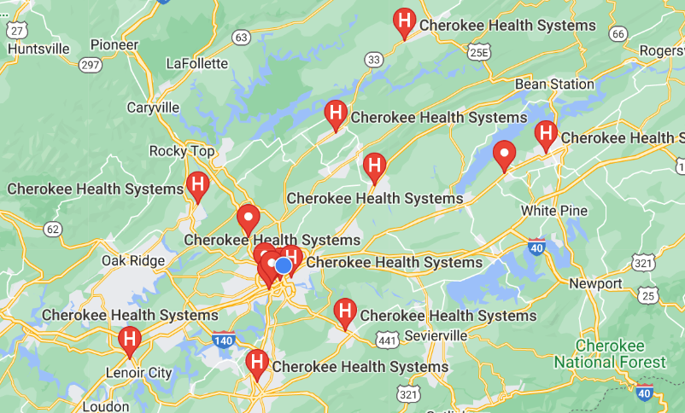
Center for Behavioral Health Research, College of Social Work

Slide 8
Interventions
Adolescent
Parent
Adapted Peer Network Counseling (PNC)
PNC (Mason et al., 2016; 2018a; 2018b)
Motivational Interviewing & Social Cognitive Theory
Close peers prosocial & risky behaviors & places where behavior occur
Evidence for indicated prevention & treatment – reducing tobacco use in teens, cannabis use in YA, increased motivation to change alcohol use in YA
16 days, automated, personalized text conversations
Risk reduction, health promotion – e.g., stress, coping
“Boost” option – extra supportive messages
Created for this study – Parenting Practices
Behavioral-skill developmental framework (Dishion et al 2016; Patterson et al., 1982)
Parenting skills prevent & reduce substance use
Parent-child communication
Parental monitoring
Parent disapproval of substance use
Parental involvement
16 days automated text conversations

Slide 9
sample
69 adolescents, 67% female
M-age = 15.2 years old (SD = 1.4)
52 parents, 90.4% female
23.1% held bachelor’s degree
36.5% had private insurance

Slide 10
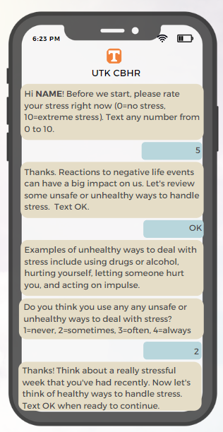
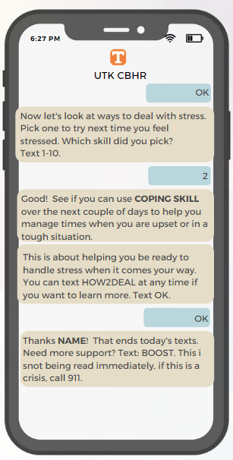
Sample
Adolescent
Text
Conversation
n=34 teens

Slide 11
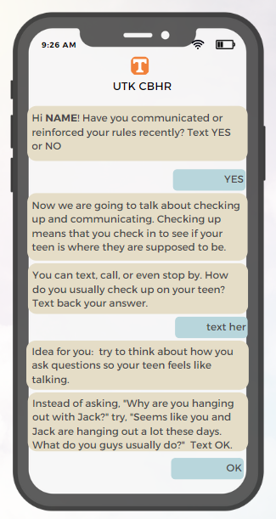
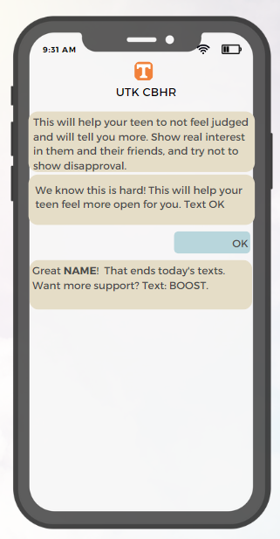
Sample
Parent
Text
Conversation
n=23 parents

Slide 12
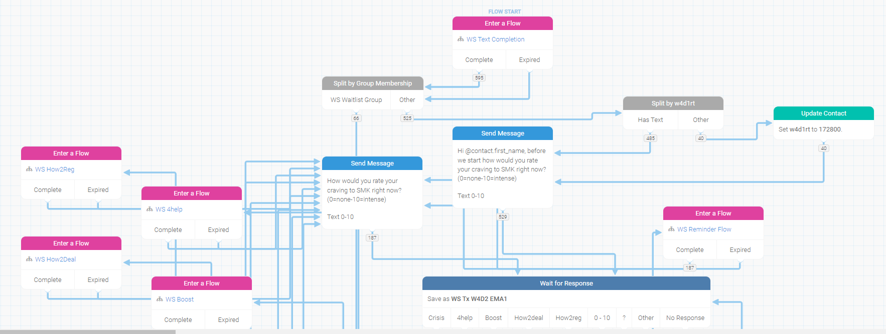
Example of intervention programming

Slide 13
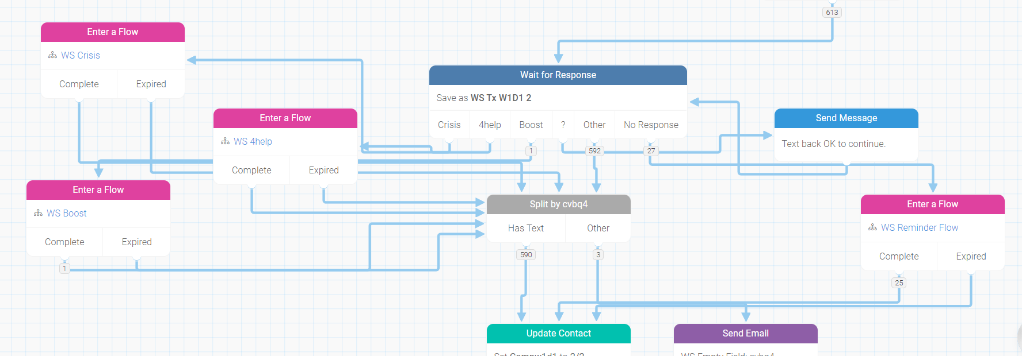
Example of intervention programming

Slide 14
Measures
Age, sex, and race
Frequency and completion of intervention (feasibility)
Program satisfaction (acceptability)
Anxiety and Depression – PHQ-4
Adolescent-Parent Relationship Quality – Parent Relations from BASC
Parenting Skills – Parenting Practices Scale
Saliva drug screen – baseline & 3-month follow-up

Slide 15
Adolescent substance use – sample results
 | Baseline |  | 3 Months
 | Control % | Treatment % | Control % | Treatment %
Any Drug | 11.4 | 20.6 | 5.7 | 5.9
Marijuana | 5.7 | 11.8 | 5.7 | 2.9
Cocaine | 0 | 13.5 | 0 | 0
Opiate | 0 | 2.9 | 0 | 0

Slide 16
Feasibility & acceptability of interventions
 | Adolescent | Parent
Completed text conversations | 94% | 98%
Tried at least 1 text-based counseling recommendation | 100% | 91%
Found the texts helpful | 79% | 78%
Indicated texts felt private | 91% | 61%
Most frequently tried skill | Stress management (exercise, relaxation) | Active listening
79% of teens said they learned new ways to deal with stress
91% of parents reported the texts made them think about their relationship with their teen

Slide 17
Results
Adolescents in the Intervention Group:
Reduced depression and anxiety
Higher quality of parental relationship and parenting skills
Marginally lower odds of positive drug tests
Parents in the Intervention Group:
No significant effects on parent-adolescent relationship or parenting skills
Treatment & control conditions increased, bigger increases for intervention group

Slide 18
takeaways
Text-based counseling may be effective in targeting risk & protective factors for adolescent substance use
Effects were 2-3x size of those from internet-delivered interventions
Text-based counseling is a cost-effective, scalable option to reach larger populations

Slide 19
Our next steps
Conducting interviews with teens, parents, & FQHC staff – improve recruitment, enrollment, engagement with trial & interventions, clinic integration
Translating into Spanish – FQHC serves large immigrant & refugee population
NIDA grant application for larger trial
Examine improvements in anxiety, depression, coping as mechanisms for preventing substance use

Slide 20
Questions from CADCA
What specific aspects of the intervention did you feel were most effective in reducing these risk factors (e.g., anxiety & depression) in adolescents?
A more accessible and wide-reaching form of substance misuse counseling is certainly of great interest to us. Do you foresee any barriers to effective implementation? And if so, how can we navigate these challenges?
In the future, how can community coalition members incorporate text-based counseling into their respective intervention strategies? How can we ensure that these messages and questions are yielding fruitful discussions?
Through your research, have you discovered any resources that you would recommend coalitions to utilize today?

Slide 21
Thank You!
CADCA wishes to thank Dr. Nikola Zaharakis for her timely and insightful presentation.
For help with any evaluation or research related issue, or questions about this webinar, please send an email to evaluation@cadca.org.

