Slide 1
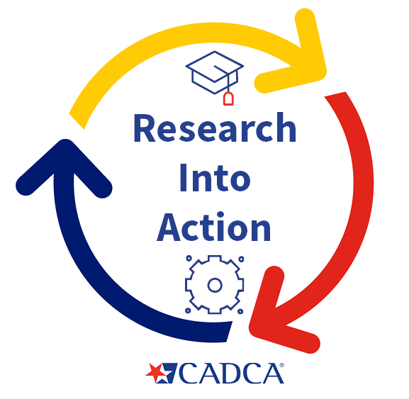

Substance Use Prevention Programming for Youth
January 17th, 2023
Research into Action Webinar Series
cadca.org

Slide 2


Today’s Presenter
Angela Moreland, Ph.D.
Associate Professor
Medical University of South Carolina

Slide 3
Angela Moreland, PhD
National Crime Victims Research and Treatment Center
Medical University of South Carolina
Substance Use Prevention Programming
for Adolescents and Young Adults:
Examination of Substance Use Perceptions and
Use of Prevention Services

Slide 4
Overview
Background on adolescent substance use
Overview of prevention programs
Explanation and overview of the study
Take Home Points

Slide 5

Substance Use in Adolescents and Young Adults
Prevelance of Substance Use in Adolescents and Young Adults

Slide 6
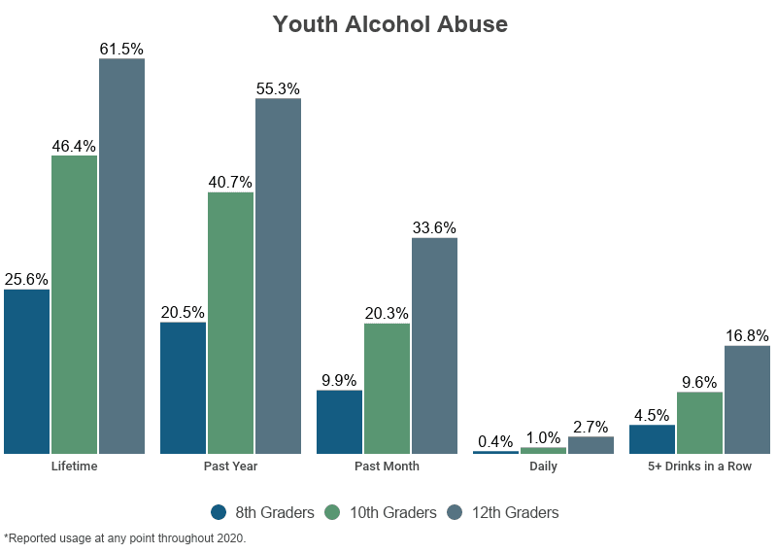

Slide 7
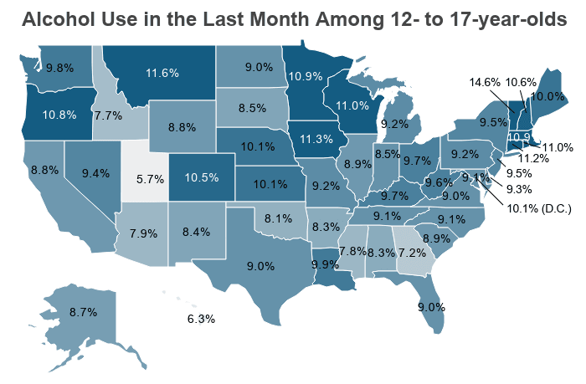
Alcohol Use by State
Notes:
https://www.cdc.gov/nchs/products/databriefs/db294.htm

Slide 8
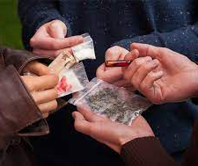
Drug use by Adolescents and Young Adults
12.78% of all 12- to 17-year-olds report using marijuana in the last year.
0.42% of all 12- to 17-year-olds report using cocaine in the last year.
0.17% report using methamphetamines.
0.02% used heroin.
2.52% report misusing pain relievers.
788,000 teenagers aged 12- to 17-years-old met the criteria for Illicit Drug Use Disorder (IDUD).

Slide 9

Why is adolescent substance use so problematic?
Early initiation linked with subsequent of substance use disorders into adulthood
Half of lifetime cases of SUD begin prior to age 14; 75% by age 25
Linked to other negative outcomes
  Education and employment failure
  Unintended parenthood’
  Criminal justice system involvement
  Mental and physical health problems

Slide 10
Substance use prevention and education
Only 71.6% have participated in a prevention group
Prevention programming does not extend beyond age 17
Early substance use prevention programming addresses individual, family, and community-level risk factors
Research had not examined opinions and engagement of substance use prevention programs from an adolescent and emerging youth perspective

Slide 11

Perceived risk of substance use
Risk perceptions are linked to actual behavior → Higher risk perception linked to decreased substance use
Important to focus on myths, norms, support, and coping in education for adolescents
Access and availability of education programs to teach perceived risk are limited

Slide 12
Current Study
Mixed methods approach to examine perceived risk of substance use compared to substance use prevalence in community outreach project with educational programs
Study Aims:
Provide accurate and descriptive statistics on substance use and perceived risk among adolescents
Determine whether perceived risk predicted substance use for adolescents and young adults
Analyze qualitative data on education programs offered in the community to help identify strengths and gaps in preventative resources

Slide 13
Method
Qualitative and quantitative data collected from adolescents (age 13-18) and young adults (age 19-25) living in the Southeast
Recruited from local schools and community events to participate in a preventive intervention
Self-report questionnaires (145 participants) were completed prior to engagement in intervention
Assessed substance use, perceived risk, and engagement in substance use education classes
Focus groups (27 participants) conducted with adolescents from local high school and young adults from local colleges to obtain information on education programs

Slide 14
Demographics of Survey Data
Living arrangements
Sexual orientation

Slide 15
Measures
Substance Use
Number of days in the past month they (1) drank at least one alcoholic drink; (2) drank at least five alcoholic drinks; and (3) used cannabis.
Age of first alcohol and cannabis use
Risk Perceptions
How much do people risk harming themselves when they (1) have 5 or more drinks of alcohol once or twice a week and (2) smoke marijuana once or twice per week.
Prevention education
In the past month, do you recall hearing, reading, or watching an advertisement about prevention of substance use?
In the past 30 days, have you been in any classes or programs where they talked about prevention of drug or alcohol use?

Slide 16
Quantitative Results: Substance Use
8% of adolescents drank at least one alcoholic drink in the last 30 days
4% of adolescents drank 5 or more alcoholic drinks in day in the last month
16% of adolescents used cannabis in the last 30 days
11% of adolescents reported weekly cannabis use

Slide 17
Quantitative Results: Perceived Risk
72% of adolescents reported moderate to great risk in having one or more drinks once or twice a week
43% of adolescents reported moderate to great risk in smoking cannabis once or twice a week

Slide 18
Quantitative Results: Perceived Risk
72% of adolescents reported moderate to great risk in having one or more drinks once or twice a week
43% of adolescents reported moderate to great risk in smoking cannabis once or twice a week

Slide 19
Quantitative Results: Education
44% of adolescents had talked to one of their parents about the dangers of tobacco, alcohol, or drug use
18% of adolescents had been to a class or program on prevention of drug and alcohol abuse
51% had heard, read, or watched an advertisement about prevention of substance use

Slide 20
Quantitative Findings
Adolescents who had been to classes or programs that talked about prevention were less likely to report
  Cannabis use in the past 30 days
  Combined alcohol and cannabis use in the past 30 days
Education was not related to alcohol use in the past 30 days or age of first alcohol or cannabis use

Slide 21
Qualitative Findings: 8 overarching themes
Methods of education delivery
Prevention methods that work
Prevention methods that do not work
Where SU knowledge was received
Prevention information that has been received
Barriers to engagement in SU prevention programs
Engagement techniques
Where would you go to receive SU information

Slide 22
Prevention methods that work and/or suggestions for programs
Education about substance abuse consequences
Visuals (videos, pictures, driving simulator)
Education about safety such as driving or walking alone
Education about biological impact
Programs that incorporated sexual assault prevention
Recognizing when someone has abused substances
Needs to personable or relatable

Slide 23
Prevention methods that do not work
Scare tactics
Abstinence-only programs
Unhelpful information (redundancy, too many videos, too long
Incorporate shame or guilt

Slide 24
Prevention methods that do not work
Scare tactics
“With the scare tactics, I feel like the scenarios they give you are so extreme sometimes that kids feel like that’s not going to happen to you”

Slide 25
Prevention methods that do not work
“I think they come sometimes with guilt…if you do these things you’re a bad person. It’s very black and white in that way. It creates shame and guilt and alienates friendships in a lot of ways”
Incorporate shame or guilt

Slide 26
Where substance use knowledge was received
Health class offered in middle or high school
Program offered in middle or high school
Course offered in college
32%
37%
32%

Slide 27
Prevention information that has been received
Receiving information on drinking and driving
Descriptions of different substances
Education about the biological impact of substance use
Abstinence only education
Personal experience or watching other use substances

Slide 28
Prevention information that has been received
“My mom and dad were crackheads, so yeah, I’m not doing no type of drug”
Personal experience or watching other use substances

Slide 29
Barriers to engagement in substance use prevention programs
Job responsibilities
Time constraints or not seeing the program as a priority
Need to babysit younger siblings
School-related responsibilities after school (homework or evening classes)
Stigma or unsupportive environment

Slide 30
Barriers to engagement in substance use prevention programs
“I think people are afraid of being judged, like, if they had a class on it, they would be afraid that people would think that they were the one doing the drugs”
Stigma or unsupportive environment

Slide 31
Engagement techniques
Give food or vouchers
Incorporate social aspects

Slide 32
Where would you go to receive substance use information
School counseling center
Private organization or program

Slide 33
Where would you go to receive substance use information
School counseling center
“I’d probably go to the counseling center because they have lots of pamphlets and they have a lot of people there that can help with situations like that”

Slide 34
Where would you go to receive substance use information
Private organization or program
“I would say Google”

Slide 35
Discussion
Youth who used alcohol or a combination of alcohol and cannabis infrequent users were more likely to have received prevention and education programs than those who use more often
Prevention programs could either be effective at reducing use or could be only engaging youth who have a low substance use risk level
Several gaps exist in resources needed to adequately address substance use

Slide 36
Discussion
Programming was only received in school settings
Barriers include stigma, time constraints, and unwillingness to prioritize other school, job, or family demands
More effort should be made to extend programming in school settings, community organizations, and pediatric settings

Slide 37
Limitations
Study conducted as a community needs assessment, so measures were brief and single items
Cross-sectional
Substance use data is self-report

Slide 38
Conclusions
First study to examine associations between substance use and likelihood of receiving substance use prevention or education programs
More applied clinical research is needed to develop and evaluate innovative strategies to engage at-risk youth in prevention programming

Slide 39

QUESTIONS?
Angela Moreland, PhD
moreland@musc.edu

Slide 40
Questions from CADCA
Given the reported efficacy of personalized and relatable education, how can community leaders create impactful and wide-reaching content?
“Scare tactics” still exist in today’s prevention advertising, and some proponents argue that they can start conversations on substance misuse. Do you think there is a place for fear appeal in prevention programming, or do you believe we should rethink this approach?
Do you have any resources you would like to recommend to our coalition members?

Slide 41
Thank You!
CADCA wishes to thank Dr. Angela Moreland for her timely and insightful presentation.
For help with any evaluation or research related issue, or questions about this webinar, please send an email to jhong@cadca.org.

