Slide 1


Step by Step
“Online Registration” Instructions
National Leadership Forum
GLOBAL | COLLABORATIVE | INNOVATIVE | PASSIONATE | LEADER

Slide 2
Table of Contents
If you have been to a CADCA Training Event…
Slide 3
If you have NOT been to a CADCA Training Event…
Slide 4
Registration Process…
Slide 5-12
Youth Registration & Special Note…
Slide 11
Payment/Shopping Cart…
Slide 13-17
Confirmation…
Slide 18
Help/Contact Us…
Slide 19

Slide 3
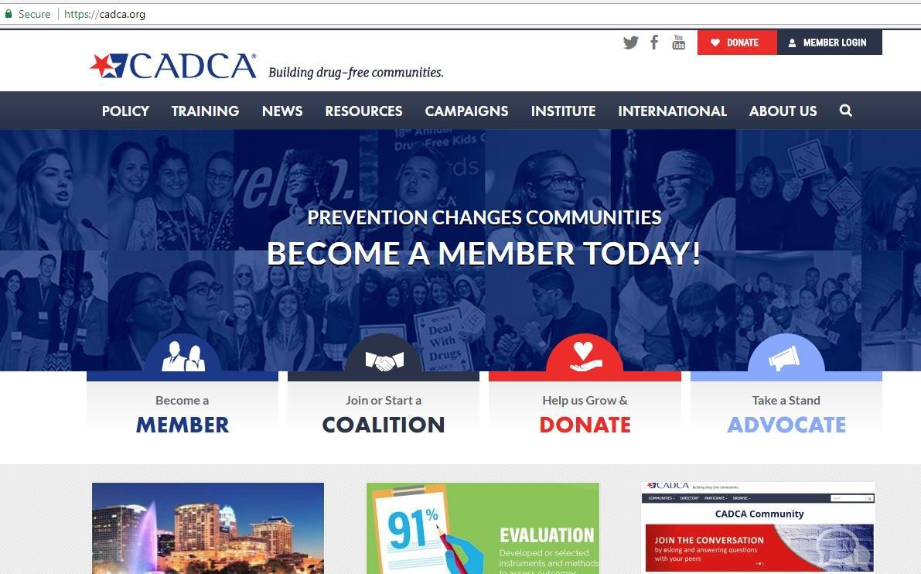
Go to cadca.org
Select [Member Login]

Slide 4
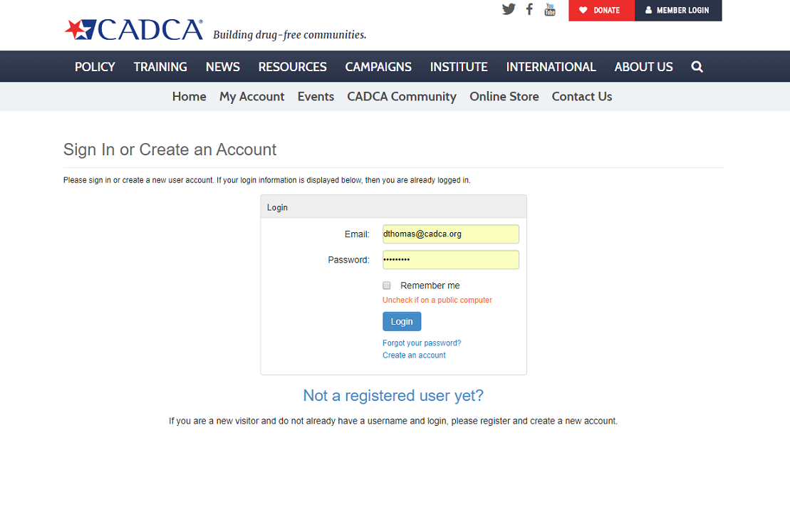
Login with your credentials (email and password)
You can login whether you are a CADCA member or non-member
If you have NEVER been to a CADCA event, select [Create an Account]

Slide 5
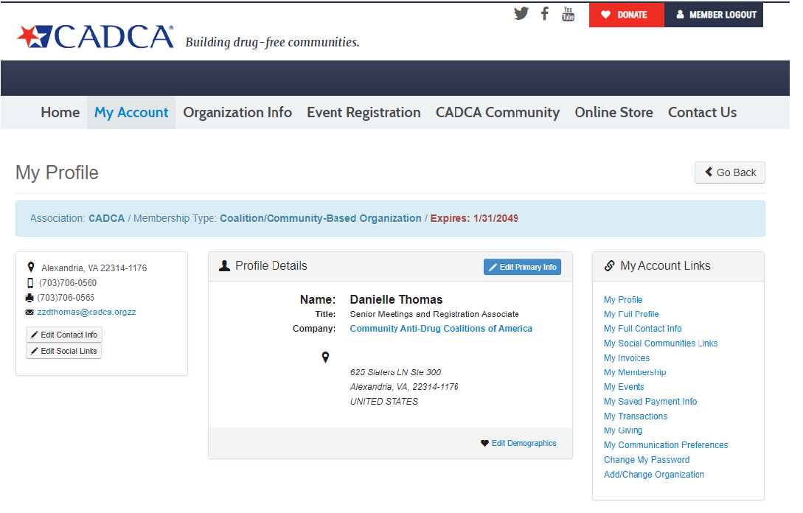
Select [Event Registration]

Slide 6
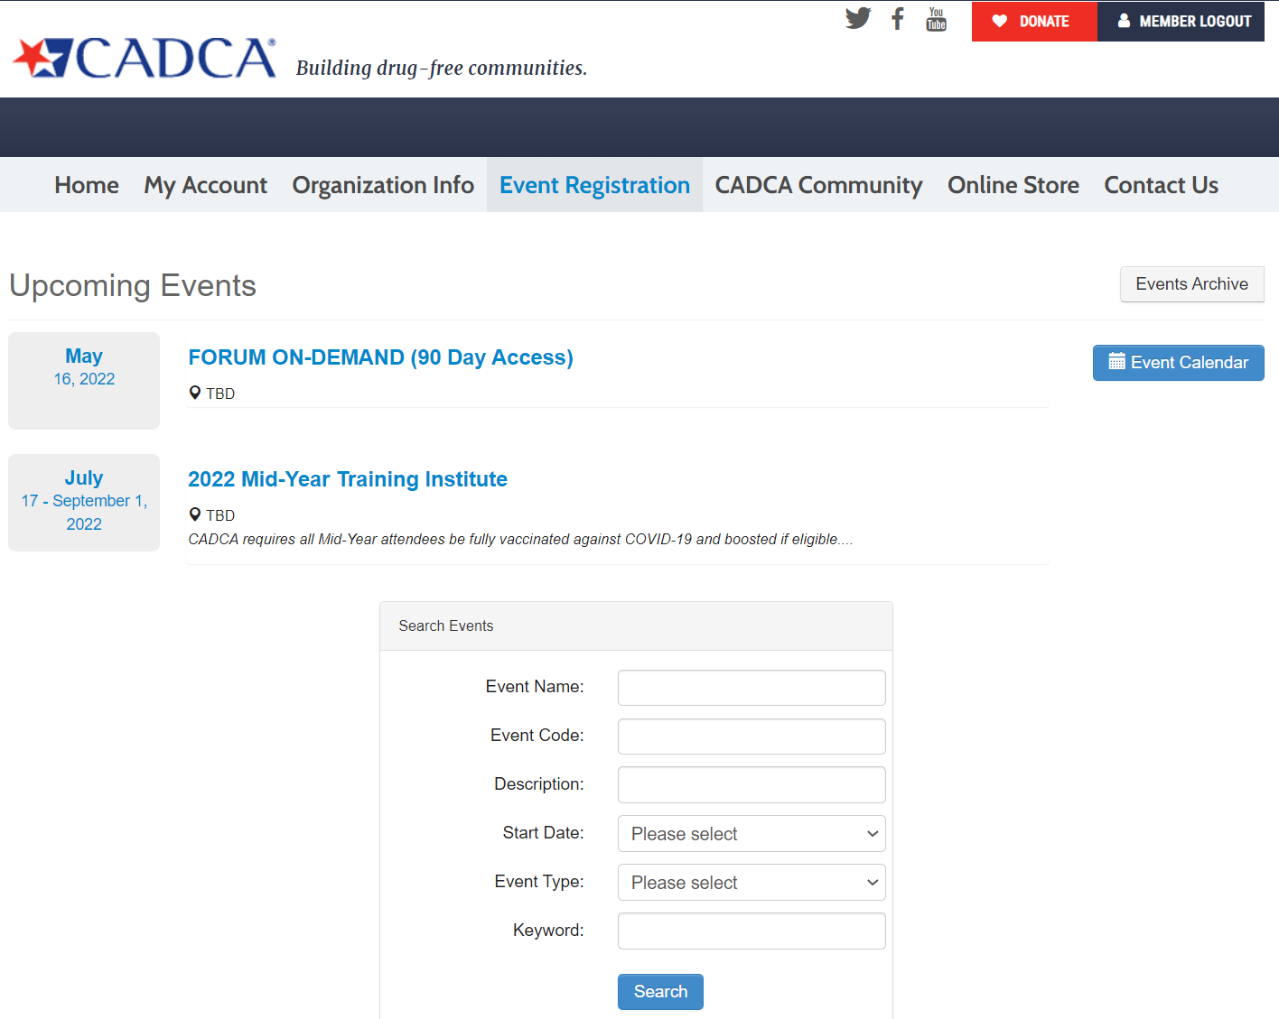
Select [2022 Mid-Year Training Institute]

Slide 7
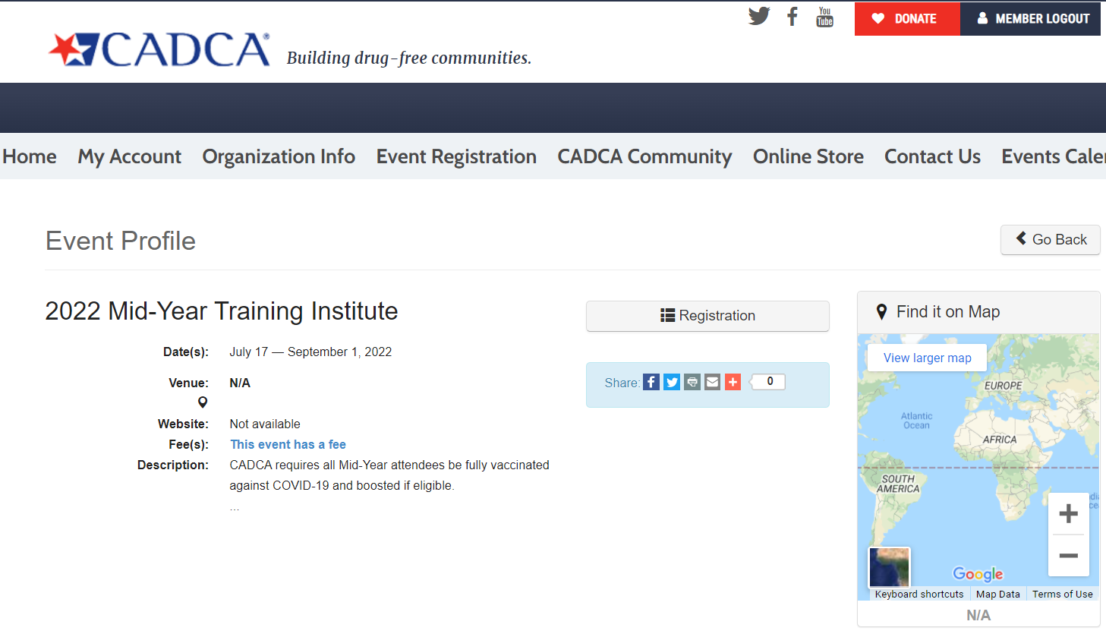
Select [Registration]
If you are a CADCA Member and/or have an Organization Profile, you will automatically continue to the Event Registration page
*ERROR MESSAGE NOTE*: you must contact CADCA at events@cadca.org
If you DO NOT have an Organization Profile, you will NOT SEE THIS PAGE and will get an error message!

Slide 8
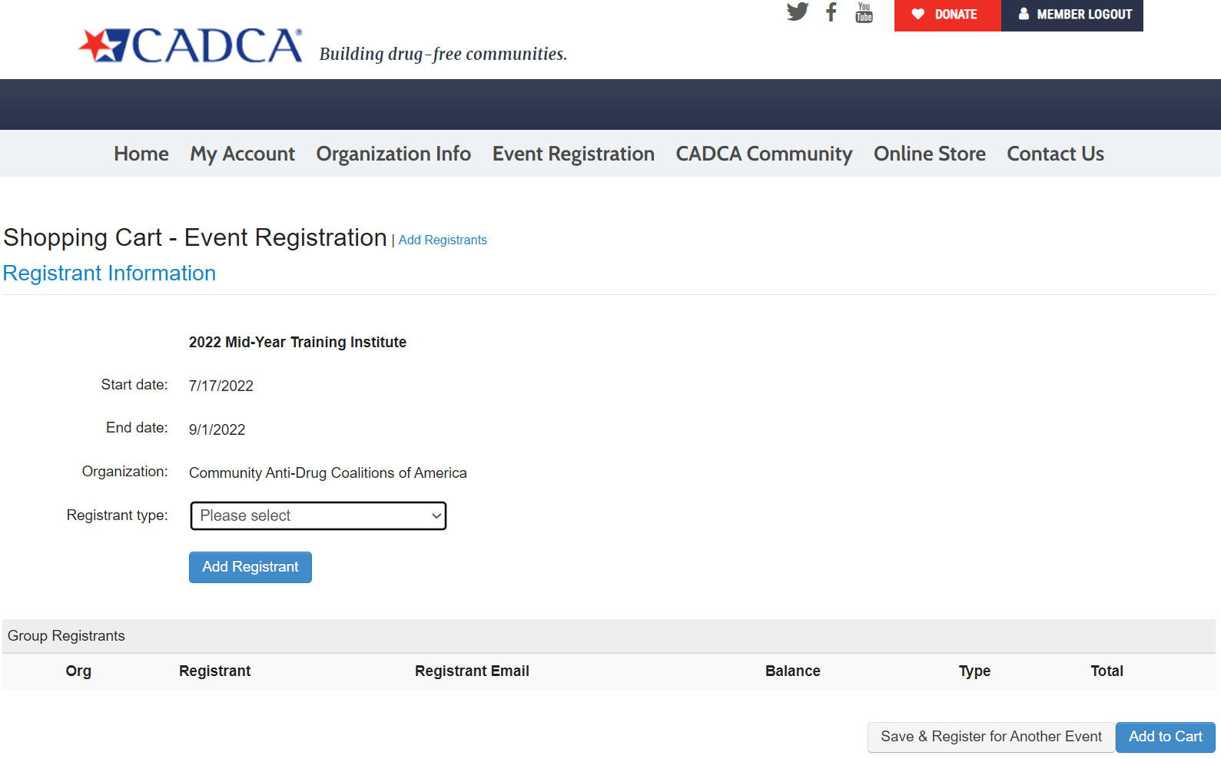
Select the [Add Registrant]

Slide 9
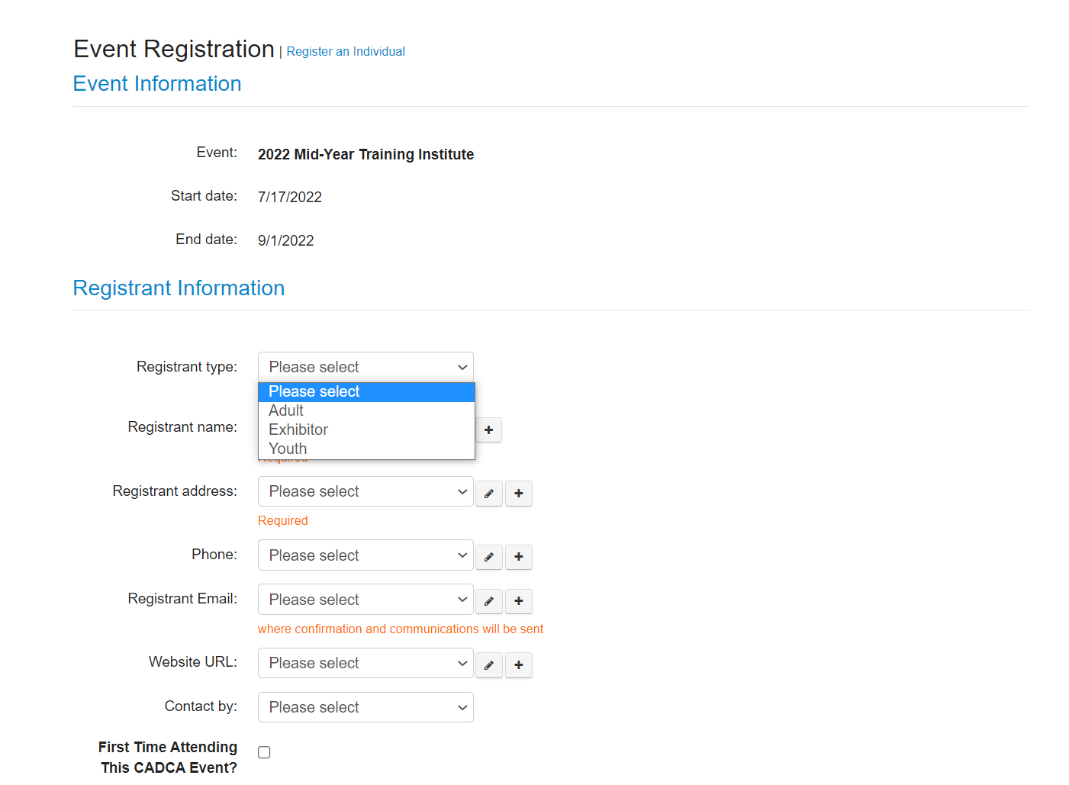
A pop-up window will appear and you will see the following screen:
Select the [Registrant Type]

Slide 10
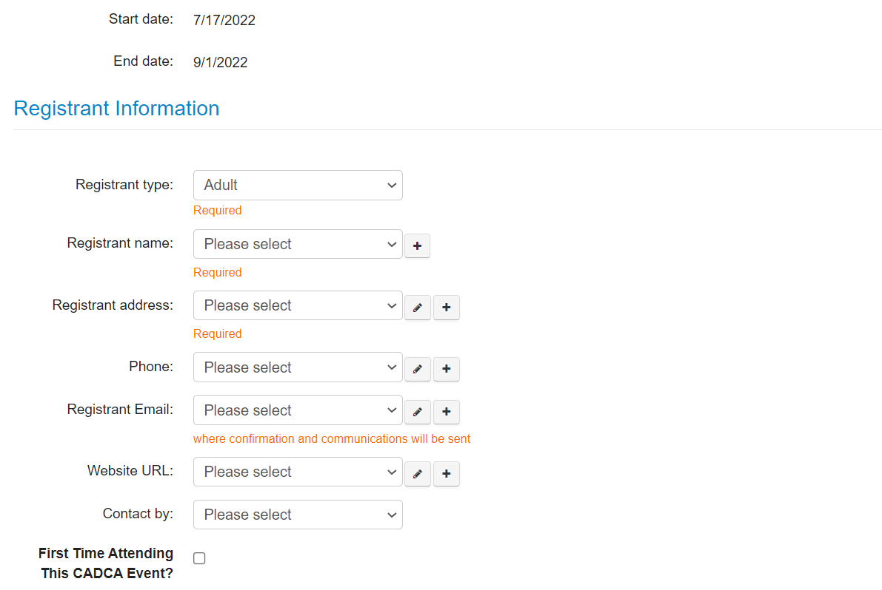
A pop-up window will appear and you will see the following screen:
Select the [Registrant Name] (actual attendee) from the drop-down organization/coalition roster
Whether you are registering an individual or a group, each person will be selected from the list shown
If you need to add an individual (that is not already in the system), click the [+]
If the email is already in the system, means there’s a profile, you will get an error message!
ALL REGISTRATIONS: Check the box if this is the Registrants First Time attending a CADCA Forum

Slide 11
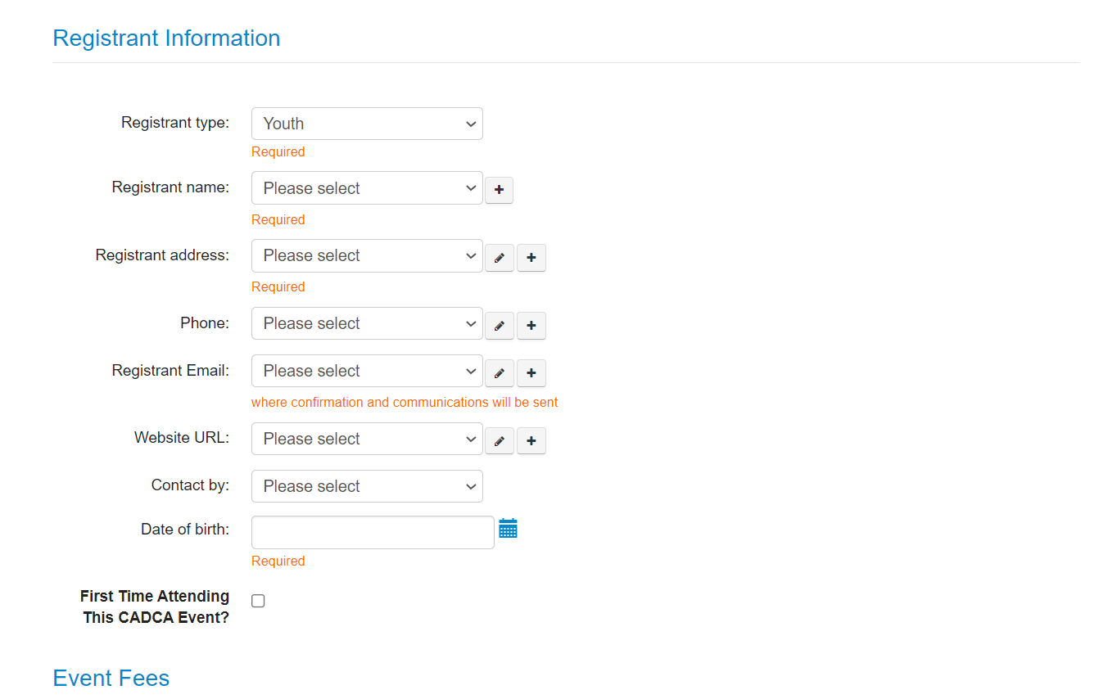
YOUTH REGISTRATION: Once you select the Registrant Type[Youth], you will be required to input the Youth’s [Date of Birth]
ALL REGISTRATIONS: Check the box if this is the Registrants First Time attending a CADCA Forum

Slide 12
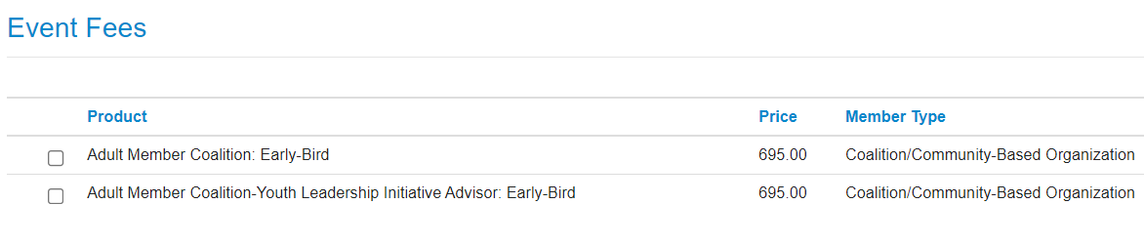
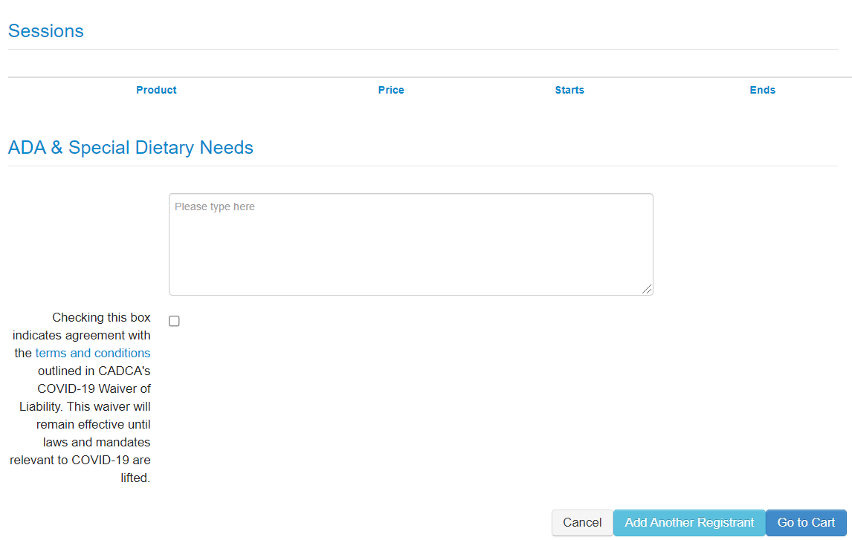
Select the correct [Event Fee] (based upon registration date and CADCA membership status)
[Adult Member-Youth Leadership Initiative Advisor] = Adult registrants attending w/ Youth
ALL REGISTRATIONS: Must review the waiver and check the box to register for CADCA’s Forum
If you are only registering yourself or just 1 individual, select [Go to Cart]
If you are registering more than 1 individual, select [Add Another Registrant] and repeat steps above

Slide 13
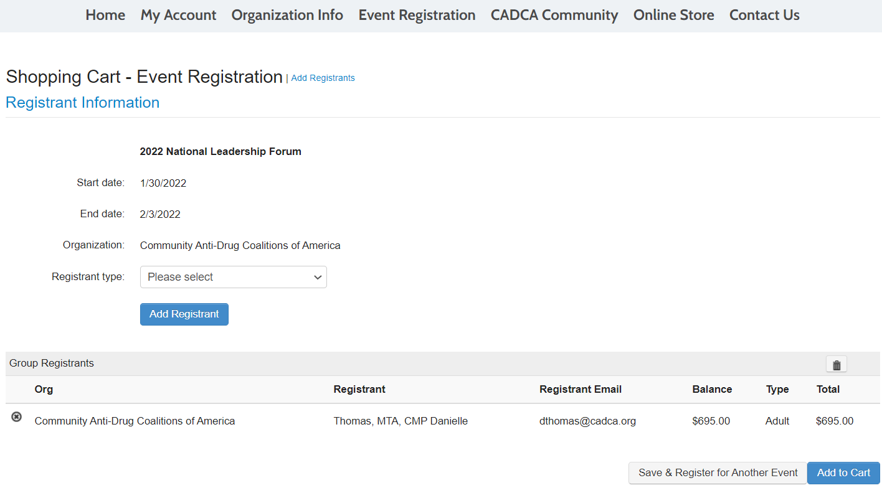
Confirm that all the information is CORRECT before clicking [Add to Cart]
This step is more important when registering 2 or more individuals, making sure everyone gets added to the Cart

Slide 14
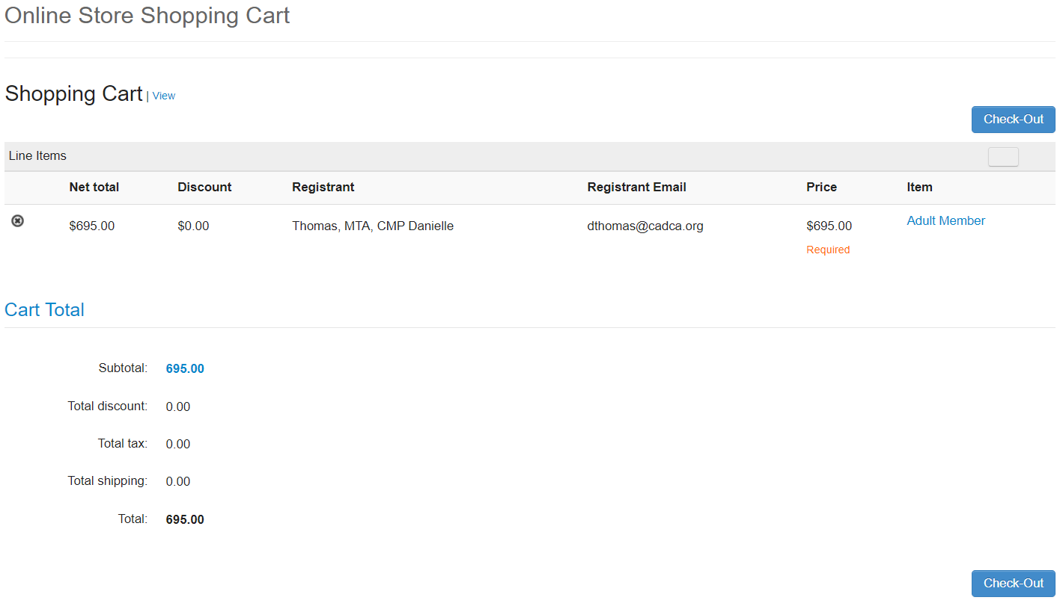
Confirm again that all the information is CORRECT before clicking [Check Out]
If you need to delete a registrant, you can select the “X” for individual deletion or the “box” to remove all.

Slide 15
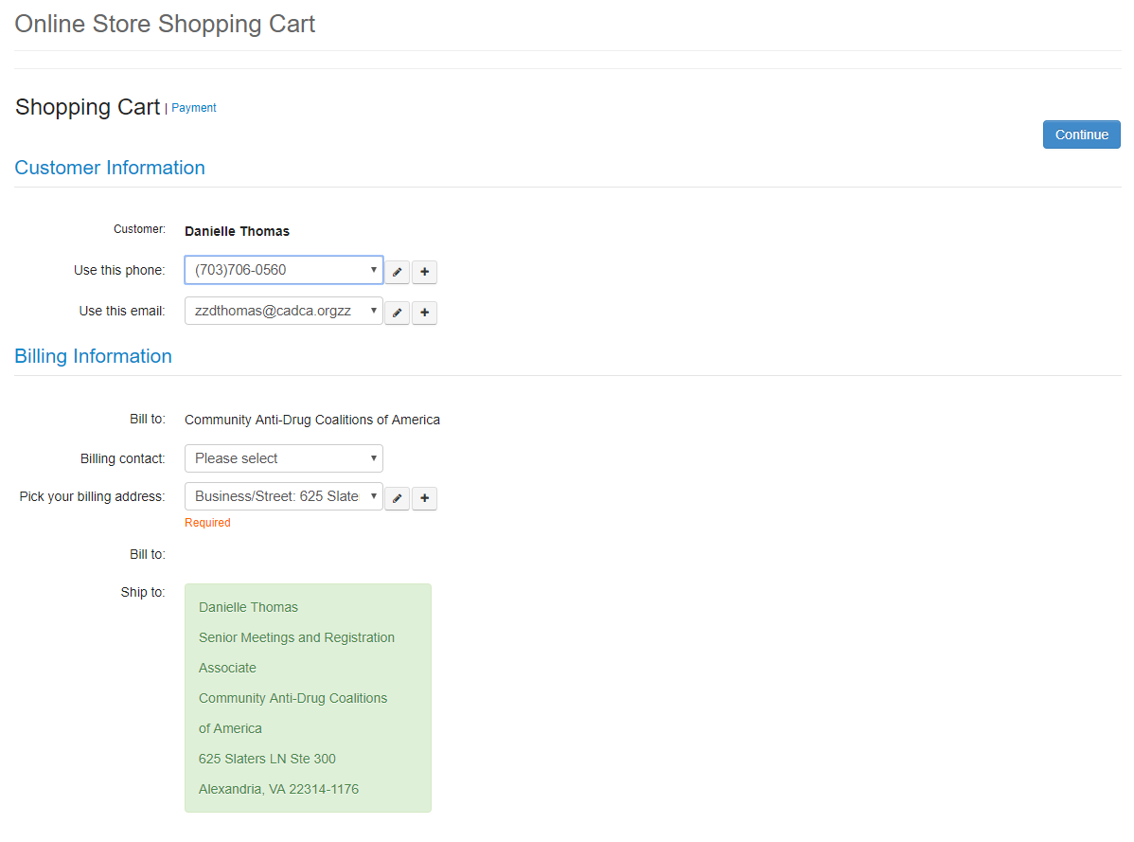
Shopping Cart payment screen:
All information is auto populated from the profile account of the event registrant
The system only allows you to change the [Bill To] address only
To do so, click the [+]

Slide 16
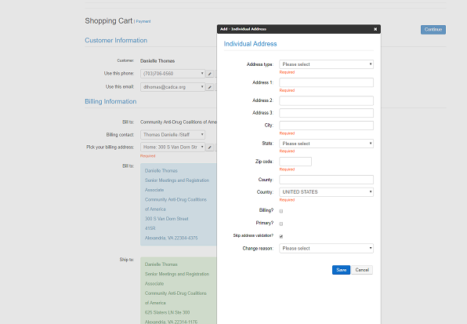
A pop-up window will appear and you will see the following screen:
Complete the information and click [Save]
Don’t select [primary] option

Slide 17
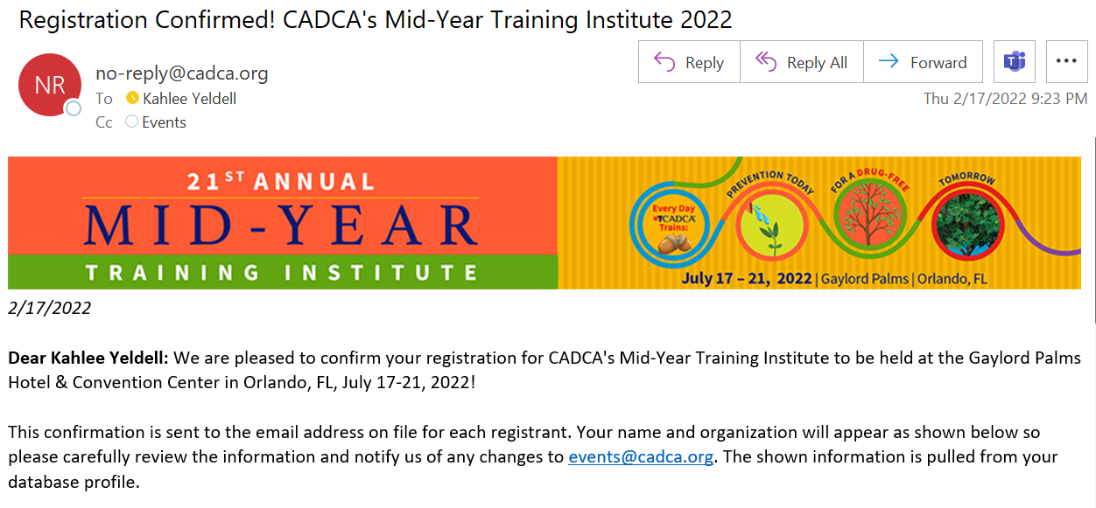
You are NOT registered until you get…
[Registration Confirmed! CADCA’s Mid-Year Training Institute 2022]

Slide 18


Specific Forum Questions
Visit cadca.org/forum2022for all updates
Issues with Membership/Your Account/Login
Contact CADCA Membership Team at membership@cadca.org or call 703-706-0560 x261
Registration Questions
Contact CADCA Meetings Team at events@cadca.org or call 703-706-0560 x253

Slide 19
Stay Connected!
Facebook.com/CADCA
Twitter.com/CADCA
Instagram.com/CADCACoalitions
YouTube.com/CADCAorg
LinkedIn.com/company/CADCA
cadca.org
®

