Slide 1
ABCs of Effective Advocacy
Sue Thau, Public Policy Consultant

Slide 2
FRAME
F = Facts
R = Reduce to 1 page
A = Anecdotes/stories
M = Map out strategy
E = Evaluate Results

Slide 3
Advocacy in Action: The Power Analysis

Slide 4
M
ap Out Strategy

Slide 5
What Do You Want To Change? What Do You Want to Stop from Changing?
Law
Regulation
Policy
Funding

Slide 6
ACTS: The Data
F

Slide 7
Gather Data and Analysis to Make Your Case

Slide 8
Why Is The Change Needed? Why Would a Change be Detrimental?
Document:
Extent of Problem
Facts
Figures
Anecdotes

Slide 9
Age of Initiation is Key: Substance Use Disorders are Pediatric-Onset Diseases
9 out of 10 adults (90%) with substance use disorders initiated their use before age 18
The earlier and heavier the use, the more likely a person will develop later problems
Of youth who began drinking before age 15, 40% were classified as dependent later in life.
Children who first smoke marijuana under the age of 14 are more than five times as likely to have a substance use disorder as an adult.
National Center on Addiction and Substance Abuse at Columbia University. (2011). Adolescent Substance Use: America’s #1 Public Health Problem. New York, NY: Author.
Substance Abuse and Mental Health Services Administration. Results from the 2012 National Survey on Drug Use and Health: Summary of National Findings. NSDUH Series H-46, HHS Publication No. (SMA) 13-4795. Rockville, MD: Substance Abuse and Mental Health Services Administration, 2013.
McCabe, S.E.; West, B.T.; Morales, M.; Cranford, J.A.; and Boyd, C.J. Does early onset of non-medical use of prescription drugs predict subsequent prescription drug abuse and dependence? Results from a national study. Addiction 102(12):1920–1930, 2007.
National Institute on Alcohol Abuse and Alcoholism. (2006). Underage Drinking A Growing Healthcare Concern. Available: http://pubs.niaaa.nih.gov/publications/PSA/underagepg2.htm.
Grant, B.F., and Dawson, D.A. Age at onset of alcohol use and its association with DSM-IV alcohol abuse and dependence: Results from the National Longitudinal Alcohol Epidemiologic Survey. J Sub Abuse 9:103-110, 1997.
The National Household Survey on Drug Abuse (NHSDA) report. August 23, 2002. Available: http://oas.samhsa.gov/2k2/MJ&dependence/MJdependence.htm

Slide 10
Prevention Is Cost Effective
Every dollar invested in prevention saves communities between $2 and $20.
Investments in prevention programs would save states and local governments $1.3 billion, including $1.05 billion in educational costs within 2 years.
Greater investment in prevention programs would reduce costs related to substance use by $33.5 billion and would preserve quality of life over a lifetime valued at $65 billion.
Swisher, J.D., Scherer, J.M. Yin, R.K. (2004 October). Cost-benefit estimates in prevention research. The Journal of Primary Prevention, Vol. 25(2). pp. 137-148.
Miller, T. and Hendrie, D. (2008). Substance abuse prevention dollars and cents: A cost-benefit analysis, DHHS Pub. No. (SMA) 07-4298. Rockville, MD: Center for Substance Abuse Prevention, Substance Abuse and Mental Health Services Administration. Available: http://store.samhsa.gov/shin/content/SMA07-4298/SMA07-4298.pdf
Butterfoss, F.D. (2007). Coalitions and partnerships for community health. San Francisco, CA: Jossey-Bass.

Slide 11
Unique Vulnerability of the Developing Brain
Rapid Brain Development Until
~ Age 25
Gogtay, et al. (2014). Dynamic mapping of human cortical development during childhood through early adulthood. PNAS, 101(21), 8174-8179. https://www.pnas.org/content/101/21/8174.full

Slide 13
R
educe to One Page

Slide 14
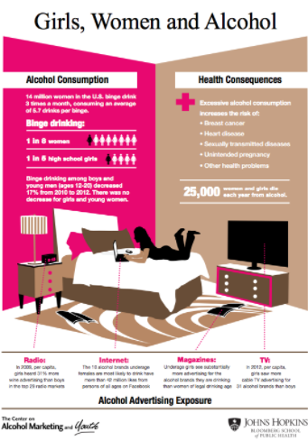

Slide 16
Example from CA: North Coastal Prevention Coalition

Slide 18
3 Questions to Consider for Your One-Pagers
Is the data accurate?
Is the data accessible and understandable?
Is the data actionable?

Slide 19
A
necdotes

Slide 20
Anecdotes
Always put a face on the data through stories that make it relevant and relatable

Slide 21
Anecdotes Matter
They make data resonate
They make data human
They make people “get it”
But…they are necessary not sufficient!

Slide 22
Identify and Engage Allies

Slide 23
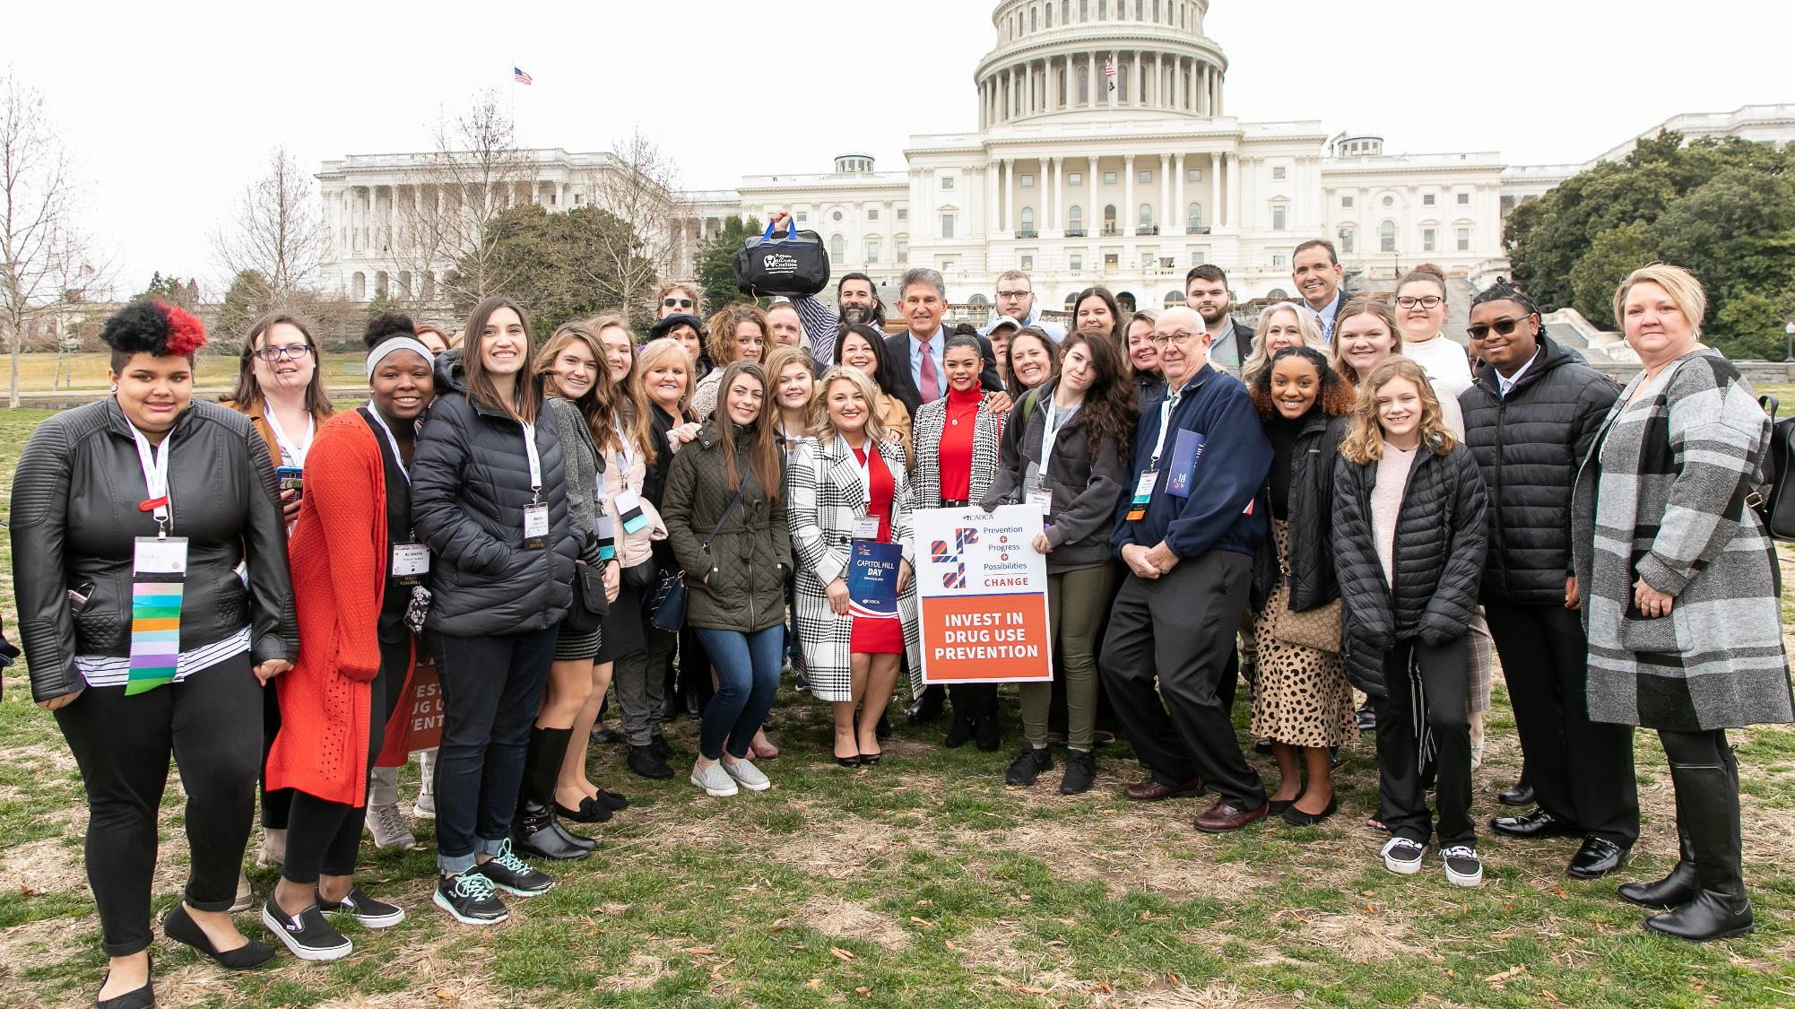
Who Will You Recruit To Be In Your Advocacy Coalition?

Slide 24
Who Are Your Potential Allies?

Slide 25
Parents
Parent groups
Faith community
Public health groups
Prevention and treatment groups
Law enforcement
Education groups
Pediatricians
Consumer safety groups
Youth serving organizations
Coaches
Researchers

Slide 26
What Is Their Shared Interest In This?
How Will You Convince Them To Join?

Slide 27
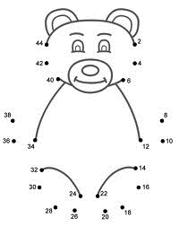
Connect the dots for them to understand your issue

Slide 28
Do You Have Important Champions in the System Needed To:
Make The Change?
Stop the Change?
Mitigate the Impacts of the Change Once Its Passed?

Slide 29
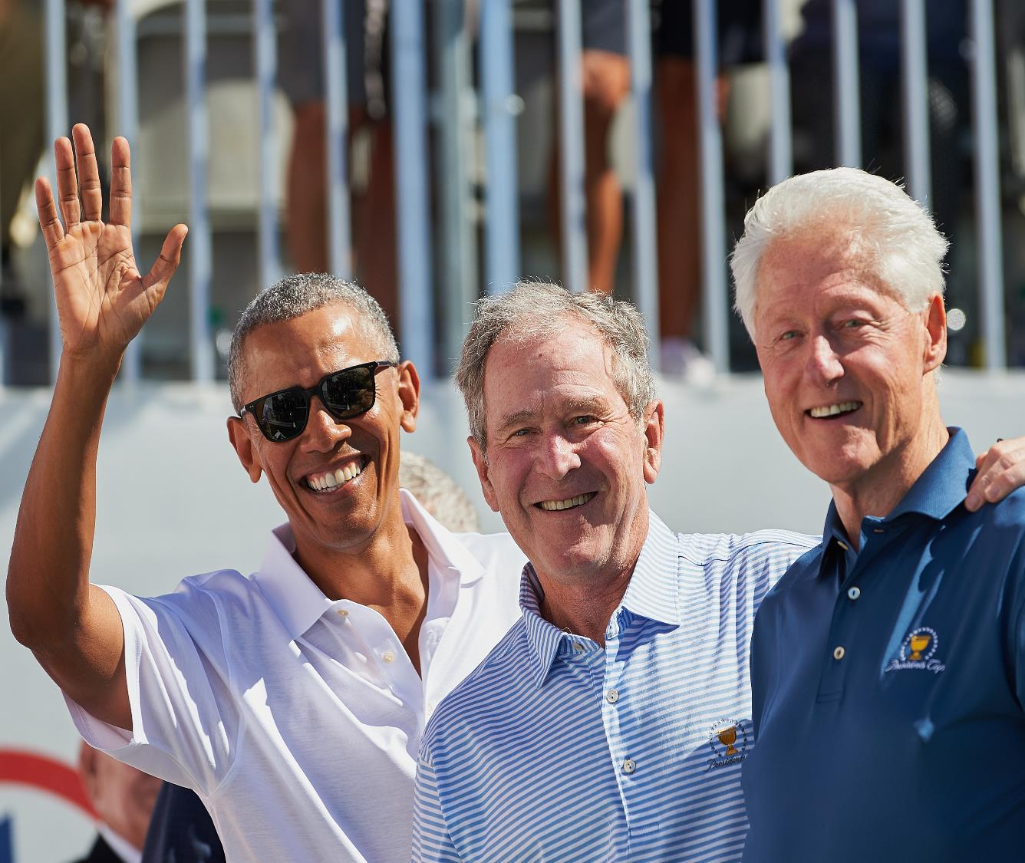
Who Will You Ask To Help You In Recruiting Your Champions?
Photo Credit: NPR

Slide 30
ENGAGE CHAMPIONS
Notes:
I’m not sure I get this graphic, and I worry about the “chief” depiction.

Slide 31
Set up meetings with your potential legislative champions to brief them on the general issue

Slide 32
Know And Fully Understand the Process

Slide 33
Who Has The Power To Make The Change? Stop the Change? Mitigate the Impacts of a Change?

Slide 34
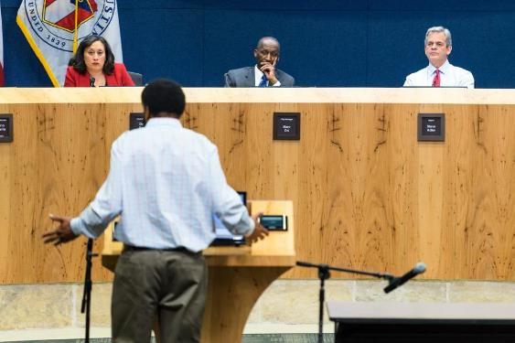
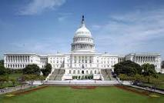
In What System?

Slide 35
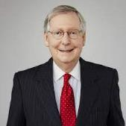
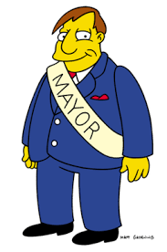
What People In The System?

Slide 36
Build Relationships with Legislators and Their Staffs
Identify the relationships you have and ones you need.
Research who your legislators are – understand their priorities and positions they have taken on issues related to our field.
Learn which members sit on Committees that have jurisdiction over your issue.
See if anyone in your coalition has a preexisting relationship with a legislator.

Slide 37
Develop Relationships with Legislative Staff
Staff can serve as gatekeepers for legislators.
They will often know much more about your issue that the legislator will – and they will brief their bosses after you meet with them.
Exchange contact information.
Invite them to events.
Meet with them when they travel back to your state/district.
Be a resource – reach out when you have new data (and not just when you need something).

Slide 38
DETERMINE THEIR TOP PRIORITIES
Education
Public Safety
Health
Economy

Slide 39
Find out what major issues the decision makers you want to influence care about

Slide 40
Specifically tailor data and messages to their priorities

Slide 41
Ask Yourself:
What would it take to make them care?
What would it take to make them ACT on caring?

Slide 42
Fact:
Underage drinking cost the United States $24.3 billion in 2010.
Sacks JJ, Gonzales KR, Bouchery EE, Tomedi LE, Brewer RD. 2010 National and State Costs of Excessive Alcohol Consumption. Am J Prev Med2015; 49(5):e73–e79.

Slide 43
Fact:
Excessive drinking is responsible for more than 4,300 deaths among underage youth each year.
Centers for Disease Control and Prevention (CDC). Alcohol-Related Disease Impact (ARDI). Atlanta, GA: CDC.

Slide 44
Fact:
Underage drinking cost the United States $24.3 billion in 2010.
Sacks JJ, Gonzales KR, Bouchery EE, Tomedi LE, Brewer RD. 2010 National and State Costs of Excessive Alcohol Consumption. Am J Prev Med2015; 49(5):e73–e79.

Slide 45
Facts:
Youth who use alcohol may remember 10% less of what they have learned than those who don’t drink.³
According to recent research, 16%-18% of teen drinkers have missed school or work because of alcohol use.⁴
³Brown, S.A., Tapert, S.F., Granholm, E., et al. (2000). Neurocognitive functioning of adolescents: Effects of protracted alcohol use. Alcoholism: Clinical and experimental research, (24)(2).
⁴Ellisckson, P.L., McGuigan, K.A., Adams, V., Bell, R.M., & Hays, R.D. (1996). Teenagers and alcohol misuse in the United States: By any definition, it’s a big problem. Addiction, (91)(10), 1489-1503

Slide 46
Outcomes from Comprehensive Community-Wide Drug Prevention Program: The Drug-Free Communities Program

Slide 47
“Social math” techniques Example from Alcohol Control
Break down numbers by time
4300 children under 16 start drinking every day
Break down numbers by place
This is the equivalent of 143 classrooms per day of new underage drinkers.
Provide comparisons with familiar things
Alcohol is cheaper than milk or orange juice
Provide ironic comparisons
There are more places to buy alcohol in our community than to buy school supplies.
Personalize the number
The average TV-watching youth saw 366 alcohol ads on TV alone in 2009.

Slide 48
Determine Who You Will Bring With You to Make Your Case and Why?

Slide 49
People to Bring
Data/Issue experts
People with anecdotes who can put a face on the data
Important allies
Constituents
Youth

Slide 50
Know Before You Go: Do Your Homework!
Learn about legislators before you meet with them
Understand:
Their personal history – e.g., a family member with a substance use disorder, membership in civic organizations, similar hobbies, children on same sports team, etc.)
Their electoral history – are they facing an election soon?
Their committee assignments and their leadership assignments – are they chair or ranking member of a committee?
Their relationship and support for (or opposition to) substance use issues.
Their other areas of interest.

Slide 51
The Do’s and Don’ts of Meeting with Legislators

Slide 52
Keep the Following in Mind:
Do the work for them – provide legislators with data, talking points, etc.
Ensure your written output is clear, concise and understandable – legislators will ignore what they cannot understand.

Slide 53
Keep the Following in Mind:
Get good, powerful sponsors and co-sponsors
Being on the right committee is important
Be bipartisan – get both Republicans and Democrats
Get as many co-sponsors as possible
Work with your allies to increase support and gain additional co-sponsors in the legislature.
If you have legislative champions, use them to gain additional support.
Get the bill introduced EARLY in the session – many good bills die because they are introduced to close to the end of the session.

Slide 54
Other Tips and Tricks for Successful Legislative Meetings
Designate one person to be the primary spokesperson
Be brief with introductions
Discuss the accomplishments of your coalition/program
Ask how you can foster a continuing relationship with the legislator and their staff.
Invite youth to participate in the meeting by talking about their experiences.
Ask the legislator and their staff the best way to provide follow up materials to them.

Slide 55
Is Timing a Factor?
Yes - timing is critical!
The earlier you make the case in any process, the better

Slide 56
Most Importantly… HAVE A CLEAR ASK

Slide 57
Who Will Your Opponents Be?

Slide 58
How Will Your Opponents Try To Defeat You?
Lay out the arguments your opponents will use to try to defeat you.
How will you counter each of your opponents arguments against your initiative?

Slide 59
Go after support from those within the system who already agree with you or are undecided FORGET ABOUT meeting with hard opponents in the system

Slide 60
Participating in Advocacy Efforts
Anyone can engage in advocacy, no matter how much experience or time they have!

Slide 61
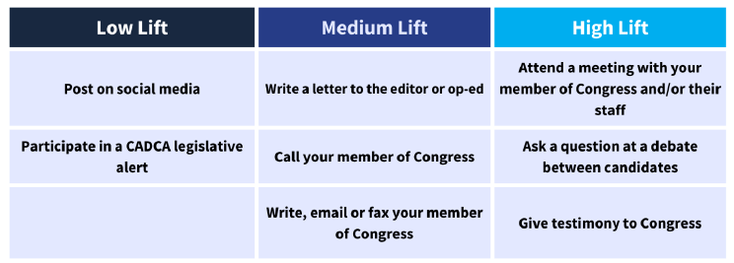
Participating in Advocacy Efforts

Slide 62
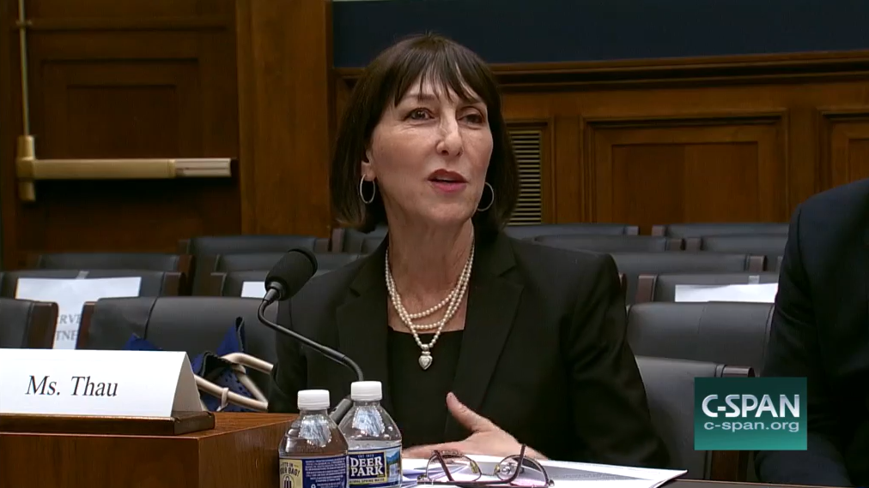
Ensure you testify at any hearings on the issue.

Slide 63
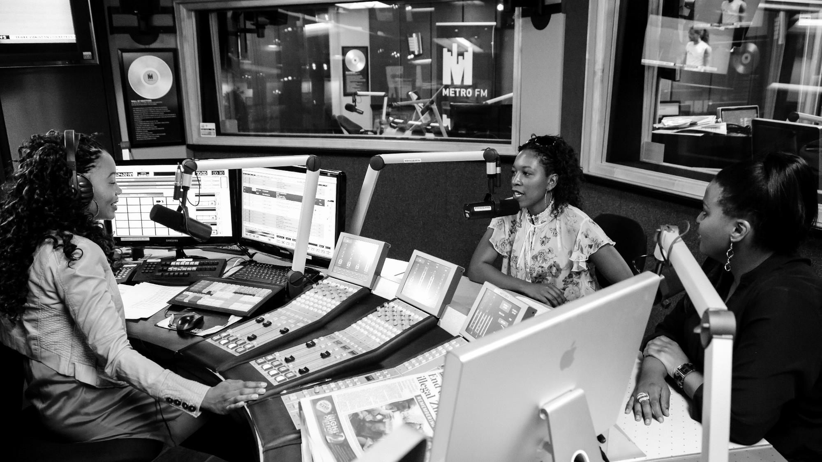
Use The Media and Social Media To Help You Make Your Case

Slide 64
Constituent Letters and Sign-On Letters
Letters are a great way to communicate with your legislators. Keep in mind:
Keep it short.
Refer to a specific issue.
Make a specific ask.
Personalize with your story or local context.
Thank the legislator.

Slide 65
Phone Calls
Phone calls are more difficult to ignore than emails.
You will not speak to the legislator directly. If possible, ask to speak the staffer that handles health or drug issues.
Have talking points that explain why the issue is important to you and make a clear ask.
Take notes and follow up in writing

Slide 66
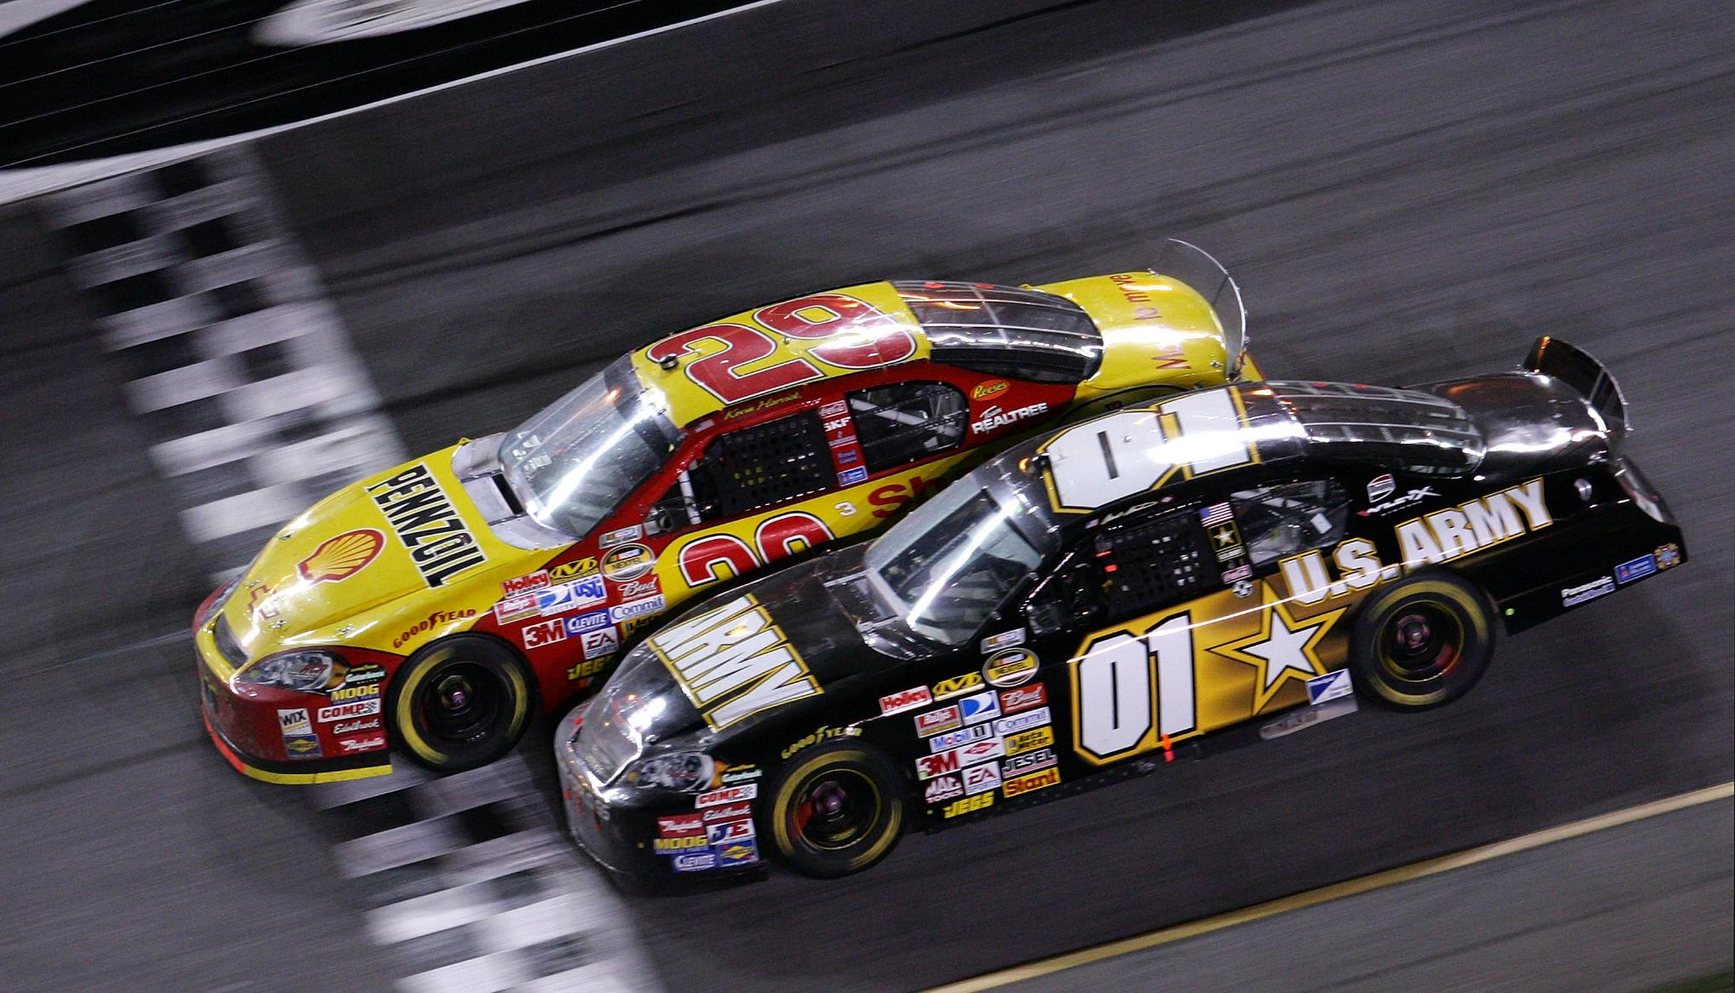
Can You Win?
Can You Win?

Slide 67
Can You Afford To Lose?

Slide 68
Can You Afford Not To Try?

Slide 69
E
valuate Results

Slide 70
Evaluate Results
Did your meetings go well? Why or why not?
Did you get the responses you wanted/needed? Why or why not?
What else do you need to do moving forward?

Slide 71
Evaluate Results
Did you achieve your objectives?
If so, how? Why? What worked?
If not, why not? How close did you come to achieving your goals?
If you did not, should you try again?
If so, when?
What would you do differently?
What else do you need to do moving forward?

Slide 72
Evaluation to protect your wins
Maryland tax increase
3% sales tax added in 2011 – first increase in beer and wine taxes since 1972, in spirits taxes since 1955
Three studies funded, conducted and published:
Effects on STDs
Effects on consumption
Effects on alcohol-impaired driving

Slide 73
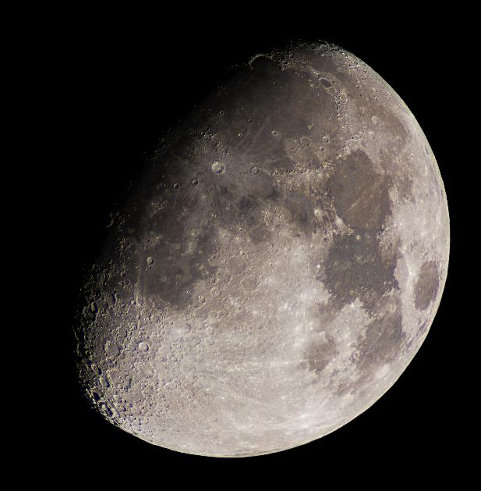
Any Questions? What Keeps You Up At Night?
Notes:
Questions?

Slide 74
Stay Connected!
Sue Thau
Public Policy Consultant
suerthau@gmail.com
publicpolicy@cadca.org
Notes:
That’s for having us today– please feel free to reach out if you have any questions.

Slide 75
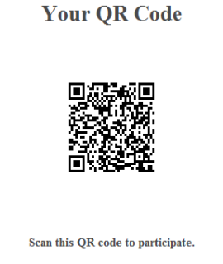
Please Evaluate This Session
https://research.zarca.com/r/9fZS5t

